Slide 1

SCG&E
Arc Flash Event
Gregory S. Leslie, CSP – PP NAM Field Service OHS Director, March 27, 2012

Slide 2
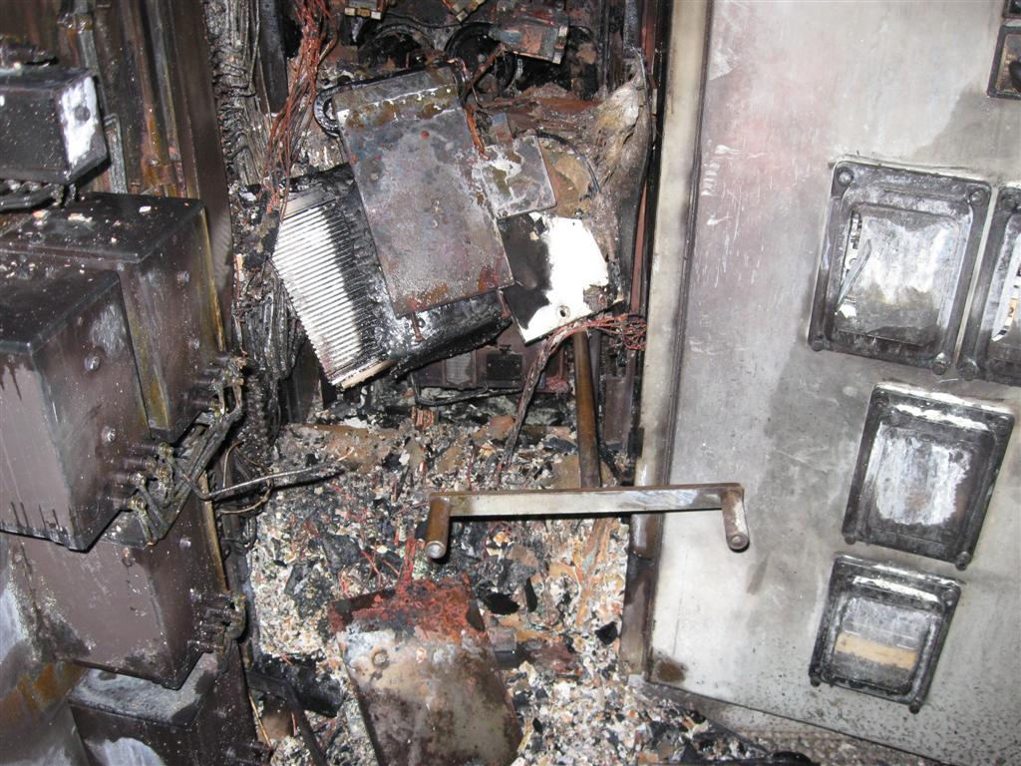
5 KV 1200 Amp Breaker
Racking Handle

Slide 3
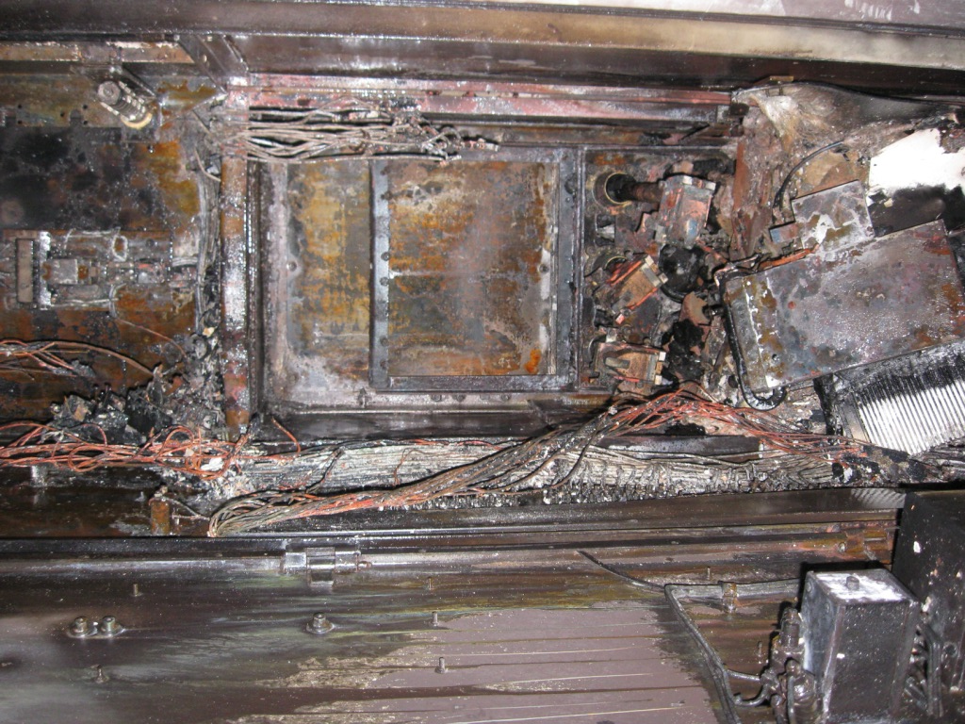
Residual Damage
Behind Where the Person was Standing

Slide 4
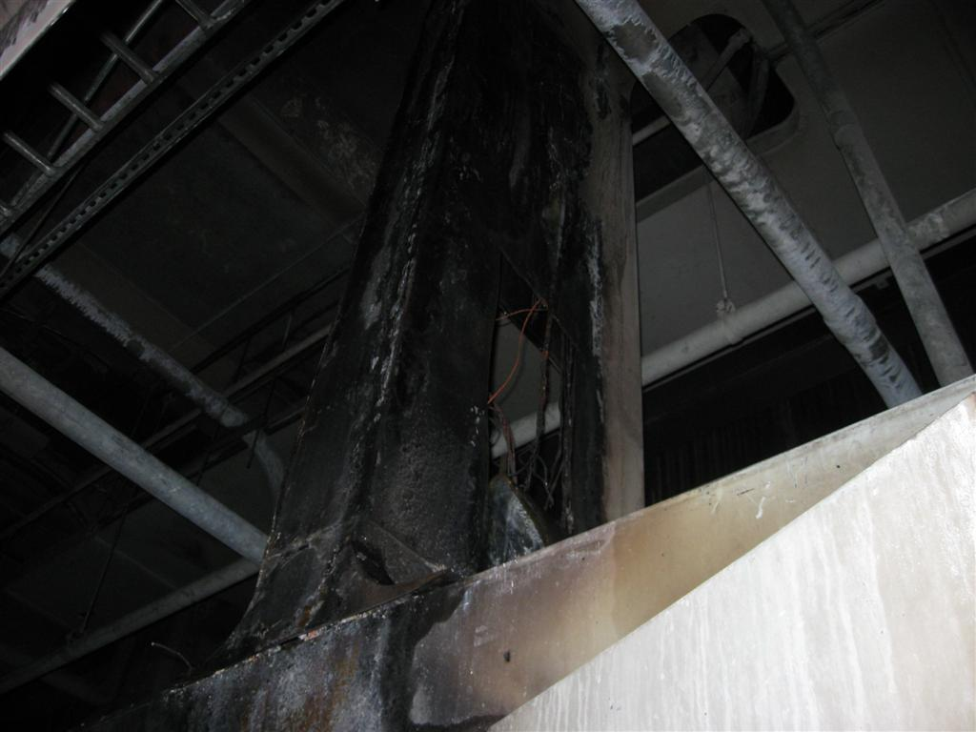
Residual Damage
Above the Gear

Slide 5
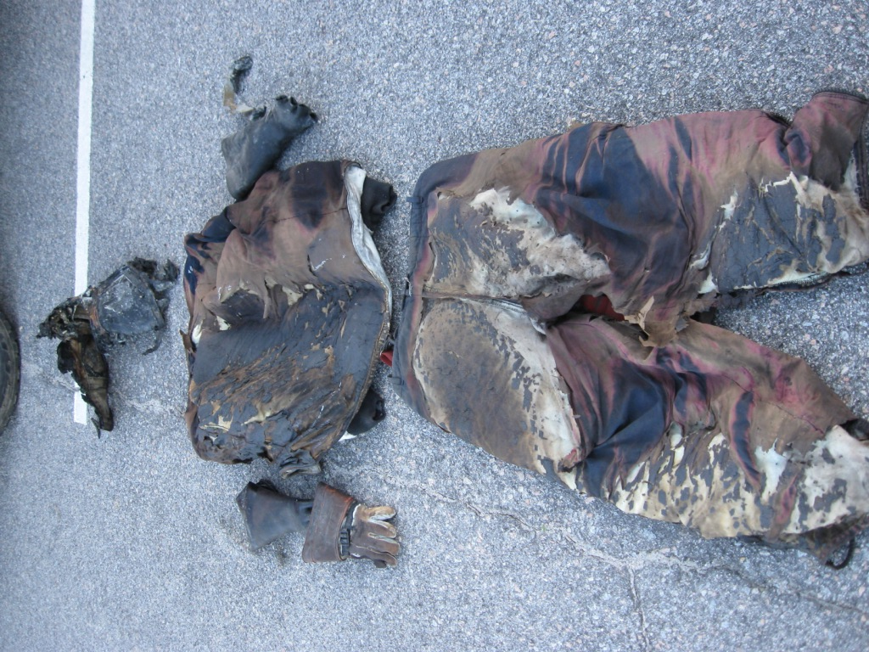
40 Cal/cm² Arc Flash Suit

Slide 6
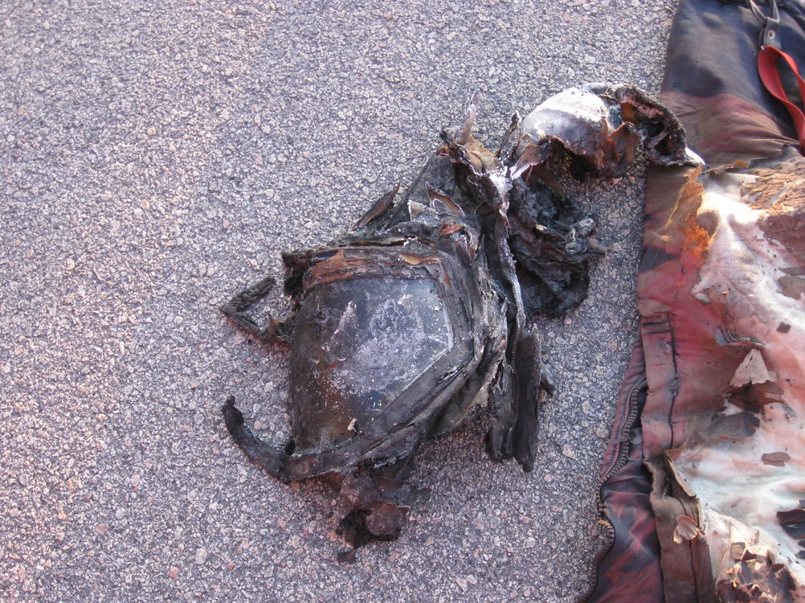
40 Cal/cm² Arc Flash Suit
40 Cal/cm² Flash Hood

Slide 7
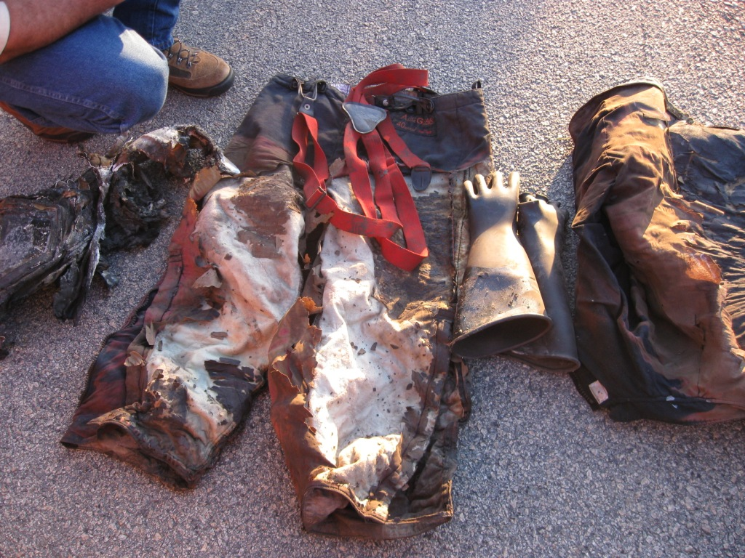
40 Cal/cm² Arc Flash Suit

Slide 8
Investigation On-going
Speculation: Racking breaker in live while the breaker was closed
NO Arc Flash Hazard Analysis
Incident Energy Unknown
SCE&G employee hospitalized for a one week period
Arc Flash PPE saved his life!

Slide 9

© ABB
2/07/2012 | Slide 9
Notes:
The end. Thank you.

