Slide 1

Process Safety
Best Practice
Line Break Program

Slide 2
Recent Incident #1 – Hi Temp Caustic
During "routine maintenance", an operator was cleaning an inline filter connected to pipework below a thickener tank. He opened the drain valve to verify isolation before undoing four bolts to open the inline filter door. On opening the inline filter door, the operator found the screen/filter full of material. As he pulled the screen/filter out of its housing, a blockage upstream of the screen/filter box dislodged. The operator was engulfed in 203°F (95°C) caustic solution, receiving thermal and caustic burns to his body and face.
An emergency responder found the main isolation valve open!

Slide 3
Incident #2 – Anhydrous Ammonia (NH3)
One (1) refrigeration technician died, and one was in a coma for 5 months and had to have a double-lung transplant due to a NH3 leak at a food plant.
USDA inspected the poultry plant and ordered the facility to replace a part in a NH3 heat exchanger, which chills poultry before packaging.
Company decided to use its own employees to install the part.
  Instructions for replacing the inner sleeve included a WARNING that all of the refrigerant – NH3- must be removed first.
The deceased technician oversaw maintaining the heat exchanger and was given the manufacturer’s instructions. He summoned another technician, who was working elsewhere in the plant for help. The deceased refrigeration technician was unscrewing a valve when the other refrigeration technician entered the room.
  "As he saw XXXXXX unscrewing the valve, XXXXXXX - who was aware of the fact that the heat exchanger contained NH3 shouted at XXXXXXX: “Stop, XXXXX, stop”. "However, his warning was too late as the pressure behind the partially opened sleeve forced ammonia out of the exchanger in an explosive manner, which caused the room to be filled with ammonia almost instantaneously."

Slide 4
Incident #3 – Tetrafluoroethylene (TFE)
Four (4) employees were engaged in finding a polymer plug that would occasionally occur due to polymerization in the line.
They had performed a line break and had reassembled the line and then opened a tetrafluoroethylene (TFE) valve at a silica gel tower.
This allowed full pressure on the line.
Due to a poorly connected flange, air had been introduced into the line after reassembly and when the TFE met the air a fire resulted leading to an explosion of the tower.
Two (2) of the four (4) employees were unable to escape the fire, and two (2) others escaped the fire scene.
Only one (1) of the two (2) employees that escaped survived and was hospitalized with burns.
Returning to service AFTER the opening
is CRITICAL!

Slide 5
Incident #4 – Black Liquor
Basic LOTO and Permitting FAILURES!
The PTW system is ONLY as good as WE MAKE IT!
Workers were removing a pump for the black liquor storage tank.
Operators are tasked with valve LOTO in this line for this task.
  LOTO of the main circuit for the pump was done by mechanics #1 and #2
Operator filled out the permit with the intent of coming back in what he thought would be a couple minutes to close the valves for which he was responsible.
  He did not expect that the maintenance workers would start as soon as they had the SWP.
  Operator was responsible for closing the valve on the suction side of the pump, which he did NOT do before issuing the permit!
Mechanics checked the bleed valve for the pump and nothing came out.
  One noticed that the bleed valve was caked with dried weak liquor and attempted boring it with a wire brush and no solvent came out.
Mechanic stated that the valve on the suction side was not seen, when he checked the other valves.
They began removing the bolts from the pump. The last four bolts were loosened, and they began prying the pump away, when the black liquor was released.
Both employees ran out the door to the showers as the release occurred but sustained chemical burns and were hospitalized.

Slide 6
PSM & RMP Requirements
1910.119(f)(4) and §68.69
The employer [owner or operator] shall develop and implement safe work practices to provide for the control of hazards during operations such as lockout/tagout; confined space entry; opening process equipment or piping; and ….
These safe work practices shall apply to employees and contractor employees.
Line Break/Process Opening can be one of the HIGHEST RISK activities within a covered process and yet we have NO standards/codes/RAGAGEPs on this activity

Slide 7
Non-routine Work Authorizations
1910.119 Appendix C (Non-Mandatory)
Non-routine Work Authorizations states...
Nonroutine WORK which is conducted in process areas needs to be CONTROLLED by the employer in a consistent manner.
Hazards MUST be communicated to those doing the work, but also to those operating personnel whose work could affect the safety of the process.
Work permit MUST have a procedure that describes the steps [that personnel] need to follow to obtain the necessary clearance to get the job started.

Slide 8
Non-routine Work Authorizations
1910.119 Appendix C (Non-Mandatory)
Non-routine Work Authorizations states...
The work authorization procedures need to reference and coordinate, as applicable, lockout/tagout procedures, line breaking procedures, confined space entry procedures and hot work authorizations.
Procedure also needs to provide clear steps to follow once the job is completed in order to provide closure for those that need to know the job is now completed and equipment can be returned to normal.

Slide 9
Routine vs. Non-Routine
Routine Openings
  Sampling
  Unloading/Loading Hose Connections
  Cleaning Strainers
  Changing Filters
  Prescribed Maintenance Activities
Non-Routine Openings
  Valve maintenance/replacement
  Instrument replacement
  Pipe/Spool Piece Replacement
  Opening drains/vents associated with energy isolations
  Un-prescribed Maintenance Activities

Slide 10
Routine Openings
“Routine” needs to be DEFINED/QUANTIFIED by the facility
  Daily, Weekly, Monthly, Quarterly
Routine Openings SHOULD BE covered by a documented Operating Procedure that is ANNUALY CERTIFIED and trained on AT LEAST every three (3) years

Slide 11
Routine Openings
The rationale is that these “routine openings” can have a lesser risk profile through proper design, planning, and HAZARD MITIGATION
JSA/JHA and a Certified PPE Hazard Assessment (1910.132(c)) SHOULD BE performed on EACH ROUTINE OPENING task and the Hierarchy of Controls applied

Slide 12
NON-ROUTINE OPENINGS
“Openings” that are so rare that the facility has
  NO DOCUMENTED procedure(s),
  NO FORMAL PRE-PLANNING has taken place,
  NO FORMAL RISK ANALYSIS
Non-Routine openings SHOULD BE managed with a Permit-To-Work (PTW) management system

Slide 13
NON-ROUTINE OPENINGS
“Openings” that are so rare that the facility has
  NO DOCUMENTED procedure(s),
  NO pre-planning has taken place,
  NO formal risk analysis, etc.
Non-Routine openings SHOULD BE managed with a Permit-To-Work (PTW) system
The PTW should include a JSA/JHA, energy isolation plan, PPE Hazard Assessment, and emergency actions on EACH Non-ROUTINE opening and the Hierarchy of Controls applied

Slide 14
Fundamentals of a
Line Break/Process Opening Permit-To-Work (PTW) Process

Slide 15
“Permit To Work” (PTW)!
OSHA/EPA require a SAFE WORK “PRACTICE” for “opening process equipment or piping”; however, there is NO requirement the program include a “permit”
  It is our opinion… Having a “line break program” WITHOUT A PERMIT is just a waste of good paper!
  We use “permits” to control other hazardous activities (e.g. LOTO, PRCS, HW, Working @ Heights, etc.) within our facilities

Slide 16
“Permit To Work” (PTW)!
Opening a process that normally contains a HHC/EHS may be one of the more hazardous task personnel can do and not having this Safe Work Permit as an extra layer of administrative control is a major miss!

Slide 17
Scope of the LEO program?
How we “scope” the program means a lot
Many businesses make the mistake of including ONLY their covered processes so that they can “comply" with PSM/RMP
  Do we really think that any of the HHC’s/EHS’s are less hazardous to workers opening a process merely because the process is under the PSM/RMP threshold?
A 1.5” liquid Cl2 pipe in a process with only 1,000 pounds of Cl2 represents the SAME RISK to the worker’s OPENING this process as does the same process with 1,500 pounds!
When it comes to opening process equipment and/or piping, PSM/RMP thresholds mean very little to the worker(s) and true process safety!

Slide 18
Scope of the program?
Although the PSM and RMP chemicals are a great place to start with making a list of inclusive chemicals, we should NOT stop there!

Slide 19
Scope of the program?
Easy method to assess ALL hazardous materials that should be considered for inclusion in the program:
  NFPA 704 Health Rating > 3
  NFPA 704 Flammability Rating > 3
  NFPA 704 Reactivity Rating > 3
  Solution with a pH > 9 or < 5 (unknown concentration)
  Solution with a temperature >130°F
  Solution with a BP<100°F
  Simple or Chemical Asphyxiant
  Combustible Dust
  Pressurized system

Slide 20
Vapor Pressure means a lot
Some facilities have a neat way of using VP as one of the means to include materials in their scope
Some use the VP > 100 mm Hg as a means to identify materials that can pose an inhalation hazard and/or develop a hazardous vapor cloud (e.g., toxic, flammable or asphyxiant)

Slide 21
Vapor Pressure means a lot
Consider this:
“opening process equipment or piping” that contains a HAZARDOUS MATERIAL in liquid form can pose DUAL HAZARDS:
  liquid contact hazard and
  inhalation hazard if the VP > 85 mm Hg

Slide 22
OPENING location goes so do RISKS
Opening process equipment can be quite hazardous at GROUND level; but imagine opening the process 30’ in the air
Working 30’ in an aerial lift, on scaffolding, or from a ladder when the line UNEXPECTEDLY releases its contents INCREASE RISKS
Working at heights while OPENING the PROCESS can create an IDLH atmosphere with very limited means of egress!!!!
EXPECTED the UNEXPETED
PLAN FOR THE WORST &
HOPE FOR THE BEST

Slide 23
EGRESS is KEY!
Opening process equipment in an area with POOR EGRESS, either because of additional piping or working @ heights should be considered EXTREMELY HAZARDOUS
  So HAZARDOUS, that “poor egress” should result in additional layers of protection such as increased ENERGY ISOLATION and/or INCREASED LEVELS of PPE to ensure the lack of egress is compensated for

Slide 24
EGRESS is KEY!
For example, workers in an aerial lift opening a process line with a high VP HAZMATl would require
  DOUBLE BLOCK isolation (engineering control/isolation),
  STAND-BY PERSON at ground level who is trained in the emergency operation of the lift, and
    workers level of PPE may be increased to LEVEL A/B with a minimum of a 4500 psi pressure-demand SCBA
Some “openings” may necessitate that a rescue team be present during the INITAL break/opening!
DON’T FORGET that egress at ground level can even become limited!
Personnel involved in the permitting and the actual work MUST verify, and continue to verify, that the workers have a CLEAR and UNOBSTRUCTED egress path should something go wrong

Slide 25
LAYERS of SAFETY
Stand-By personnel are common for LEO SWPs
  Concept mirrors 1910.134(g)(3) Procedures for IDLH atmospheres
Energy Isolation (e.g., LOTO) is an ABSOLUTE!
PPE should be based on the conditions BEFORE the line/equipment is prepared for opening!
  ALWAYS ASSUME the HHC/EHS is present at its highest temp, greatest pressure, etc. and SUIT UP for this degree of HAZARD for the “1st break”
    Some openings may need LEVEL B and maybe even LEVEL A protection!

Slide 26
LAYERS of SAFETY
ALWAYS “break” the bolts FURTHEST AWAY FIRST
  PLEASE refer to ASME P-1, Guidelines for Pressure Boundary Bolted Flange Joint Assembly
    “Due to the possibility of residual liquid in the pipe and any unrelieved pressure, the first bolts loosened should be in a location that will direct any pressure release AWAY from the assembler. ”
STAY OUT of the LINE OF FIRE
Permit is ISSUED @ the point of OPENING!
Permits covers ONLY ONE (1) OPENING
  additional permit(s) required for additional openings???

Slide 27
Safety Equipment
Nearest SAFETY SHOWER/EYEWASH identified during the permitting process
  FLOW EW/SS to ensure it OPERATES, CLEAN, and GOOD Temp
Nearest means to sound the alarm MUST be identified
  This could be a phone, pull station, or maybe even the safety shower/eye wash if it is alarmed back to an occupied location (i.e. control room)
Communications between primary and back-up personnel, as well to call for emergency assistance
Having “respirator available” MAKES NO SENSE for Line Break WORK!!! It is either NEEDED or not!

Slide 28
Returning to Service
PTW systems should address CLOSURE of the SWP!
SWP CLOSURE should address the following:
  VISUAL INSPECTION by a “qualified examiner”
    Process appears to be constructed correctly with labels, insulation, supports, bonding/ground systems, etc. PUT BACK IN PLACE
  PHYSICAL TESTING of equipment that was “open”
    Pressure Testing/Leak Testing (ANSI B31.3)
      Hydro or Pneumatic Pressure Testing Procedure?
    Bolt tightening technique, including torque values?

Slide 29

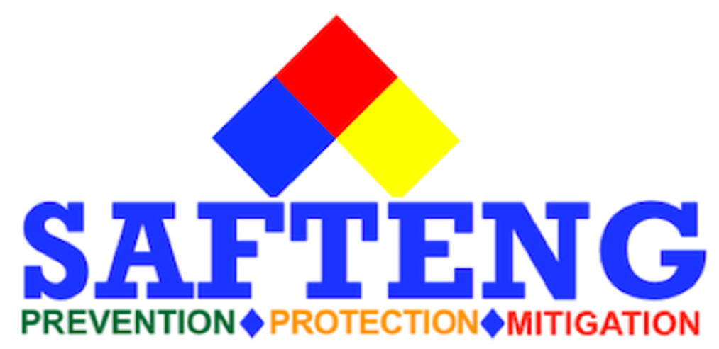
Questions or Concerns?
Copies of Line Break permits, and written programs can be downloaded from the conference folder
Jonathan Zimmerman, MS, CSP, CHMM
EHS Manager
Bryan Haywood, MS
Founder & CEO
SAFTENG.net LLC

