Slide 1

Managing
Safe Work Permits

Slide 2
What is a “Safe Work Permit”?
A Safe Work Permit (SWP) is a WRITTEN document which SPECIFICALLY DEFINES THE WORK to be done AND the SPECIFIC PRECAUTIONS to be taken.
We MUST recognize that a SWP is merely an ADMINISTRATIVE CONTROL and will ONLY bring the level of safety desired when the permit-to-work system is DEVELOPED, IMPLEMENTED, and MANAGED properly!

Slide 3
What is a “SWP Management System”?
A Safe-Work-Permit Management System is a FORMAL - WRITTEN MANAGEMENT SYSTEM used to control certain types of work that are considered…
NON-ROUTINE, and/or
present POTENTIAL SERIOUS HAZARDS, and/or
take place in POTENTIALLY HAZARDOUS WORK LOCATIONS

Slide 4
When is a Safe-Work-Permit needed?
A SWP is needed when HAZARDOUS WORK ACTIVITY can ONLY be carried out if normal safeguards (i.e. written and approved procedures) are NOT in place to MANAGE THE RISKS associated with the work or when NEW HAZARDS are introduced/ created by the work.
Examples are:
Line Breaking/Opening Process | Excavating/Trenching
Contractor Work | PRCS Entry
Hot Work | Live electrical work
Working @ Heights

Slide 5
Why is there a need for a management system?
A safety survey conducted by a safety agency showed that 1/3 of all accidents in the chemical industry were maintenance-related.
The largest single cause being A LACK OF, OR DEFICIENCY in, SAFE-WORK-PERMIT-SYSTEMS
  2/3 of companies were NOT CHECKING safety systems adequately
  2/3 of safe work permits did not adequately IDENTIFY KNOWN AND POTENTIAL HAZARDS
  1/3 of permits were UNCLEAR ON WHAT PPE was required for the specific task(s)
  1/4 of permits did not deal adequately with FORMAL HAND-BACK OF EQUIPMENT/AREA once maintenance work had finished
  In many cases little thought had been given to permit form design
  Source: UK’s Health & Safety Executive (HSE)

Slide 6
Regulatory Requirements
Some OSHA standards and Consensus Standards REQUIRE “safe work permit(s)” for specific hazardous work activities:
  Entering Permit Required Confined Spaces
  Welding, Cutting, Brazing (e.g. HOTWORK)
  Live Electrical Work (NFPA 70E)
BEST PRACTICES also suggest that other HIGH HAZARD ACTIVITIES be managed via a “safe work permit”
  Line Break/Process Opening* (PSM/RMP)
  Lockout/Tagout (LOTO)
  Cranes (Critical Lifts)
    Lifting personnel
    Exceeding 75% capacity
    Lifting over LIVE PSM/RMP processes
  Excavation/Trenching

Slide 7
Permit Required Confined Spaces (PRCS)
1910.146 (e) Permit system
    Before entry is authorized, the employer shall document the completion of measures required by paragraph (d)(3) of this section by preparing an entry permit.
PERMIT SYSTEM means the employer's WRITTEN PROCEDURE for preparing and issuing permits for entry and for returning the permit space to service following termination of entry.

Slide 8
Opening process equipment or piping
Process Safety Management (and RMP)
  1910.119(f)(4) The employer shall DEVELOP and IMPLEMENT safe work practices to provide for the CONTROL OF HAZARDS during operations such as
    lockout/tagout;
    confined space entry;
    opening process equipment or piping; and
    control over entrance into a facility by support personnel
  LINE BREAKING means the intentional opening of a pipe, line, or duct that is or has been carrying flammable, corrosive, or toxic material, an inert gas, or any fluid at a volume, pressure, or temperature capable of causing injury.

Slide 9
Hot Work Permit - PSM/RMP and Grain Handling
The implementation of a PERMIT SYSTEM for hot work is intended to assure that employers maintain control over operations involving hot work and to assure that employees are aware of and utilize appropriate safeguards when conducting these activities.
…
It should be noted that the permit is not a record, but is an AUTHORIZATION of the employer certifying that certain safety precautions have been implemented prior to the beginning of work operations.

Slide 10
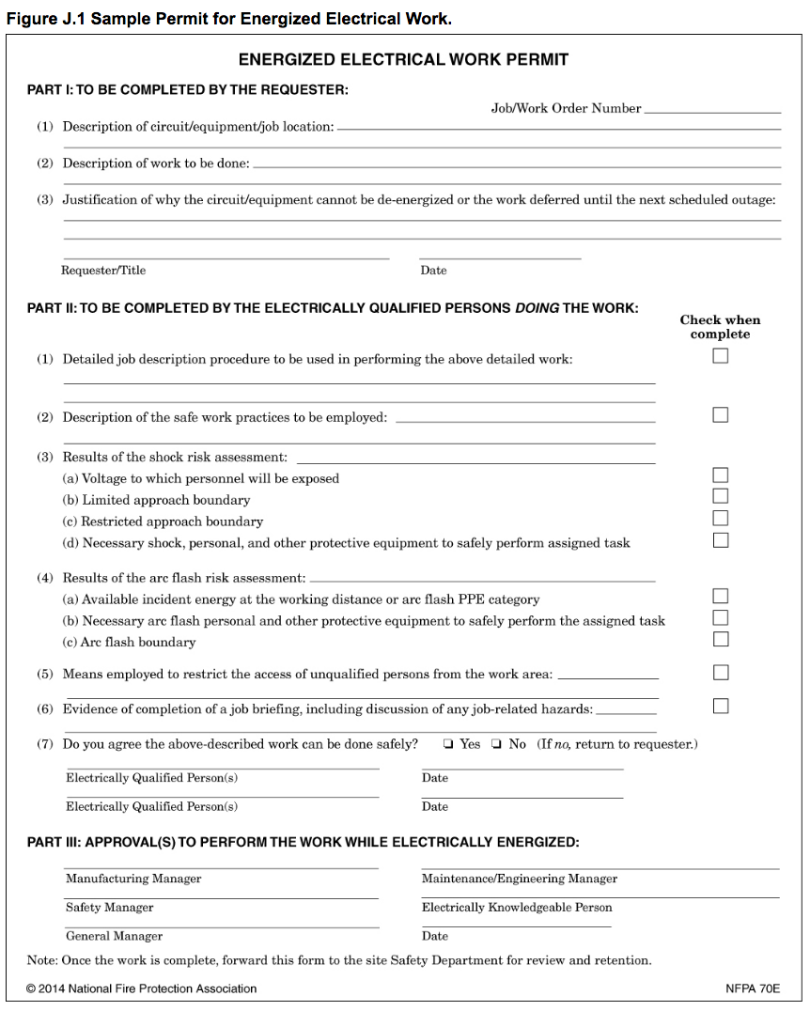
1910.333(c) and NFPA 70E
Electrical Safety Related Work Practices
  130.2(B) Energized Electrical Work Permit.
  130.2(B)(1) When Required.
  When energized work is permitted in accordance with 130.2(A), an energized electrical work permit shall be required under the following conditions:
  (1) When work is performed within the restricted approach boundary
  (2) When the employee interacts with the equipment when conductors or circuit parts are not exposed but an increased likelihood of injury from an exposure to an arc flash hazard exists

Slide 11
CONTRACTORS & PSM/RMP Process(s)
  1910.119(f)(4)(iv) The employer shall DEVELOP and IMPLEMENT safe work practices … to CONTROL the ENTRANCE, PRESENCE and EXIT of contract employers and contract employees in covered process areas.
  A PERMIT SYSTEM or work authorization system for these activities would also be helpful to all affected employers. The use of a WORK AUTHORIZATION SYSTEM keeps an employer informed of contract employee activities, and as a benefit the employer will have better coordination and more management control over the work being performed in the process area.

Slide 12
Best Practices
Excavation/Trenching
Working @ Heights
Cranes/Aerial Lifts
LOTO

Slide 13
Reality in PSM/RMP Covered Process(s)
A Contractor installing welded pipe in a “pipe rack” within a PSM/RMP covered process may require them to be part of
Contractor Work Permit
LOTO Permit,
Line Break Permit,
Hot Work Permit
Aerial Lift /Working @ Heights Permit
This work may REQUIRE five (5) SEPARATE work permits, often times issued by different individuals.
LAYERS of
[ADMINISTRATIVE] PROTECTION!

Slide 14
Developing, Implementing, Managing a Safe Work Permit
Management System

Slide 15
Step #1 - DEFINE the scope
Establish which activities will be “PERMITTED” activities
  Consider Regulatory Requirements and Best Practices
Establish ownership of EACH PERMIT to ensure permit is 100% compliant with respect to CONTENT

Slide 16
STEP #2 – DEFINE “competency”
Establish WHO can be a “PERMIT ISSUER/APPROVER”
  DEFINE the SKILLS, EXPERIENCE, and KNOWLEDGE for EACH SAFE WORK PERMIT
    Realize that being competent to issue one type of permit in one area does NOT make one competent in all permits in all areas!
  Keep regulatory requirements in mind

Slide 17
STEP #3 – Develop TRAINING programs
DEVELOP training program(s) for EACH Permit
  Include TESTING w/ Pass/Fail limits
  Include REQUIRED MINIMUM REFRESHER frequencies (i.e. annual, every 3 years, etc.)
    Refresher frequencies may NOT be the same for all SWPs
    Include other triggers for REFRESHER training (such as failing audit results)
  Training programs should include a PROBATIONARY PERIOD where students issue permits UNDER TRAINED APPROVERS
  MOST IMPORTANT – permit training needs to explain ALL permit requirements and WHY they are what they are (e.g. why 35’ on HW permits?)

Slide 18
STEP #4 – MANAGE/MEASURE Permits
LIMIT the # of permits issued in each area/unit at same time - CONTROL RISKS
  More SWPs issued = HIGHER RISKS
  Most facilities have limited ERT capabilities to respond (Fire/HAZMAT/Rescue)
    Hotwork
    Line Break/Process Openings
    PRCS Entries
  CRITICAL during Shutdowns/Outages
  Site emergency CANCELS/VOIDS ALL SWPs

Slide 19
Step #5 – Audit Permits
FIELD AUDITS are CRITICAL
  Permit(s) issued properly?
    Person “authorized”
    Permit completely filled out
  Personnel working under permit properly?
    Working within scope of work?
    Working within the permitted area?
    Personnel wearing required PPE?
    Personnel understand emergency protocols?

Slide 20
Step #5 – Audit Permits
DESK-TOP AUDITS are CRITICAL
  Permit(s) ISSUED properly?
  Permits CLOSED properly?
KEEP SCORE!
  Trend your findings

Slide 21
Step #6 – IMPROVE process
Based on data from the field audits and desk-top audits DEVELOP an IMPROVEMENT PLAN
Plan may include:
  Revising program(s) and permit(s)
  Revising “competency” for authorizers
  Retraining authorizers
  Retraining receivers

Slide 22
Summary
STEP 1 – DEFINE the SCOPE of your SWP mgt system
STEP 2 – DEFINE COMPETENCY of Permit Approvers
STEP 3 – Develop TRAINING PROGRAM
STEP 4 – MANAGE permits DAILY
STEP 5 – AUDIT, AUDIT, AUDIT, AUDIT and then AUDIT!
STEP 6 – IMPROVEMENT PLAN based on data from audits

