Slide 1
Control of Hazardous Energy
Lockout / Tagout (LOTO)
AFFECTED EMPLOYEES

Slide 2
Who is an “Affected Person”?
A Person (including Temps and Contractors) whose job requires him/her to operate or use a machine or equipment on which SERVICING and/or MAINTENANCE is being performed under lockout or tagout, or whose job requires him/her to work in an area in which such servicing or maintenance is being performed
An AFFECTED PERSON is someone who operates machines/equipment during NORMAL PRODUCTION
If something happens and a guard or safety device needs to be remove/defeated to perform a servicing or maintenance task, then an AUTHORIZED PERSON will lockout the energy sources, thus the person who was running the machine will be “AFFECTED” by the LOTO

Slide 3
Who is an “Authorized Person”?
A person who LOCKS OUT (or Tags Out) machines or equipment in order to perform SERVICING and/or MAINTENANCE on that machine/equipment
An AFFECTED PERSON becomes an AUTHORIZED PERSON when their duties include performing SERVICING and/or MAINTENANCE
An AUTHORIZED PERSON is someone who has been trained on how to apply Lockout/Tagout practices to hazardous energy sources BEFORE they remove/open guards or defeat a safety device in order to perform a maintenance/servicing task(s)
These persons are the ONLY persons on the plant site who are permitted to remove/open guards or defeat a safety device(s)

Slide 4
When does LOTO apply?
“Normal Production” operations are NOT part of LOTO, as personnel MUST BE PROTECTED by GUARD(s) and/or SAFETY DEVICE(s) during “NORMAL PRODUCTION”
It is when SERVICING and/or MAINTENANCE takes place during NORMAL PRODUCTION OPERATIONS when LOTO applies and this INCLUDES when:
A GUARD has to be REMOVED/OPENED or SAFETY DEVICE has to be DEFEATED/BYPASSED to do the work;
OR
Worker wants to PLACE ANY PART OF HIS/HER BODY INTO AN AREA ON A MACHINE OR PIECE OF EQUIPMENT where work is actually performed upon the material being processed (point of operation) or where an associated danger zone exists during a machine operating cycle

Slide 5
What is Servicing and/or Maintenance?
Servicing and/or maintenance is workplace activities such as constructing, installing, setting up, adjusting, inspecting, modifying, and maintaining and/or servicing machines or equipment.
  These activities include LUBRICATION, CLEANING or UNJAMMING of machines or equipment and MAKING ADJUSTMENTS or TOOL CHANGES, where the worker may be exposed to the unexpected energization or startup of the equipment or release of hazardous energy
Setting up is any work performed to prepare a machine or equipment to perform its “normal production” operation.

Slide 6
MINOR Servicing EXCEPTION
MINOR tool changes and adjustments, and other MINOR servicing activities, which TAKE PLACE DURING NORMAL PRODUCTION OPERATIONS, are not covered if they are:
ROUTINE ,(done each shift) and
REPETITIVE, (done multiple times each shift) and
INTEGRAL, (if not done the machine/equipment will not function properly) and
Do NOT involve DISASSEMBLY of part of the machinery/equipment
to the use of the equipment for production, provided that the work is performed using ALTERNATIVE MEASURES which provide effective protection (See Subpart O –Machine Guarding)
Discuss “Interlocks” and how to get a “Minor Servicing Exception” Approval

Slide 7
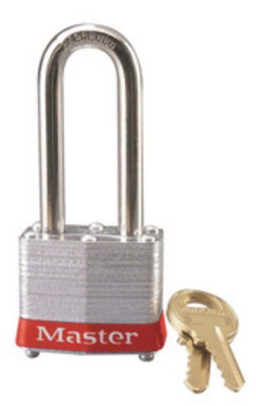
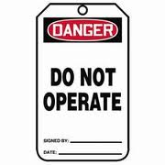
What does all of this mean?
As an “AFFECTED EMPLOYEE” you may NOT:
  REMOVE or OPEN a guard to perform a servicing/maintenance task*
  BYPASS a safety device to perform a servicing/maintenance task*
  Put ANY BODY PART into a hazardous area of a machine/equipment
Understand that the facility’s Lockout locks are SILVER locks with a RED BAND and will have a DANGER Tag attached
You MUST be able to IDENTIFY these LOCKOUT LOCKS simply by their COLOR(s) NOTE: These locks have a 2 inch tall Shackle as well
Under NO CIRCUMSTANCES is ANYONE allowed to tamper with or attempt to defeat the lock OR the energy isolation device the lock (or Tag) is attached to or operate equipment which has been LOCKED/TAGGED OUT
Any attempt to defeat a Lockout/Tagout or an energy isolation device that is locked or tagged will result in disciplinary action, including up to termination, even on the first offense
*Minor Servicing Exception

Slide 8
What does all of this mean?
Due to the age of the Norwood facility, there may be occasions where a LOCKOUT LOCK can not be applied to an energy isolation device
When this occurs, the AUTHORIZED EMPLOYEE(s) will apply a TAGOUT DEVICE to the energy isolation device
This TAGOUT tag looks exactly like this
AND will be the ONLY device applied to
ENERGY ISOLATION DEVICE
Under NO CIRCUMSTANCES are you allowed to tamper with or attempt to defeat the TAGOUT or the energy isolation device the Tag is attached to or operate equipment which has been TAGGED OUT

Slide 9
QUESTIONS or CONCERNS??
WHEN IN DOUBT...
LOCK IT OUT

