Slide 1
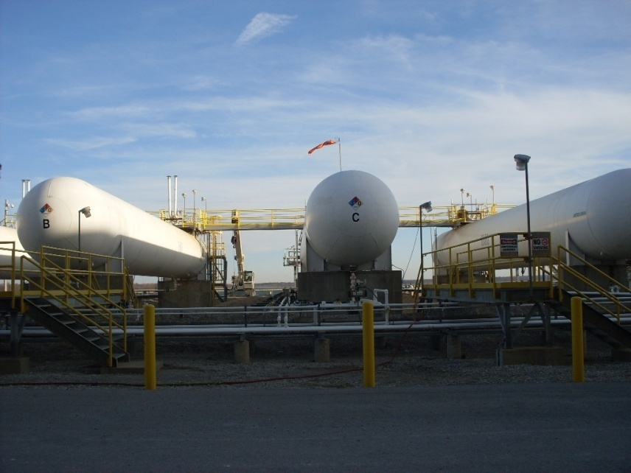
Anhydrous Ammonia Accident
November 18, 2011

Slide 2
What Happened
On November 18, 2011, SCR ammonia tank farm storage tank “C” was taken out of service to have its 10 year non-destructive examination performed. After the ammonia tank was purged and opened, two employees were removing two safety relief valves for their 5 year inspection. The two relief valves are flanged 8 bolt connected to a “Anderson Greenwood-Safety Selector Valve”. The selector valve is used to select one safety relief valves to be in-service.
The two employees had removed both valves on E & D tanks prior to beginning work on tank C. The employees first removed the north safety relief valve and were in the process of breaking the flange on the second safety valve by using a cut off wheel (cutting the studs between the flanges) to remove the flange bolts. The employee was lying down on the platform while cutting the 4th bolt when trapped ammonia gas escaped through the flange. The ammonia gas contacted the employee’s face shield, which was approximately two feet from the flange. The employee inhaled ammonia gas and had exposure to his face and eyes, which caused irritation. The second employee was exposed to the ammonia gas as he was located downwind from the escaping ammonia. However, the second employee did not experience any irritation or difficulty breathing as a result.
The area of gas released was ~<1 cubic foot

Slide 3
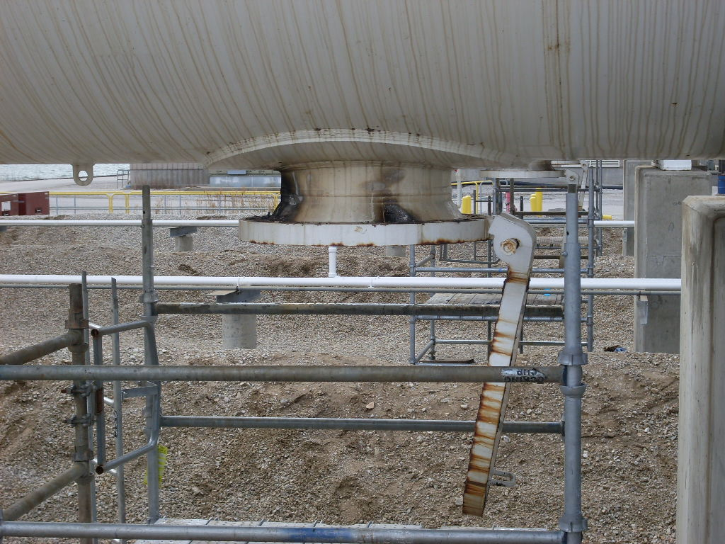
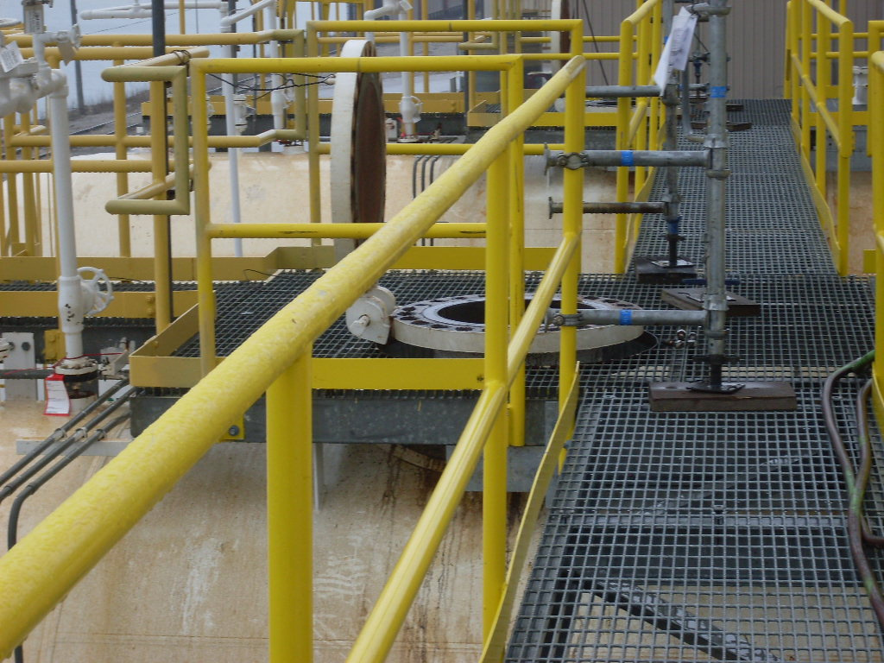
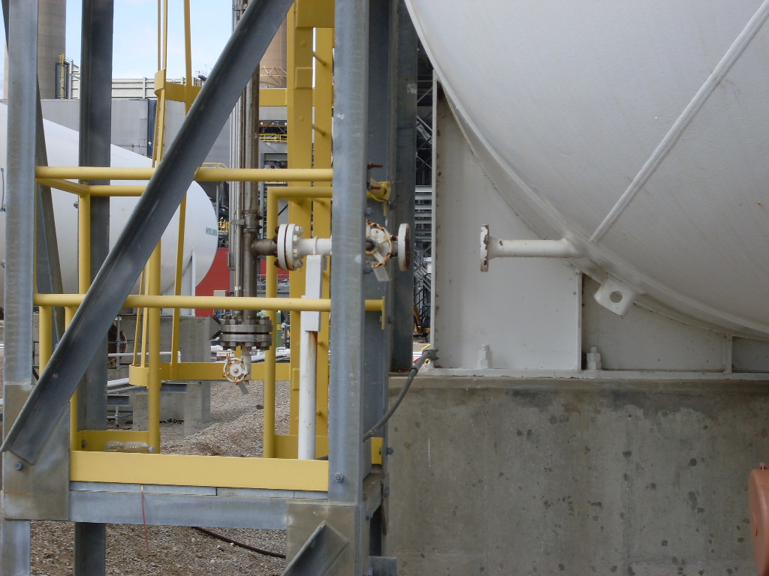
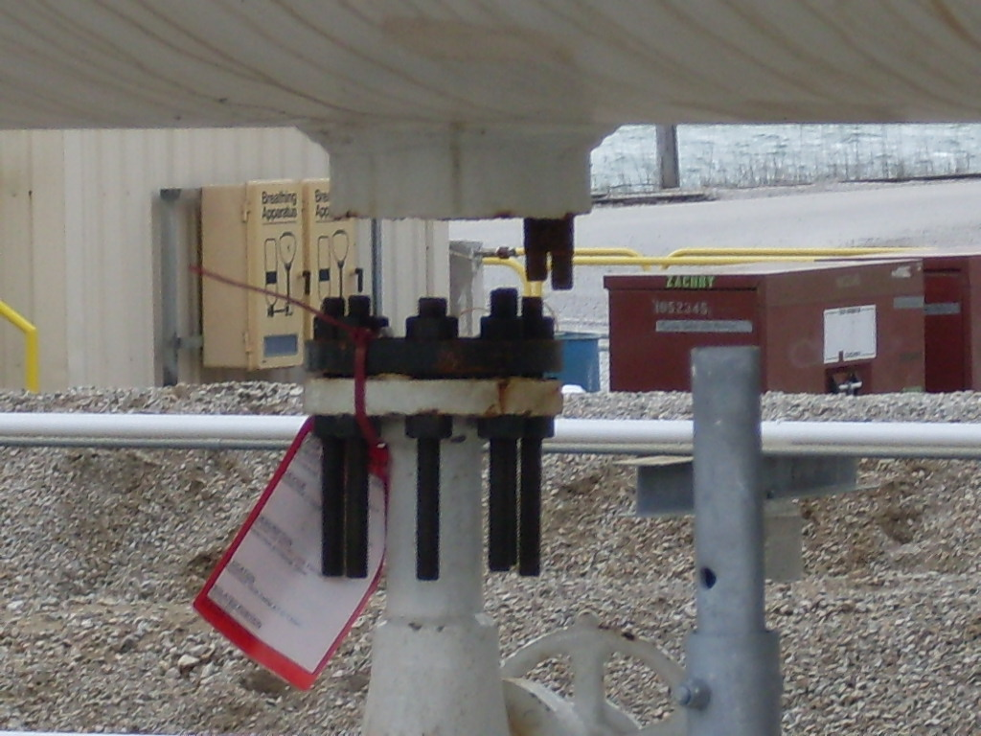
Tank Isolated & Purged
Tank Isolated & Purged
Tank Isolated & Purged
Tank Isolated & Purged
Tank Isolated & Purged

Slide 4
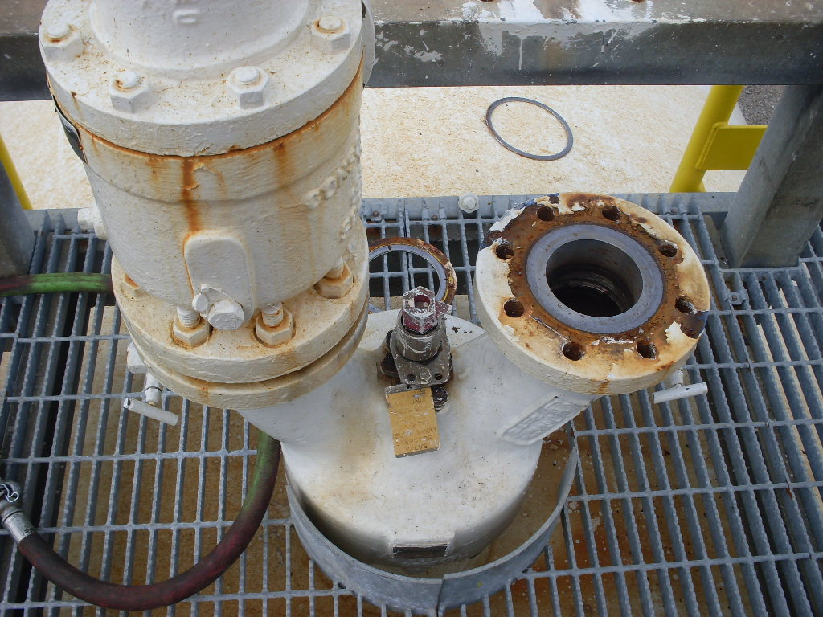
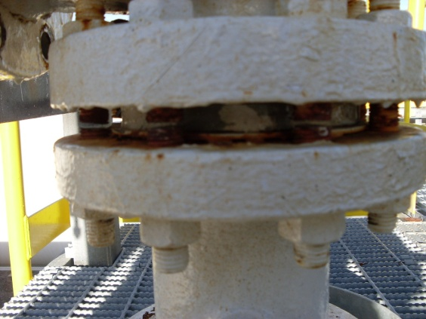
Valve that was being removed when accident occurred
South
valve
North valve (removed)
Location of employee when accident occurred (lying down)
Area employee was making cuts on flange bolts
Bleed Ports
Safety Selector Valve
Indicator showing active valve

Slide 5
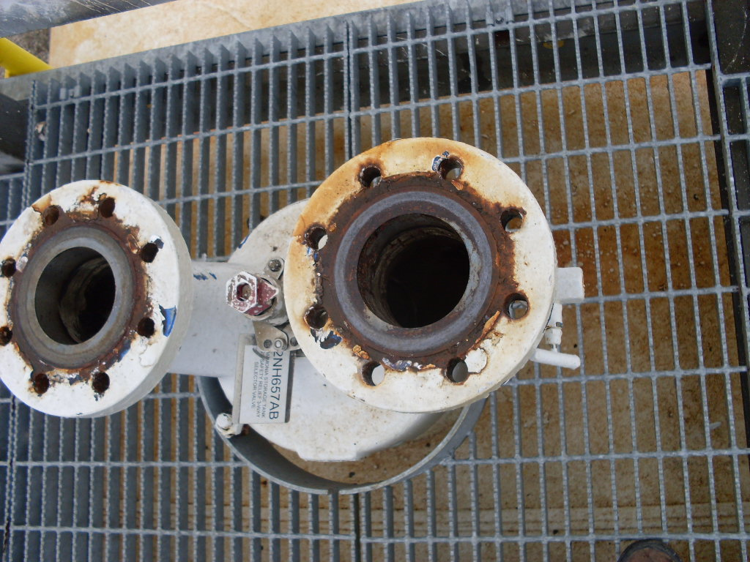
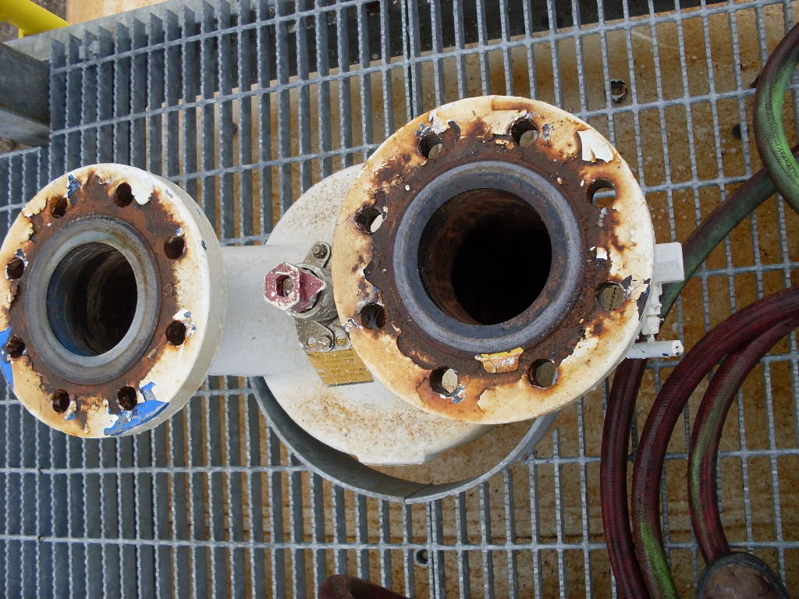
Safety selector valves on tanks “E” and “D” (RV’s removed)
E-Valve
Indicator pointing toward north valve
D-Valve
South North
Bleed Valve open (north)

Slide 6
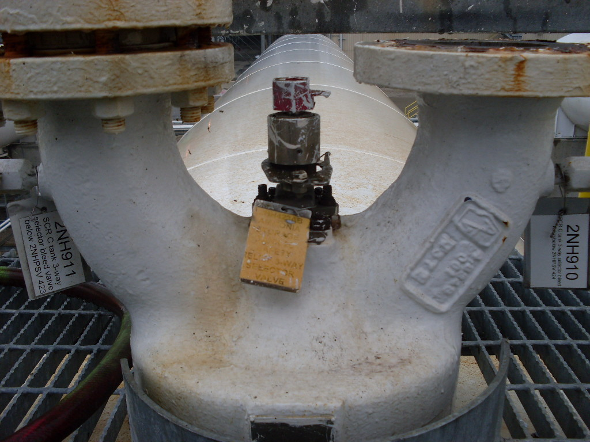
Safety Selector Valve “C” Tank
“C” valve is the valve where the accident occurred.
This is a view to get a prospective of the valve configuration
Notice the bleeders north and south
Note the indicator pointing north
South North

Slide 7
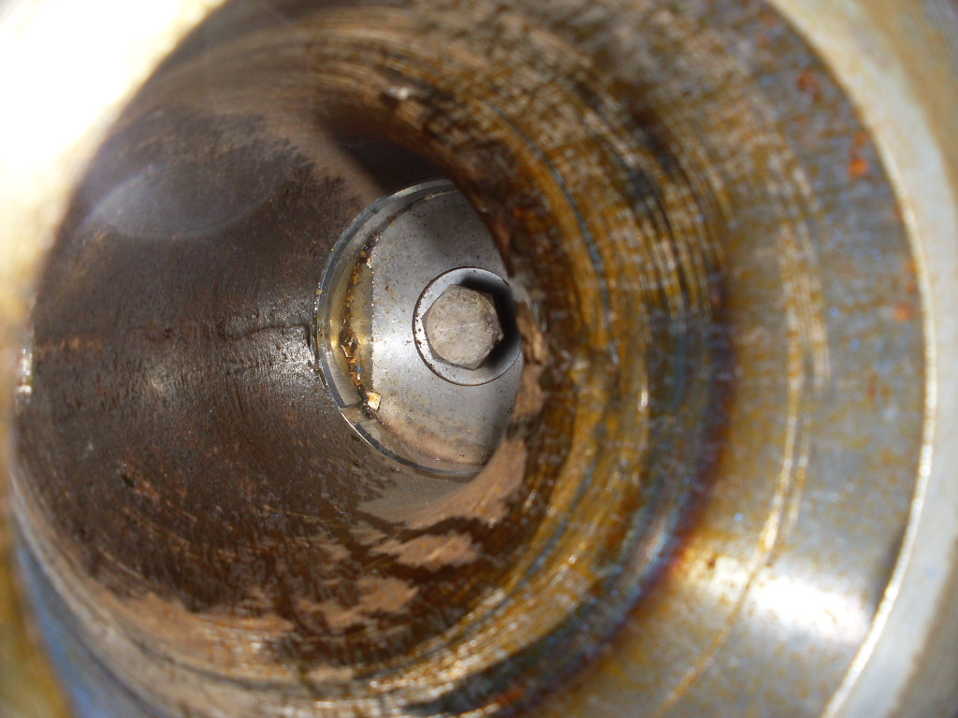
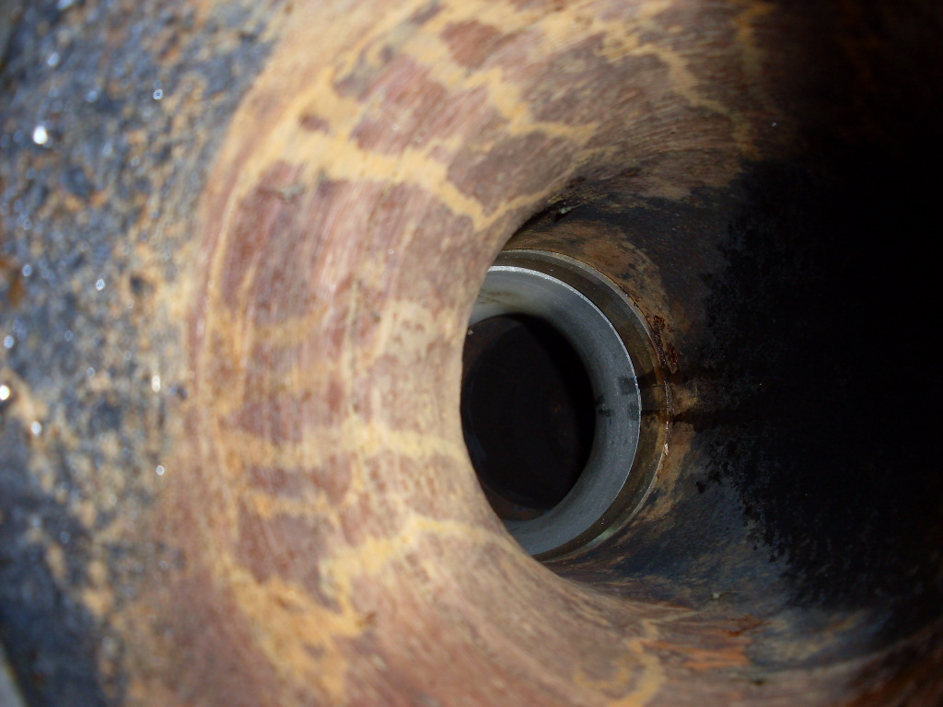
Picture looking down into the SSV
South (sealed port of the SSV)
North (active port of the SSV)
Isolation Disk (stand by position)
Active port opening

Slide 8
Accident Facts/Causal Factors
The ammonia system is a truck filled system
The ammonia tanks were purged and open on October 31, 2011
Tank was out of service and open for ~ 18 days prior to accident on November 18th
The safety selector valve was activating the (north) safety relief valve
Ammonia gas became trapped in the south devise due to the SSV activation of the north valve.
It is believed Ammonia gas became trapped in the south valve during the alternating of the PRV PM’s
The bleed valve was not on the clearance for the tank and therefore was not opened during the ammonia tank LOTO clearance
Five other safety relief valves 2 ea., on tanks “E” & “D” and one on “C” (north valve) were removed using the same procedure adding to the confidence that ammonia gas was removed from the ammonia tank and piping
Ammonia transfer and vapor piping to and from the ammonia tank was LOTO’ed, disconnected, and blanked

Slide 9
Accident Facts/Causal Factors cont.
Manways top and bottom of the tank were opened
The SSV were not identified in the LOTTO as part of the isolation system for the tanks
It was unknown that the Anderson Greenwood Safety Selector Valve would store energy (vapor) in the standby position
The indicators for all three SSV were pointed to the north valves resulting in the north valves being “active”
The north bleeders for the SSV on tanks “E” and “D” were open
The south bleeders for the SSV on tanks “E” and “D” were closed
The bleeders for the SSV on tank “C” were both closed (north & south)
This same scope was performed in the Summer on tanks “A” and “B”
Zachry was asked by Duke to sign of clearance ~11/14/11 that they could continue to work on the vessel that a “dead leg” was created

Slide 10
Accident Facts/Causal Factors cont.
Work was being performed on the tanks on Thursday without being signed on the LOTTO, this was discovered by Zachry safety and work was halted
It was told to Zachry Safety the removing of the RV and vents would not take place until Monday the 21st of November
The employee was wearing a hard hat, face shield, safety glasses, leather gloves and ear plugs no other PPE was being utilized
Line break on the STA was answered “no”
Hazardous chemicals was checked on the STA
The STA identified ammonia as a potential hazard but did not mitigate the hazard
Line break permit and proper PPE was utilized during initial isolation of piping and opening of manways
The supervisor that was on the job from the beginning was off on Thursday and was not contacted they were going to work Friday, this project was scheduled for 4-10’s

Slide 11
Recommended Actions
Review ammonia system procedures and LOTO’s to include Safety Selector and all bleed valves, insuring all are identified, labeled, and utilized during servicing and maintenance work activities
Ensure all work is performed by trained persons in line break and LOTTO’s work procedures
Clarify what isolation points must be included in LOTTO
Review line break permit and make modifications as needed and retrain all employees (minimum PPE - full face respirators, face shield, acid suite, and rubber gloves.
Perform pre-job briefs reviewing system and LOTTO procedures and specific hazards identified in task being performed.
Ensure bleed valves are open and operate correctly
Follow safe work practices for activities being performed and wear line break PPE
Ensure all employees are trained and re train all employees on new isolation procedures
Insure daily meetings occur between superintendents and foreman
Share accident findings with all company and customer employees.

