Slide 1
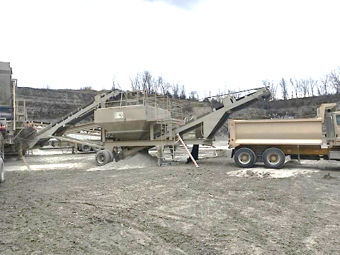
1/8/2020 IA
Surface Limestone
Slip/Fall of Person
Truck Driver
Age: 30
32 Weeks Mining Exp.
Victim fell into a lime surge hopper and
became engulfed by the material.

Slide 2
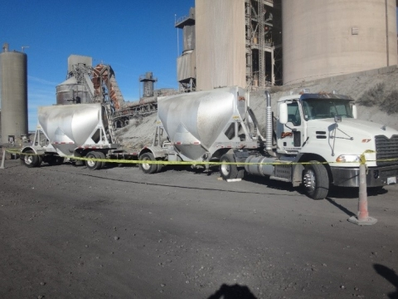
1/23/2020 CA
Facility Cement
Slip/Fall of Person
Truck Driver
Age: 71
48 Years Mining Exp.
Victim fell from the top of a bulk trailer while opening the trailer lids. He later died on January 26, 2020, due to head trauma he received from the fall.

Slide 3
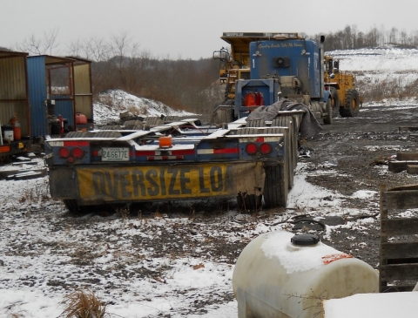
2/27/2020 WV
Surface Coal
Powered Haulage
Mechanic
Age: 50
20 Years Mining Exp.
The victim was assisting a truck driver in positioning a trailer. He was struck by the trailer’s wheels as it moved forward.

Slide 4
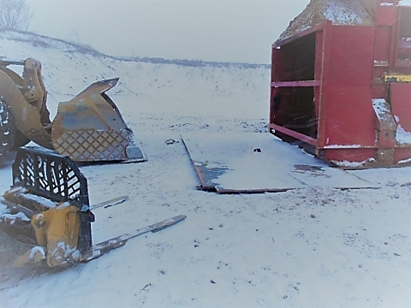
2/27/2020 MI
Surface Sand & Gravel
Handling Material
Equipment Operator
Age: 29
2 Years Mining Exp.
While working with other miners to set a steel plate vertically against the frame of a feed hopper, the steel plate fell on the victim.

Slide 5
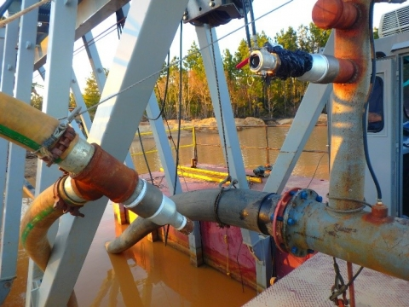
2/29/2020 LA
Surface Sand
Machinery
Plant Foreman
Age: 28
4 Years Mining Exp.
Victim was closing a water valve when a two-inch cam lock fitting (fitting) failed. The pressurized water knocked him into the operator’s compartment and then swept him into the dredge pond where he drowned.

Slide 6
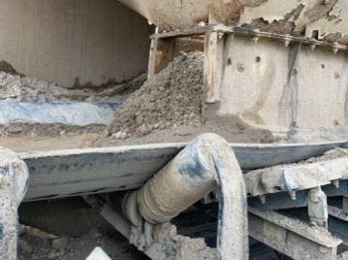
5/2/2020 OH
Surface Crushed Stone
Handling Material
Equipment Operator
Age: 56
8 Years Mining Exp.
Victim entered the hopper to clear a blockage of material. Once inside, a large amount of material dislodged engulfing him.

Slide 7
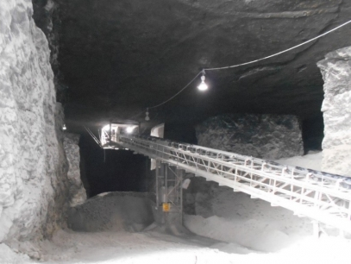
5/21/2020 IL
UG Limestone
Hand Tools
Mechanic
Age: 60
27 Years Mining Exp.
Victim was struck in the head while attempting to remove an electric motor. A chain hoist was attached to a overhead steel pipe and to the lifting eye on the motor. The steel pipe slid and fell forward striking the miner.

Slide 8
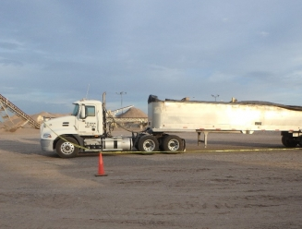
6/1/2020 AZ
Surface Sand & Gravel
Slip/Fall of Person
Truck Driver
Age: 61
13 Years Mining Exp.
Victim fell from the top of a end-dump trailer while attempting to deploy the tarp.

Slide 9
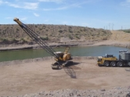
6/13/2020 AZ
Surface Sand & Gravel
Machinery
Dragline Operator
Age: 25
3 Years Mining Exp.
The victim was found inside the dragline after it was removed from the water. Failure to maintain control of the equipment resulted in the accident.

Slide 10
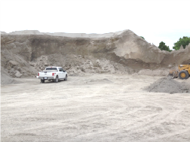
6/19/2020 KS
Surface Limestone
Fall of Material
Quality Technician
Age: 68
50 Years Mining Exp.
Victim was inspecting a stockpile for over-sized material. As he paused and knelt during his inspection, the stockpile collapsed and covered him with approximately four feet of material.

Slide 11
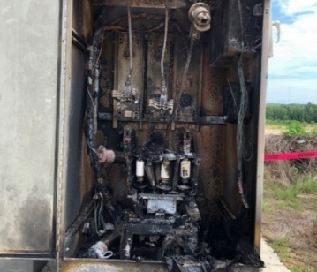
7/9/2020 GA
Surface Sand
Electrical
Superintendent
Age: 60
36 Years Mining Exp.
Victim made contact with energized high-voltage components in a 4,160 volt (4,160 VAC), three-phase electrical enclosure.

Slide 12
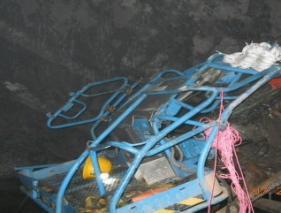
7/24/2020 GA
UG Limestone
Machinery
Miner
Age: 24
3 Days Mining Exp.
Victim was pinned to the roof and face of the underground mine while performing work from a personnel basket.

Slide 13
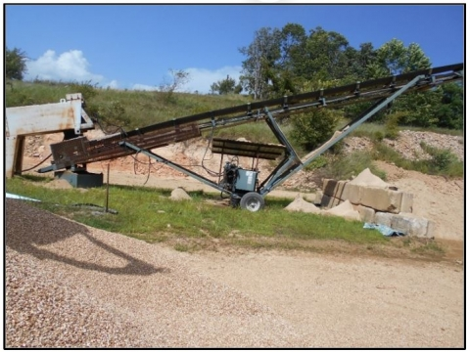
7/29/2020 MO
Surface Sand & Gravel
Powered Haulage
Equipment Operator
Age: 63
8 Years Mining Exp.
Victim became entangled in a moving belt conveyor. He was air-lifted to a trauma center where he died as a result of his injuries on August 5, 2020.

Slide 14
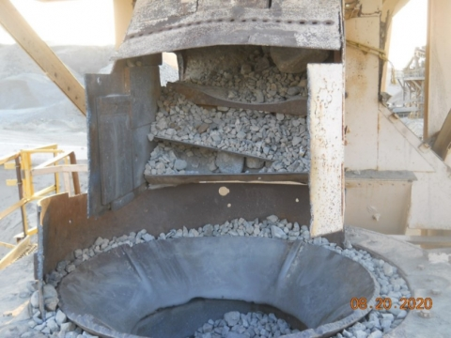
8/18/2020 CA
Surface Sand & Gravel
Machinery
Equipment Operator
Age: 21
1 Year Mining Exp.
Victim entered the cone crusher and falling material entrapped the miner beneath the feed hopper.

Slide 15

8/21/2020 IA
Surface Limestone
Machinery
Truck Driver
Age: 69
8 Years Mining Exp.
Victim sustained fatal head injuries while deploying the tarp system on a fifth-wheel side-dump trailer.

Slide 16
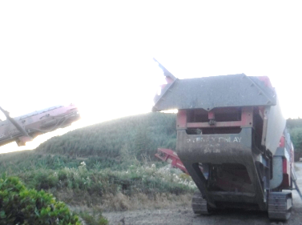
8/26/2020 WA
Surface Sand & Gravel
Machinery
Crusher Foreman
Age: 52
23 Years Mining Exp.
Victim was preparing a jaw crusher for transport by removing wedges that held the right side hopper extension in a raised position. The extension fell on him.

Slide 17
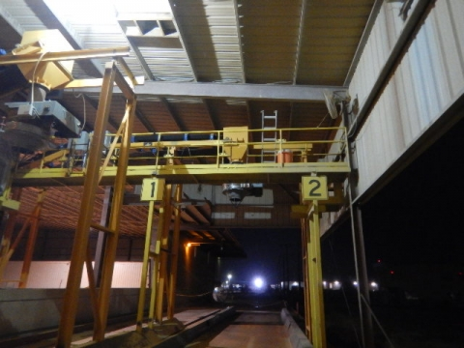
9/1/2020 TX
Surface Sand
Slip/Fall of Person
Plant Helper
Age: 53
2 Years Mining Exp.
Victim fell while attempting to close a hatch on the top of a bulk material trailer. He was wearing a fall protection harness, but his lanyard was not attached to a secure anchorage point.

Slide 18
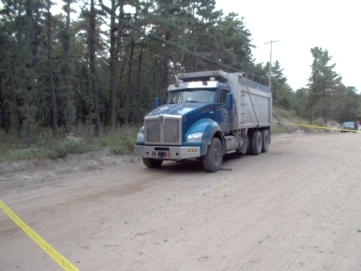
9/16/2020 NJ
Surface Sand & Gravel
Powered Haulage
Truck Driver
Age: 47
20 Years Mining Exp.
Victim was run over by a dump truck while he was underneath attempting to adjust the brakes. At the time of the accident, the parking brake was not set, the transmission was in drive, and the engine was on.

Slide 19
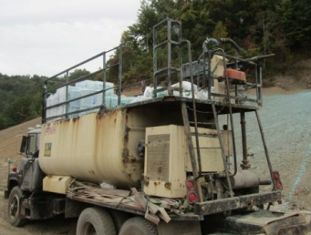
10/9/2020 KY
Surface Coal
Machinery
Equipment Operator
Age: 48
8 Years Mining Exp.
Victim accidentally engaged the hydro-seeder’s clutch while the nozzle was pointing towards him. The release of material caused him to fall backwards striking his neck on the hydro-seeder handrail.

Slide 20
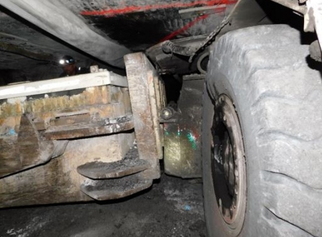
10/13/2020 KY
UG Coal
Powered Haulage
Equipment Operator
Age: 58
30 Years Mining Exp.
Victim parked the shuttle car in an intersection and was exiting when a scoop went through a ventilation curtain in an adjacent crosscut and struck him.

Slide 21
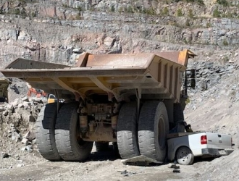
10/14/2020 SC
Surface Granite
Powered Haulage
Lead Person
Age: 61
17 Years Mining Exp.
Victim was killed when his pickup truck was struck by a haul truck.

Slide 22
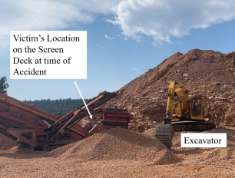
10/19/2020 CO
Surface Sandstone
Machinery
Plant Operator
Age: 58
8 Weeks Mining Exp.
The victim was standing on the cross beam of a grizzly hopper screen where he was struck by an excavator’s bucket.

Slide 23
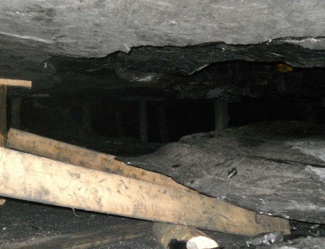
10/27/2020 PA
UG Coal
Fall of Roof
Miner
Age: 37
2 Years Mining Exp.
Victim was digging a hole to install a wooden post for roof control when a section of the roof fell on him.

Slide 24
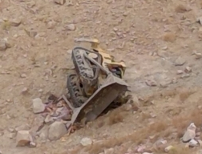
11/8/2020 NV
Surface Gold
Machinery
Bulldozer Operator
Age: 58
41 Years Mining Exp.
Victim was killed when the bulldozer he was operating backed over the edge of a highwall.

Slide 25
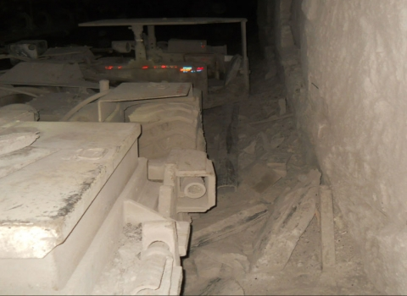
11/23/2020 WV
UG Coal
Powered Haulage
Equipment Operator
Age: 20
1 Years Mining Exp.
Victim was operating a battery-powered scoop when he ran over a section of pipe in the roadway. The four-inch plastic pipe entered the operator’s compartment and struck him.

Slide 26
11/23/2020 TX
Facility Barnite/Barium
Electrical
Mechanic
Age: 39
1 Year Mining Exp.
The victim was electrocuted while he was troubleshooting a disconnect box for a drive motor. The victim had the electrical disconnect box open, and the main power supply was not de-energized.

Slide 27
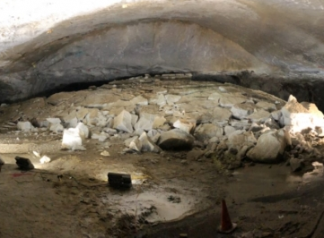
12/14/2020 LA
UG Salt
Roof Fall
Grouters
Age: 27 & 41
Both had less than 1 Year Mining Exp.
The victims were pumping sealing grout in the intersection when salt blocks and anhydrite fell from beneath a slickenside and on top of them.

Slide 28
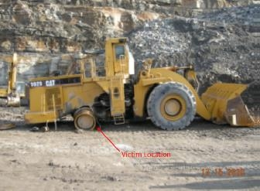
12/15/2020 KY
SUR Sandstone
Machinery
Grouters
Age: 58
22 Years Mining Exp.
The victim was changing the rear tire on a front-end loader. The victim was underneath the FEL when it fell.

Slide 29
12/15/2020 KY
SUR Sandstone
Machinery
Grouters
Age: 58
22 Years Mining Exp.
The victim was changing the rear tire on a front-end loader. The victim was underneath the FEL when it fell.

