Slide 1

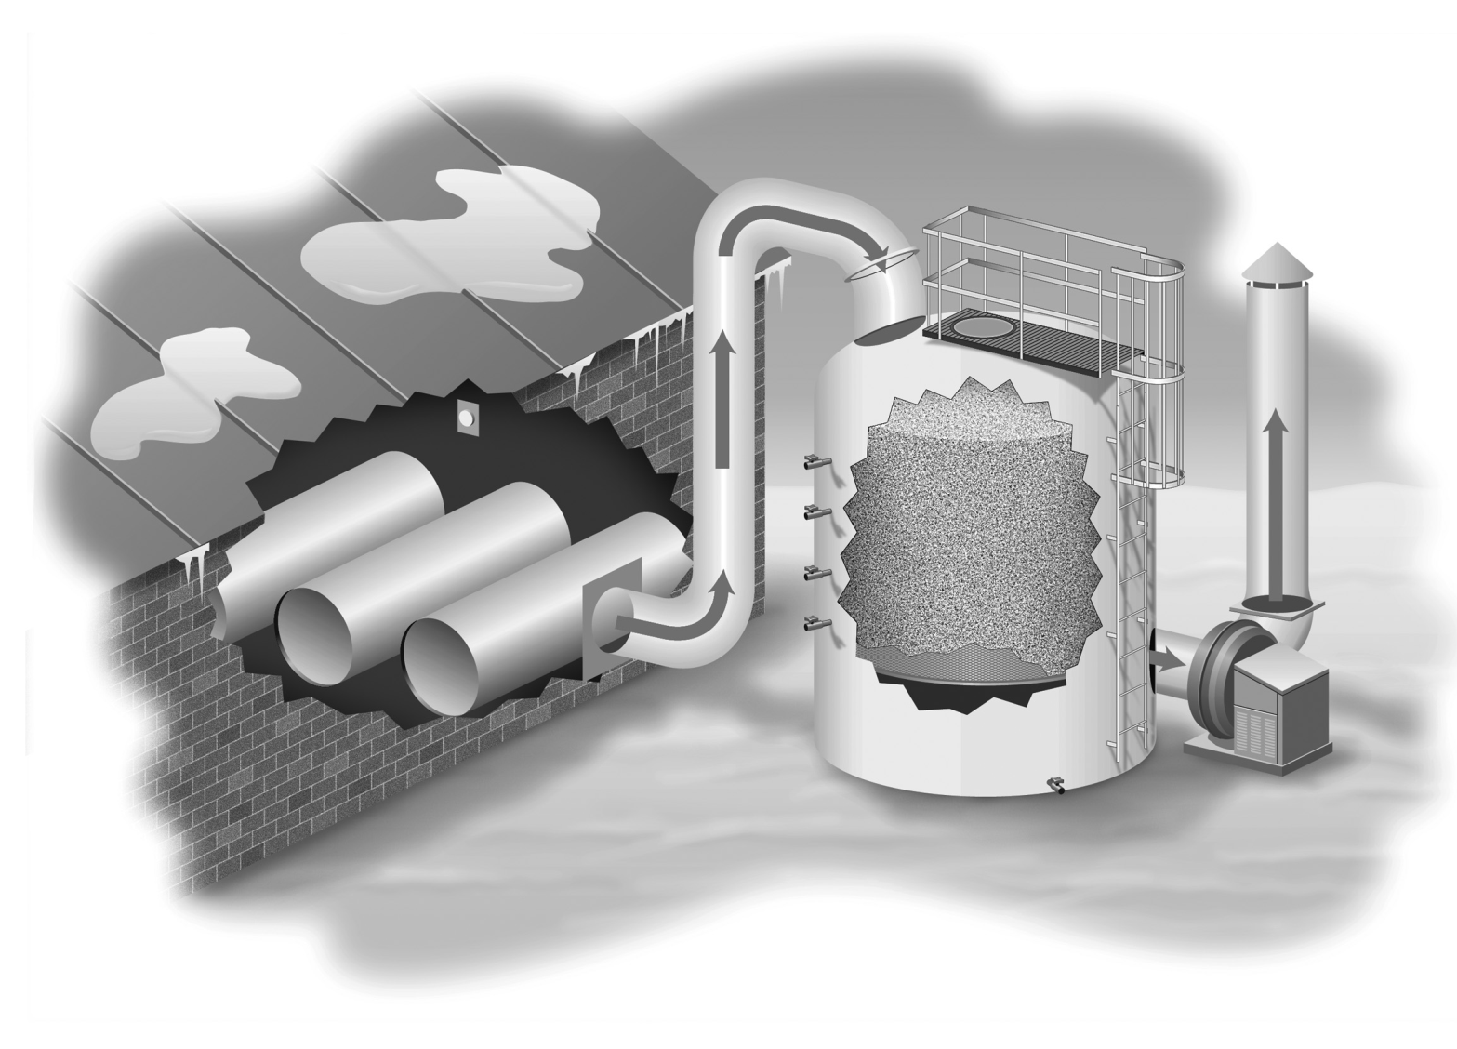
Chlorine is “Toxic”
State Fire Code (IFC)
OSHA Occupational Safety & Health Standards
OSHA PSM
EPA RMP

Slide 2
OSHA PSM and EPA RMP Thresholds
OSHA’s PSM Threshold is 1,500 pounds of Cl₂
EPA’s RMP Threshold is 2,500 pounds Cl₂
If the facility has an RMP covered Cl₂ process, then a “TREATMENT SYSTEM” may be REQUIRED by the State Fire Code!
If the facility is utilizing “short-filled” cylinders (i.e. <1500 lbs) AND they have ONLY one (1) cylinder in the room, they would NOT be required to have a “treatment system”

Slide 3
OSHA’s Weakness Below PSM Threshold
Below these amounts… there is NO OSHA standard for Design, Storage, and Handling Cl₂
So, what does one do to ensure a level of safety?
NOTE: EPA has an RMP General Duty Clause they could use, but OSHA sort of has it’s hands tied below the PSM threshold for Cl₂

Slide 4
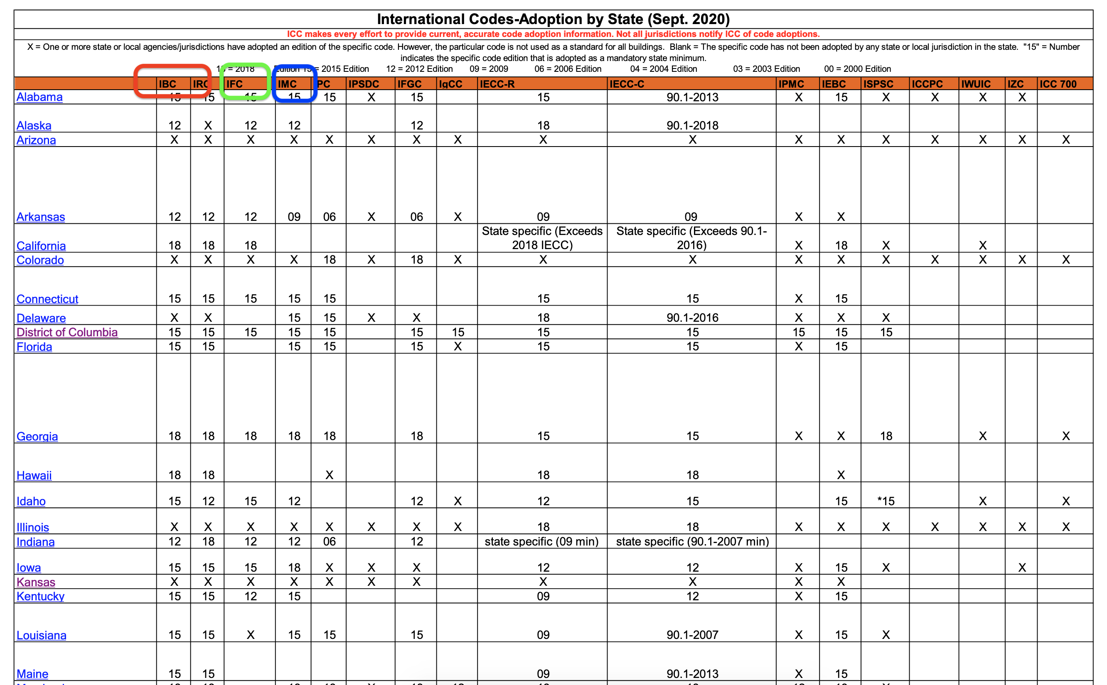
State Fire/Mechanical/Building Codes
https://www.iccsafe.org/wp-content/uploads/Master-I-Code-Adoption-Chart-Sept-2020.pdf

Slide 5
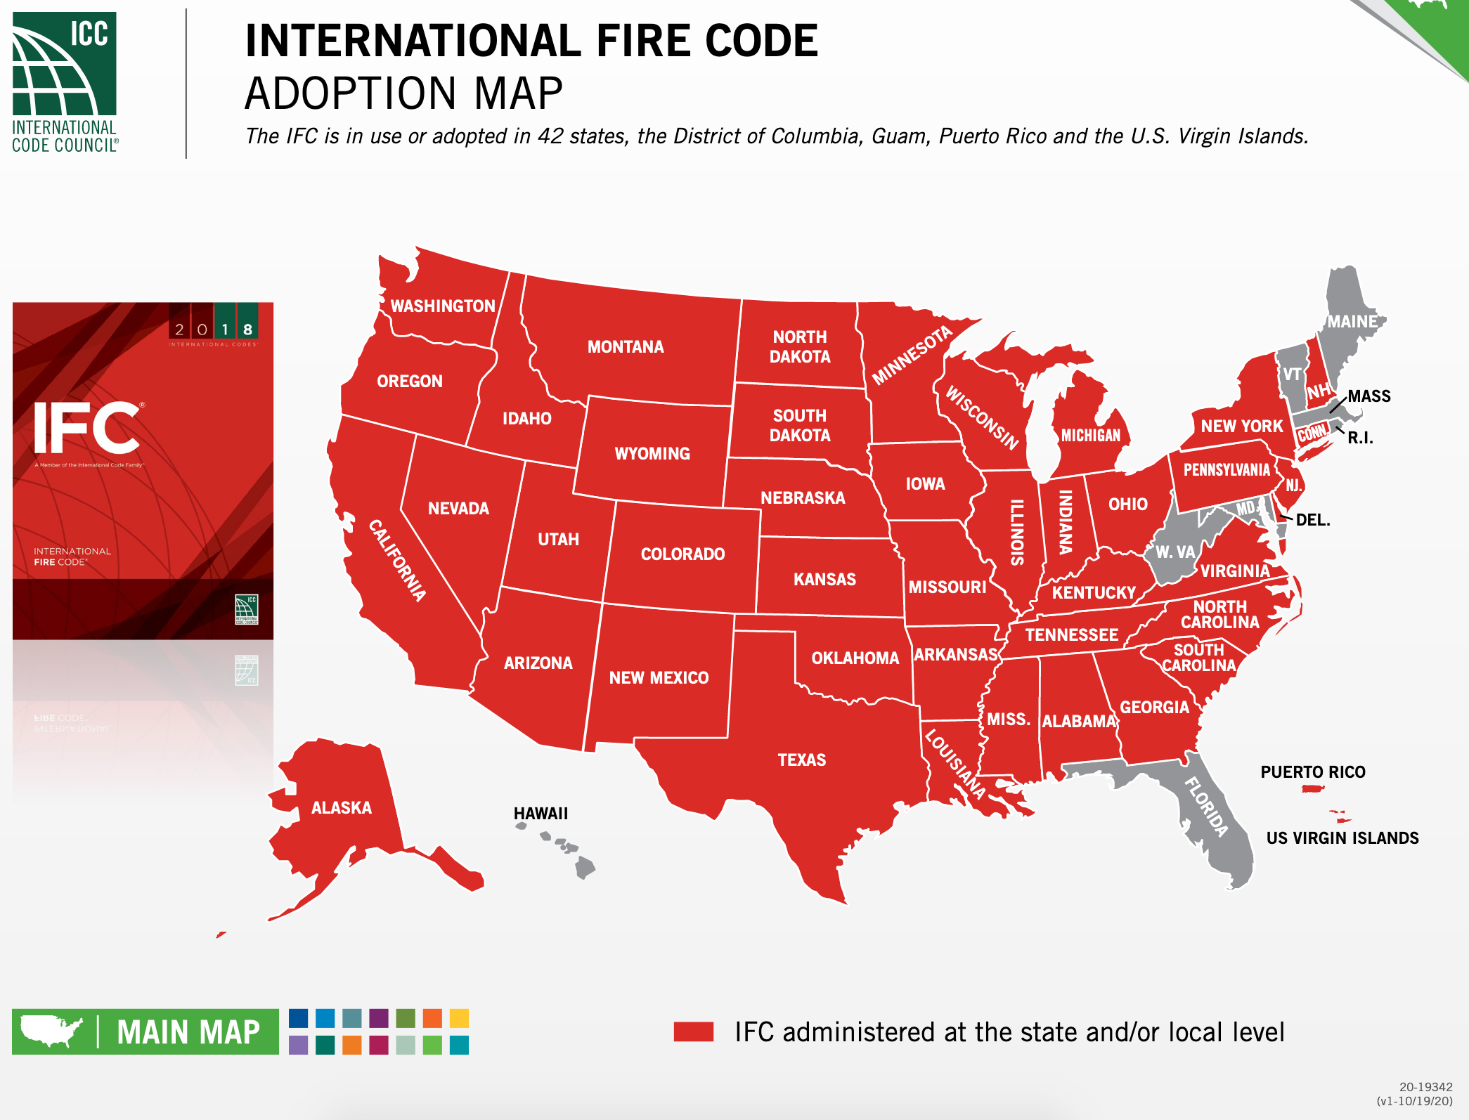
State Adoption of the IFC

Slide 6

How is Cl₂ classified by the Codes?
The codes are built upon the CLASSIFICATION of the Hazardous Material (HAZMAT)
Cl₂ is classified as a
  COMPRESSED GAS,
  CORROSIVE GAS, and
  TOXIC GAS
  NOTE: Some facilities manage Cl₂ as a “Highly Toxic” Gas, but by definition it is ONLY a “Toxic” gas

Slide 7
Why is Cl₂ classified as a Compressed Gas?
Compressed Gas is a material, or a mixture of materials, that:
  is a gas at 68°F (20°C) or less at 14.7 psia (101 kPa) of pressure, AND
  has a boiling point of 68°F (20°C) or less at 14.7 psia (101 kPa) which is either liquefied, nonliquefied, or in solution, except those gases which have no other health or physical hazard properties are not considered to be compressed until the pressure in the packaging exceeds 41 psia (282 kPa) at 68°F (20°C)

Slide 8
Why is Cl₂ classified as a Compressed Gas?
The states of compressed gases are CATEGORIZED as follows:
  NON-LIQUEFIED COMPRESSED GASES are gases, other than those in solution, that are in a packaging under the charged pressure and are ENTIRELY GASEOUS at 68°F (20°C)
  LIQUEFIED COMPRESSED GASES are gases that, in a packaging under the charged pressure, are partially liquid at a temperature of 68°F (20°C)
  COMPRESSED GASES in solution are nonliquefied gases that are DISSOLVED IN A SOLVENT
  COMPRESSED GAS MIXTURES consist of a mixture of two or more compressed gases contained in a packaging, the hazard properties of which are represented by the properties of the mixture as a whole
Cl₂ is shipped as either NON-LIQUEFIED COMPRESSED GAS or as a LIQUEFIED COMPRESSED GAS

Slide 9
Toxic Gas vs. Highly Toxic Gas
Highly Toxic | Toxic
LD50 of ≤ 50 mg/kg body weight oral albino rat 200 - 300 g OR LD50 of ≤ 200 mg/kg body weight continuous 24 h contact (or less if death occurs before 24 h) albino rabbits 2 - 3 kg OR LC50 ≤ 200 ppm by volume of gas or vapor, or > 2 mg/L dust/fume/mist continuous inhalation for 1 h (or less if death occurs in less than 1 h) to albino rats 200 - 300 g. | 50 mg/kg < LD50 ≤ 500 mg/kg ( body weight) oral albino rat 200 - 300 g OR 200 mg/kg < LD50 ≤ 1000 mg/kg (body weight) continuous 24 h contact (or less if death occurs before 24 h) albino rabbits 2 - 3 kg OR 200 ppm < LC50 ≤ 2000 ppm (by volume of gas or vapor), or 2 mg/L < LC50 ≤ 20 mg/L (dust, fume, mist) continuous inhalation for 1 h (or less if death occurs in less than 1 h) to albino rats 200 - 300 g
Chlorine’s LC50 = 293 ppm
NOTE: Sulfur Dioxide’s (SO2) LC50 = 2,520 ppm

Slide 10
Toxic Gas vs. Highly Toxic Gas
Highly toxic* | Toxic*
Arsine (AsH3) Cyanogen (CN2) Diazomethane (CH2N2) Diborane (B2H6) Fluorine (F) Hydrogen Cyanide (HCN) Hydrogen Selenide (H2Se) Nitric Oxide (NO) Oxygen difluoride (OF2) Phosgene (COCl2) Phosphine (PH3) Perfluoroisobutylene (C4F8) Selenium Hexafluoride (SeF6) Stibine (SbH3) Sulfur Tetrafluoride (SF4) Tellurium Hexafluoride (TeF6) | Boron Tribromide (BBr3) Bromine Chloride (BrCl) Bromomethane (CH3Br) Chlorine (Cl2) Chlorine trifluoride (CIF3) Cyanogen (C2N2) Dichlorosilane (H2Cl2Si) Germane (GeH4) Hydrogen Fluoride (HF) Hydrogen Sulfide (H2S) Perchloryl Fluoride (ClFO3) Phosphorus Pentafluoride (PF5) Silicon Tetrafluoride (SiF4) Silicon Tetrachloride (SiCl4) Trifluoroacetyl Chloride (C2ClF3O) Tungsten Hexafluoride (WF6)
*Highly Toxic gases would also be a Category 1 (Acute Toxicity) per OSHA; Category 2's would be Toxic Gases

Slide 11
Cl2 Application
Cl₂ is a “Toxic”, “Corrosive” “Compressed Gas” and the areas where it is STORED, DISPENSED, USED AND HANDLED MUST meet the minimum requirements of:
Chapter 50: Hazardous Materials—General Provisions
  SECTION 5001 GENERAL
  SECTION 5003 GENERAL REQUIREMENTS
  SECTION 5004 STORAGE
  SECTION 5005 USE, DISPENSING, AND HANDLING
Chapter 60: Highly Toxic and Toxic Materials
  SECTION 6004 HIGHLY TOXIC AND TOXIC COMPRESSED GASES
Chapter 53: Compressed Gases
Chapter 54: Corrosive Materials*
*Nothing additional in Chapter 54, as it is really geared towards corrosive liquids.

Slide 12
IFC Chapter 50: Hazardous Materials-
SECTION 5001, GENERAL PROVISIONS
5001.1 Scope
  PREVENTION, CONTROL and MITIGATION of dangerous conditions related to storage, dispensing, use and handling of hazardous materials shall be in accordance with this chapter.
  This chapter shall apply to ALL HAZARDOUS MATERIALS, including those materials regulated elsewhere in this code, except that where specific requirements are provided in other chapters, those specific requirements shall apply in accordance with the applicable chapter.
  Where a material has MULTIPLE HAZARDS, ALL HAZARDS shall be addressed.

Slide 13
IFC Chapter 50: Hazardous Materials-
SECTION 5001, GENERAL PROVISIONS
SECTION 5001, GENERAL
  5001.2.2.2 Health hazards
    The material categories listed in this section are classified as HEALTH HAZARDS.
  A material with a primary classification as a HEALTH HAZARD can also pose a physical hazard.
    1. Highly toxic and TOXIC materials
    2. Corrosive materials

Slide 14
IFC Chapter 50: Hazardous Materials-
SECTION 5003, GENERAL REQUIREMENTS
5003.1 Scope
  The storage, use and handling of ALL HAZARDOUS MATERIALS shall be in accordance with this section.
5003.1.1 Maximum Allowable Quantity (MAQ) per control area
  The maximum allowable quantity per control area shall be as specified in Tables 5003.1.1(1) - 5003.1.1(4).

Slide 15
IFC Chapter 50: Hazardous Materials-
SECTION 5003, GENERAL REQUIREMENTS
MAXIMUM ALLOWABLE QUANTITY PER CONTROL AREA -
The maximum amount of a hazardous material allowed to be STORED OR USED within a control area inside a building or an outdoor control area.
The maximum allowable quantity per control area is based on
  the material state (solid, liquid or gas) and
  the material storage or use conditions
EXCEEDING this amount will place the use area or building into a HAZARDOUS OCCUPANCY classification.

Slide 16
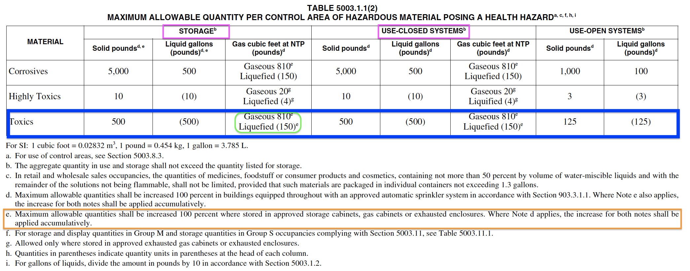
IFC Chapter 50: Hazardous Materials-
SECTION 5003, GENERAL REQUIREMENTS
The MAQ of 810 cubic feet for corrosive and toxic gases established in the table is based on a single 150-pound cylinder of chlorine

Slide 17
IFC Chapter 50: Hazardous Materials-
SECTION 5003, GENERAL REQUIREMENTS
The MAQ of 810 cubic feet for corrosive and TOXIC GASES established in table 5003.1.1(2) is based on a single 150-pound cylinder of chlorine
Cl₂ = 5.38 cubic ft/pound
150 pounds of Cl₂ is 807 cubic feet

Slide 18
IFC Chapter 50: Hazardous Materials-
SECTION 5003, GENERAL REQUIREMENTS
5003.1.3 Quantities NOT EXCEEDING the MAQ
  The storage, use and handling of hazardous materials in quantities NOT exceeding their MAQ shall be in accordance with Sections 5001 and 5003.
5003.1.4 Quantities EXCEEDING the MAQ
  The storage, use and handling of hazardous materials in quantities EXCEEDING the MAQ shall be in accordance with this chapter.

Slide 19
IFC Chapter 50: Hazardous Materials-
SECTION 5003, GENERAL REQUIREMENTS
5003.8.4 Gas rooms
  Where a GAS ROOM is used to INCREASE the MAQ or provided to comply with the provisions of Chapter 60 - HIGHLY TOXIC AND TOXIC MATERIALS, the gas room shall be in accordance with Sections 5003.8.4.1 and 5003.8.4.2.
Gas Room - A separately ventilated, fully enclosed room in which only compressed gases and associated equipment and supplies are stored or used.

Slide 20
IFC Chapter 50: Hazardous Materials-
SECTION 5003, GENERAL REQUIREMENTS
5003.8.4.1 Construction…
5003.8.4.2 Ventilation system
  The ventilation system for gas rooms shall be designed to operate at a NEGATIVE PRESSURE in relation to the surrounding area.
  Highly toxic and TOXIC GASES shall also comply with Section 6004.2.2.6.
  The ventilation system shall be installed in accordance with the International Mechanical Code.

Slide 21
IFC Chapter 50: Hazardous Materials-
SECTION 5003, GENERAL REQUIREMENTS
6004.2.2.6 Gas rooms
  Gas rooms shall comply with Section 5003.8.4 and both of the following requirements:
    The exhaust ventilation from gas rooms shall be directed to an EXHAUST SYSTEM.
    Gas rooms shall be equipped with an approved automatic sprinkler system. Alternative fire-extinguishing systems shall not be used.
EXHAUST SYSTEM - An assembly of connected ducts, plenums, fittings, registers, grilles and hoods through which air is conducted from the space or spaces and exhausted to the outdoor atmosphere.

Slide 22
IFC Chapter 50: Hazardous Materials-
SECTION 5003, GENERAL REQUIREMENTS
5003.8.5 Exhausted enclosures
  Where an EXHAUSTED ENCLOSURE is used to INCREASE MAQ or where the location of hazardous materials in exhausted enclosures is provided to comply with the provisions of Chapter 60 - HIGHLY TOXIC AND TOXIC MATERIALS, the exhausted enclosure shall be in accordance with Sections 5003.8.5.1 through 5003.8.5.3.
EXHAUSTED ENCLOSURE - An appliance or piece of equipment which consists of a top, a back and two sides providing a means of local exhaust for capturing gases, fumes, vapors and mists. Such enclosures include laboratory hoods, exhaust fume hoods and similar appliances and equipment used to retain and exhaust locally the gases, fumes, vapors and mists that could be released. Rooms or areas provided with general ventilation, in themselves, are NOT exhausted enclosures.

Slide 23
IFC Chapter 50: Hazardous Materials-
SECTION 5003, GENERAL REQUIREMENTS
5003.8.5.1 Construction…
5003.8.5.2 Ventilation
EXHAUSTED ENCLOSURES shall be provided with an EXHAUST VENTILATION system.
The ventilation system for EXHAUSTED ENCLOSURES shall be designed to operate at a NEGATIVE PRESSURE in relation to the surrounding area.
Ventilation systems used for highly toxic and TOXIC GASES shall also comply with Items 1, 2 and 3 of Section 6004.1.3.
The ventilation system shall be installed in accordance with the IMC.

Slide 24
IFC Chapter 60:
HIGHLY TOXIC AND TOXIC MATERIALS
6004.1.3 Exhausted enclosures
Exhausted enclosures containing highly toxic or TOXIC COMPRESSED GASES shall comply with Section 5003.8.5 and the following requirements:
  The average ventilation velocity at the face of the enclosure shall be NOT LESS THAN 200 feet per minute with NOT LESS THAN 150 feet per minute
  Exhausted enclosures shall be connected to an exhaust system
  Exhausted enclosures shall NOT be used as the sole means of exhaust for any room or area

Slide 25
IFC Chapter 50: Hazardous Materials-
SECTION 5003, GENERAL REQUIREMENTS
5003.8.6 Gas cabinets
  Where a GAS CABINET is used to increase the MAQ or where the location of compressed gases in gas cabinets is provided to comply with the provisions of Chapter 60- HIGHLY TOXIC AND TOXIC MATERIALS, the gas cabinet shall be in accordance with Sections 5003.8.6.1 through 5003.8.6.3.

Slide 26
IFC Chapter 50: Hazardous Materials-
SECTION 5003, GENERAL REQUIREMENTS
5003.8.6 Gas cabinets
  5003.8.6.1 Construction…
  5003.8.6.2 Ventilation
    Gas cabinets shall be provided with an exhaust ventilation system.
    The ventilation system for gas cabinets shall be designed to operate at a negative pressure in relation to the surrounding area.
    Ventilation systems used for highly toxic and TOXIC GASES shall also comply with Items 1, 2 and 3 of Section 6004.1.2.
    The ventilation system shall be installed in accordance with the IMC.

Slide 27
IFC Chapter 60:
HIGHLY TOXIC AND TOXIC MATERIALS
6004.1.2 Gas cabinets
  Gas cabinets containing highly toxic or TOXIC COMPRESSED GASES shall comply with Section 5003.8.6 and the following requirements:
    The average ventilation velocity at the face of gas cabinet access ports or windows shall be not less than 200 feet per minute (1.02 m/s) with NOT LESS THAN 150 feet per minute (0.76 m/s) at any point of the access port or window
    Gas cabinets shall be connected to an EXHAUST SYSTEM
    Gas cabinets shall not be used as the sole means of exhaust for any room or area

Slide 28
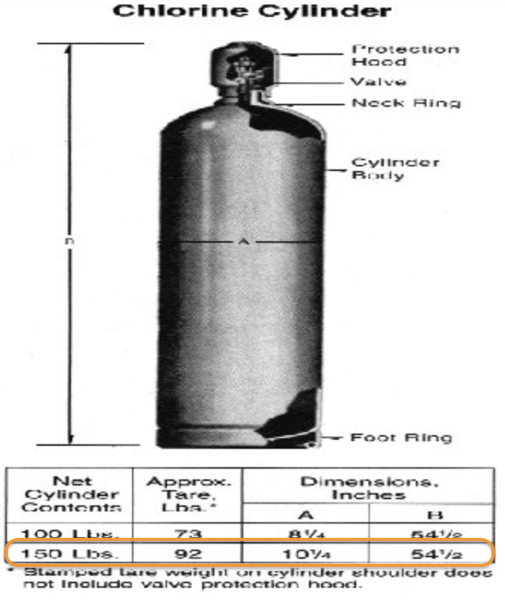
IFC Chapter 50: Hazardous Materials-
SECTION 5004, STORAGE
5004.1 Scope
  Storage of hazardous materials in amounts EXCEEDING the MAQ shall be in accordance with Sections 5001, 5003 and 5004.
  Storage of hazardous materials in amounts NOT EXCEEDING the MAQ shall be in accordance with Sections 5001 and 5003.
Remember… The MAQ for Cl₂ is 810 cubic ft, which is one (1) 150-pound cylinder.

Slide 29
IFC Chapter 50: Hazardous Materials-
SECTION 5004, STORAGE
5004.3 Ventilation
  INDOOR STORAGE AREAS and STORAGE BUILDINGS shall be provided with MECHANICAL EXHAUST VENTILATION (or natural ventilation where natural ventilation can be shown to be acceptable for the materials as stored)

Slide 30
IFC Chapter 50: Hazardous Materials-
SECTION 5004, STORAGE
5004.3.1 System requirements
EXHAUST VENTILATION systems shall comply with ALL the following:
Installation shall be in accordance with the IMC.
Ventilation shall be at a rate of NOT LESS THAN 1 cubic foot per minute per square foot of floor area
Systems shall operate continuously unless alternative designs are approved.
A manual shutoff control shall be provided outside of the room in a position adjacent to the access door to the room or in an approved location. The switch shall be a break-glass or other approved type and shall be labeled: VENTILATION SYSTEM EMERGENCY SHUTOFF.
Exhaust ventilation shall be designed to consider the density of the potential fumes or vapors released.
  fumes or vapors heavier than air, exhaust shall be taken from a point within 12” of the floor
  fumes or vapors lighter than air, exhaust shall be taken within 12” of the highest point of the room
The location of BOTH the exhaust and inlet air openings shall be designed to provide air movement across ALL PORTIONS OF THE FLOOR OR ROOM to prevent the accumulation of vapors
Exhaust air shall not be recirculated to occupied

Slide 31
IFC Chapter 50: Hazardous Materials-
SECTION 5005 USE, DISPENSING AND HANDLING
5005.1 General
  Use, dispensing, and handling of hazardous materials in amounts EXCEEDING the MAQ shall be in accordance with Sections 5001, 5003 and 5005.
  Use, dispensing, and handling of hazardous materials in amounts NOT EXCEEDING the MAQ shall be in accordance with Sections 5001 and 5003.
Remember… The MAQ for Cl₂ is 810 cubic ft, which is one (1) 150-pound cylinder.

Slide 32
IFC Chapter 50: Hazardous Materials-
SECTION 5005 USE, DISPENSING AND HANDLING
5005.1.9 Ventilation
  Indoor dispensing and use areas shall be provided with EXHAUST VENTILATION in accordance with Section 5004.3.

Slide 33
IFC Chapter 50: Hazardous Materials-
SECTION 5005 USE, DISPENSING AND HANDLING
5005.2.1.1 Ventilation
  Where gases, liquids or solids having a HAZARD RANKING OF 3 OR 4 in accordance with NFPA 704 are dispensed or used, MECHANICAL EXHAUST VENTILATION shall be provided to capture gases, fumes, mists or vapors AT THE POINT OF GENERATION.
5005.2.2.1 Ventilation
  Where CLOSED SYSTEMS are designed to be opened as part of normal operations, ventilation shall be provided in accordance with Section 5005.2.1.1.

Slide 34
IFC Chapter 60: SECTION 6004
HIGHLY TOXIC AND TOXIC COMPRESSED GASES
6004.1 General
  The storage and use of highly toxic and TOXIC COMPRESSED GASES shall comply with this section.
6004.1.3 Exhausted enclosures
  EXHAUSTED ENCLOSURES containing highly toxic or TOXIC COMPRESSED GASES shall comply with Section 5003.8.5 and the following requirements:
  The average ventilation velocity at the face of the enclosure shall be not less than 200 feet per minute with NOT LESS THAN 150 feet per minute.
  Exhausted enclosures shall be connected to an exhaust system.
  Exhausted enclosures shall not be used as the sole means of exhaust for any room or area.

Slide 35
IFC Chapter 60: SECTION 6004
HIGHLY TOXIC AND TOXIC COMPRESSED GASES
6004.2.1.1 Quantities NOT EXCEEDING the MAQ
  The INDOOR STORAGE OR USE of highly toxic and TOXIC GASES in amounts NOT EXCEEDING the MAQ shall be in accordance with Sections 5001, 5003, 6001 and 6004.1.
6004.2.1.2 Quantities EXCEEDING the MAQ
  The INDOOR STORAGE OR USE of highly toxic and TOXIC GASES in amounts EXCEEDING the MAQ shall be in accordance with Sections 6001, 6004.1, 6004.2 and Chapter 50.
Remember… The MAQ for Cl₂ is 810 cubic ft, which is one (1) 150-pound cylinder.

Slide 36
IFC Chapter 60: SECTION 6004
HIGHLY TOXIC AND TOXIC COMPRESSED GASES
6004.2.2.1 Cylinder and tank location
6004.2.2.2 Ventilated areas
The room or area in which GAS CABINETS or EXHAUSTED ENCLOSURES are located shall be provided with EXHAUST VENTILATION.
    Gas cabinets or exhausted enclosures shall not be used
    as the sole means of exhaust for any room or area.
CYLINDERS shall be located within: | PORTABLE and STATIONARY TANKS shall be located within:
GAS CABINETS | ------------------------
EXHAUSTED ENCLOSURES | EXHAUSTED ENCLOSURES
GAS ROOMS | GAS ROOMS

Slide 37
IFC Chapter 60: SECTION 6004
HIGHLY TOXIC AND TOXIC COMPRESSED GASES
6004.2.2.6 Gas rooms
  GAS ROOMS shall comply with Section 5003.8.4 and BOTH of the following requirements:
  The EXHAUST VENTILATION from gas rooms shall be directed to an EXHAUST SYSTEM.
  GAS ROOMS shall be equipped with an approved automatic sprinkler system. Alternative fire-extinguishing systems shall not be used.

Slide 38
IFC Chapter 60: SECTION 6004
HIGHLY TOXIC AND TOXIC COMPRESSED GASES
6004.2.2.7 Treatment systems
  The EXHAUST VENTILATION from gas cabinets, exhausted enclosures, and gas rooms, and local exhaust systems required in Sections 6004.2.2.4 and 6004.2.2.5 SHALL BE DIRECTED TO A TREATMENT SYSTEM.
  The treatment system shall be utilized to handle the accidental release of gas and to process exhaust ventilation.
  The treatment system shall be designed in accordance with Sections
  6004.2.2.7.1 through 6004.2.2.7.5 and Section 510 – Hazardous Exhaust Systems of the IMC.

Slide 39
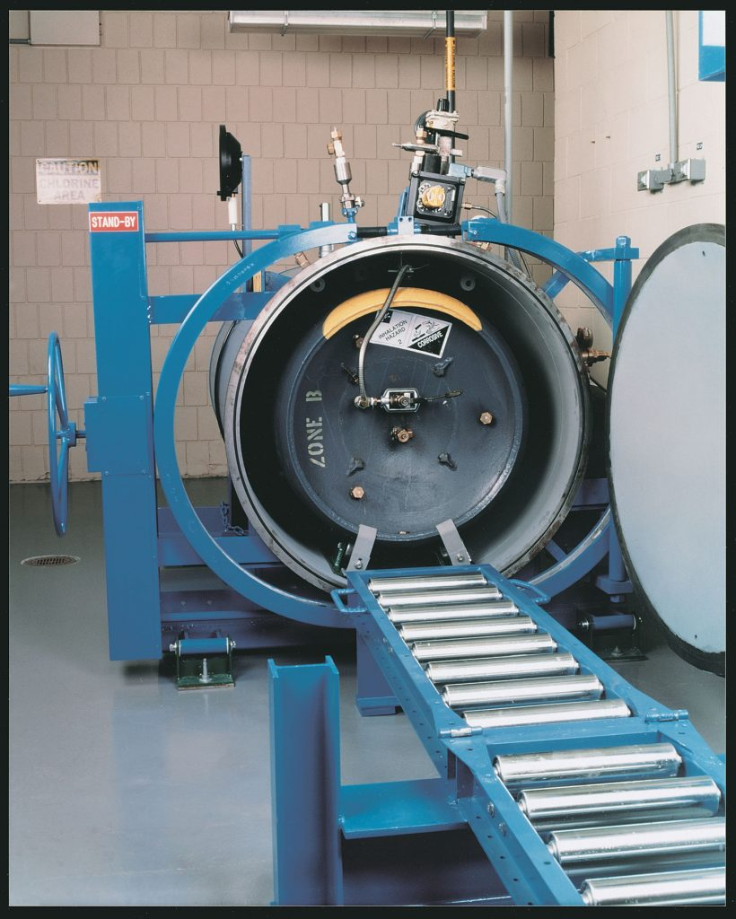
IFC Chapter 60: SECTION 6004
HIGHLY TOXIC AND TOXIC COMPRESSED GASES
Exceptions to treatment systems:
Highly toxic and TOXIC GASES—STORAGE
  A treatment system is NOT required for cylinders,
  containers and tanks in storage where ALL the
  following controls are provided:
  Valve outlets are equipped with gas-tight
  outlet plugs or caps
  Handwheel-operated valves have handles
  secured to prevent movement
  APPROVED CONTAINMENT VESSELS or
  containment systems are provided

Slide 40
IFC Chapter 60: SECTION 6004
HIGHLY TOXIC AND TOXIC COMPRESSED GASES
SECTION 6004 HIGHLY TOXIC AND TOXIC COMPRESSED GASES
Exceptions to treatment systems:
TOXIC GASES—USE
  Treatment systems are NOT required for TOXIC GASES supplied by CYLINDERS OR PORTABLE TANKS:
    NOT EXCEEDING 1,700 POUNDS WATER CAPACITY, AND
    where a GAS DETECTION SYSTEM complying with Section 6004.2.2.10, AND
    listed or approved AUTOMATIC-CLOSING FAIL-SAFE VALVES are provided.
  The gas detection system shall have a sensing interval not exceeding 5 minutes.
  AUTOMATIC-CLOSING FAIL-SAFE valves shall be located immediately adjacent to cylinder valves and shall close when gas is detected at the PEL by a gas sensor monitoring the exhaust system at the point of discharge from the gas cabinet, exhausted enclosure, ventilated enclosure, or gas room.
*A 1-ton Cl₂ container holds ~1,600 pounds of water

Slide 41
IFC Chapter 60: SECTION 6004
HIGHLY TOXIC AND TOXIC COMPRESSED GASES
SECTION 6004 HIGHLY TOXIC AND TOXIC COMPRESSED GASES
Exception 2 is for toxic gases supplied by cylinders limited to a size of 1,700 pounds water capacity. The 1,700-pound limit was derived as follows:
  A 1-ton Cl₂ container typically holds about 1,600 pounds of water, and a filling density of approximately 125% of the water capacity is allowed for chlorine [1,600 x 1.25 = 2,000 pounds]. The resulting weight of product in a filled container is one 1-ton for Cl₂. The maximum capacity of 1,700 pounds versus 1,600 pounds is intended to accommodate manufacturing variations that occur from one container to the next, but this does not affect the ultimate gas capacity of a filled container, which is limited to 2,000 pounds regardless of the variation in water capacity.
Source: 2018 IFC Code and Commentary
1,600 lbs X 125% (filling density) = 2,000 pounds
Cl₂ Container Dimensions and Weights¹
Capacity |  | 100 lb. | 150 lb. | 2,000 lb.
Volume of liquid Cl₂ (approximate at 60°F) | gal | 8.42 | 12.64 | 168.5
Tare Weight | lb. | 63-115 | 85-140 | 1,300-1,650
Outside Diameter | in. | 8.25-10.75 | 10.25-10.75 | 30
Cylinder Height | in. | 39.5 - 59* | 53 - 56*
Ton Container Length |  |  |  | 79.75 – 82.5
*Heights are to the top of the valve protection housing. The height to the center of the valve outlet is about 3.5 in. (89 mm) less.
1 – Source of data is CI Pamphlet 155

Slide 42
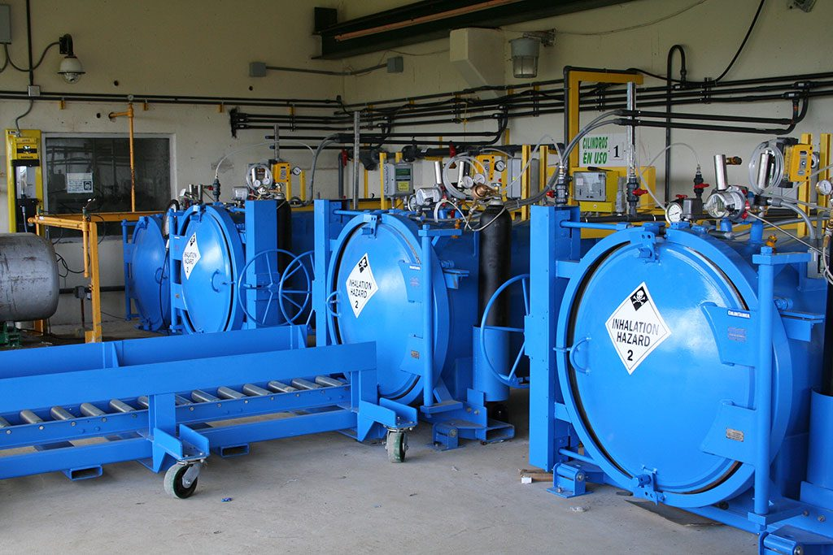
IFC Chapter 60: SECTION 6004
HIGHLY TOXIC AND TOXIC COMPRESSED GASES
6004.2.2.7.1 Design
  TREATMENT SYSTEMS shall be capable of diluting, adsorbing, absorbing, containing, neutralizing, burning or otherwise processing the contents of the LARGEST SINGLE VESSEL of COMPRESSED GAS.
  Where a TOTAL CONTAINMENT SYSTEM is
  used, the system shall be designed to handle
  the maximum anticipated pressure of release
  to the system when it reaches equilibrium.

Slide 43

IFC Chapter 60: SECTION 6004
HIGHLY TOXIC AND TOXIC COMPRESSED GASES
TOTAL CONTAINMENT SYSTEM

Slide 44
IFC Chapter 60: SECTION 6004
HIGHLY TOXIC AND TOXIC COMPRESSED GASES
6004.2.2.7.2 Performance
  TREATMENT SYSTEMS shall be designed to reduce the maximum allowable discharge concentrations of the gas to ½ of the IDLH at the point of discharge to the atmosphere.
  Where MORE THAN ONE GAS is emitted to the TREATMENT SYSTEM, the TREATMENT SYSTEM shall be designed to handle the WORST-CASE RELEASE based on:
    the RELEASE RATE,
    the QUANTITY, and
    the IDLH for all compressed gases stored or used
Cl₂ IDLH = 10 ppm, so the discharge of treatment MUST BE NO MORE THAN 5 ppm!

Slide 45
IFC Chapter 60: SECTION 6004
HIGHLY TOXIC AND TOXIC COMPRESSED GASES
6004.2.2.7.3 Sizing
  TREATMENT SYSTEMS shall be sized to process the MAXIMUM WORST-CASE RELEASE OF GAS based on the MAXIMUM FLOW RATE of release from the LARGEST VESSEL utilized.
  The ENTIRE CONTENTS of the largest compressed gas vessel shall be considered.

Slide 46
IFC Chapter 60: SECTION 6004
HIGHLY TOXIC AND TOXIC COMPRESSED GASES
6004.2.2.7.5 Portable tanks and cylinders
The MAXIMUM FLOW RATE OF RELEASE for portable tanks and cylinders shall be calculated based on the total release from the cylinder or tank WITHIN THE TIME specified in Table 6004.2.2.7.5.
Where portable tanks or cylinders are equipped with APPROVED EXCESS FLOW or REDUCED FLOW VALVES, the worst-case release shall be determined by the MAXIMUM ACHIEVABLE FLOW from the valve as determined by the valve manufacturer or compressed gas supplier.
  Reduced flow and excess flow valves shall be permanently marked by the valve manufacturer to indicate the maximum design flow rate.
  Such markings shall indicate the flow rate for air under normal temperature and pressure.

Slide 47
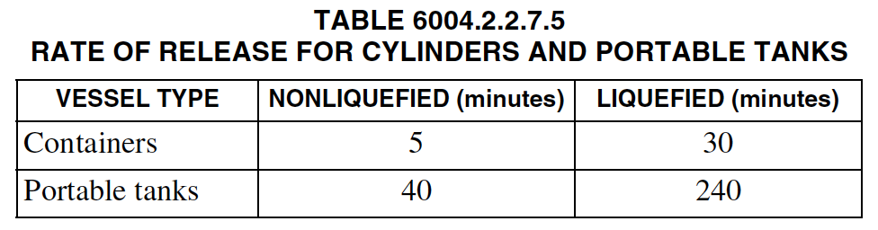
IFC Chapter 60: SECTION 6004
HIGHLY TOXIC AND TOXIC COMPRESSED GASES
COMPRESSED GAS CONTAINER - A pressure vessel designed to hold compressed gases at pressures greater than one atmosphere at 68°F (20°C) and includes cylinders, containers and tanks.
TANK, PORTABLE - A packaging of more than 60-gallon capacity and designed primarily to be loaded into or on or temporarily attached to a transport vehicle or ship and equipped with skids, mountings or accessories to facilitate handling of
the tank by mechanical means. It does NOT include any cylinder having less than a 1,000-pound water capacity,
CARGO TANK, TANK CAR TANK or TRAILERS carrying cylinders of more than 1,000-pound water capacity.

Slide 48
IFC Chapter 60: SECTION 6004
HIGHLY TOXIC AND TOXIC COMPRESSED GASES
6004.2.2.8 Emergency power
Emergency power shall be provided for the following systems in accordance with Section 604:
Exhaust ventilation system
Treatment system
Gas detection system
Smoke detection system
Temperature control system
Fire alarm system
Emergency alarm system
6004.2.2.8.1 Fail-safe engineered systems
Emergency power shall NOT be required for mechanical exhaust ventilation, treatment systems and temperature control systems where APPROVED FAIL-SAFE ENGINEERED SYSTEMS ARE INSTALLED.

Slide 49
IFC Chapter 60: SECTION 6004
HIGHLY TOXIC AND TOXIC COMPRESSED GASES
6004.2.2.10 Gas detection system
A gas detection system complying with Section 916 shall be provided to detect the presence of gas at or below the PEL or ceiling limit of the gas
for which detection is provided.
The system shall be capable of monitoring the DISCHARGE FROM THE TREATMENT SYSTEM at or below ½ the IDLH limit and SHALL INITIATE a response in accordance with Sections 6004.2.2.10.1 through 6004.2.2.10.3 if the gas detection alarm is activated.
EXCEPTION: A gas detection system is NOT required for toxic gases when the physiological warning threshold level for the gas is at a level below the accepted PEL for the gas.
½ IDLH of Cl₂ = 5 ppm
Cl₂ has an odor threshold lower than it’s TLV of 1.0 ppm; but this “exception” is NOT recommended!

Slide 50
IFC Chapter 60: SECTION 6004
HIGHLY TOXIC AND TOXIC COMPRESSED GASES
6004.2.2.10.1 Alarms
The gas detection system shall initiate a local alarm and transmit a signal to a CONSTANTLY ATTENDED control station when a short-term hazard condition is detected.
The alarm shall be BOTH AUDIBLE and VISIBLE and shall provide warning BOTH INSIDE and OUTSIDE the area where gas is detected.
The AUDIBLE ALARM shall be distinct from all other alarms.
Exception: Signal transmission to a constantly attended control station is NOT required where NOT more than one (1) cylinder of highly toxic or toxic gas is stored

Slide 51
IFC Chapter 60: SECTION 6004
HIGHLY TOXIC AND TOXIC COMPRESSED GASES
6004.2.2.10.2 Shut off of gas supply
The gas-detection system shall AUTOMATICALLY close the shutoff valve at the source on gas supply piping and tubing related to the system being monitored for whichever gas is detected.
Exception: Automatic shutdown is NOT required for reactors utilized for the production of highly toxic or toxic compressed gases where such reactors are:
  Operated at pressures less than 15 psig
  Constantly attended
  Provided with emergency shutoff valves that have ready access

Slide 52
IFC Chapter 60: SECTION 6004
HIGHLY TOXIC AND TOXIC COMPRESSED GASES
6004.2.2.10.3 Valve closure
Automatic closure of shutoff valves shall be in accordance with the following:
  Where the gas-detection sampling point initiating the gas detection system alarm is within a GAS CABINET or EXHAUSTED ENCLOSURE, the shutoff valve in the gas cabinet or exhausted enclosure for the specific gas detected shall automatically close.
  Where the gas-detection sampling point initiating the gas detection system alarm is within a GAS ROOM and compressed gas containers are NOT in gas cabinets or exhausted enclosures, the shutoff valves on all gas lines for the specific gas detected shall automatically close.
  Where the gas-detection sampling point initiating the gas detection system alarm is within a piping distribution manifold enclosure, the shutoff valve for the compressed container of specific gas detected supplying the manifold shall automatically close.
Exception: Where the gas-detection sampling point initiating the gas-detection system alarm is at a use location or within a gas valve enclosure of a branch line downstream of a piping distribution manifold, the shutoff valve in the gas valve enclosure for the branch line located in the piping distribution manifold enclosure shall
automatically close.

