Slide 1
Safety Engineering Series
PREVENT – PROTECT- MITIGATE
Swiss Cheese Model
Layers of Protection
Hierarchy of Hazard Control Measures

Slide 2
Anatomy of an Event
Training/
Licensing
Emergency Response
ERs/Trauma Centers
Roadway
Design
Design of
Vehicle
Seatbelts
Airbags
EMS/Life Flight
Traffic
Controls
Initiators
Road
Conditions
EVENT
Driver(s)
Distractions
CONSEQUENCE
Unsafe
Behaviors
Some vehicles may
Have Technology
PREVENTION
PROTECTION
MITIGATION

Slide 3
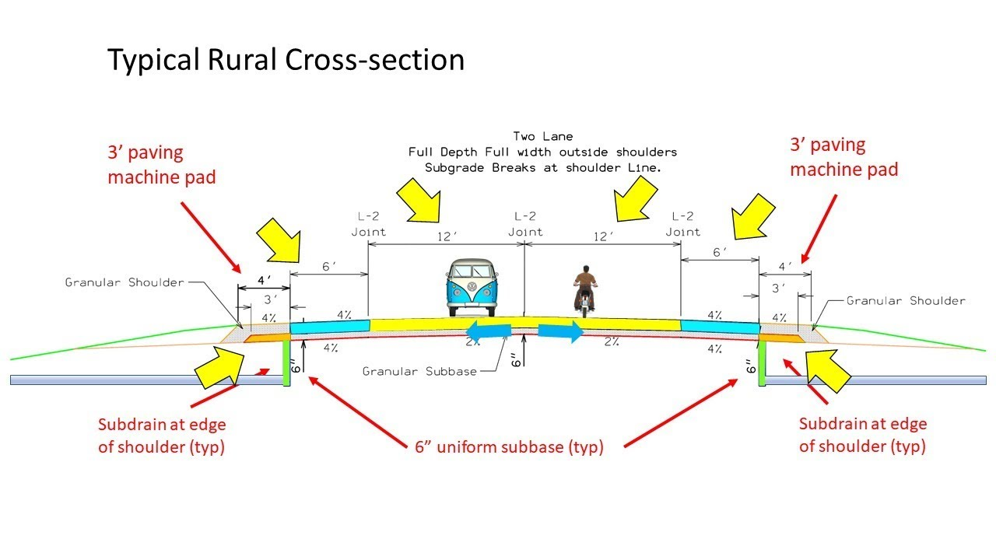
PREVENT
Measures that intend to lessen the likelihood an initiating event will occur
  Roadway Designs
  Traffic Controls (Lights/Signs)
  Driver Training/Licensing
  Safety Systems in vehicles
  Roadway Laws w/ Enforcement

Slide 4
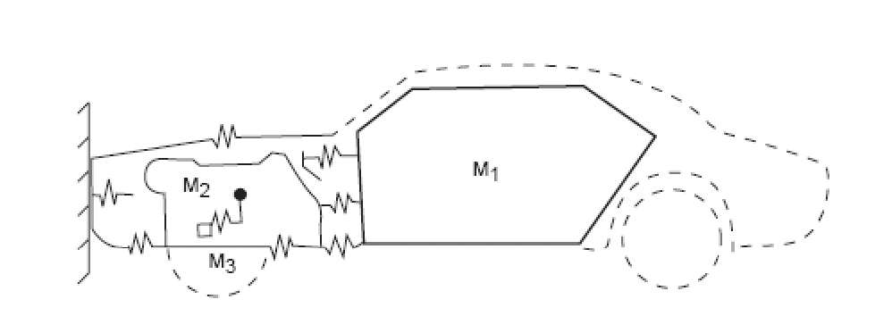
PROTECT
Measures that intend to PROTECT personnel and assets once the event sequence begins
  Design of Vehicle Structures for Crash Energy Management
  Crumple Zones
  Seatbelts
  Airbags and Deployment Thresholds

Slide 5
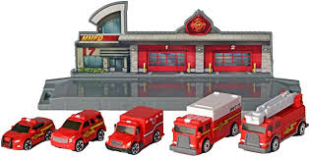
MITIGATE
Measures that intend to LESSEN the CONSEQUENCES to personnel and assets
  Emergency Response
    Personnel (Police/Rescue/EMS)
    Personnel Training
    Traffic Control @ scene
    Rescue and EMS Equipment
    Timely Response/Life Flights
    Trauma Centers/ERs

Slide 6
 | PREVENT |  | PROTECT |  | MITIGATE
 | Elimination |  | Elimination |  | Elimination
 | Substitution |  | Substitution |  | Substitution
 | Engineering Controls |  | Engineering Controls |  | Engineering Controls
 | Administrative Controls |  | Administrative Controls |  | Administrative Controls
 | Personal Protective Equipment |  | Personal Protective Equipment |  | Personal Protective Equipment

Slide 7
PREVENTION via Hierarchy of Hazard Control Measures
Hierarchy of Hazard Control Measures
 | HAZARD CONTROLS
 | ELIMINATION | REMOVE HAZARDS
 | Eliminate the hazard during design
 | SUBSTITUTION | REPLACE HAZARDS
 | Substitution of less hazardous equipment, system, or energy
 | ENGINEERING CONTROLS | ISOLATE HAZARDS
 | Design options that automatically reduce risks
 | EXPOSURE CONTROLS
 | WARNINGS | PROMOTE AWARENESS
 | Automatic or manual, permanent or temporary, visible or audible warning systems, signs, barriers, and labels
 | ADMINISTRATIVE CONTROLS | MANAGE BEHAVIORS
 | Planning Processes, training, work permits, safe work practices, maintenance systems, communications, and work management
 | Personal Protective Equipment | WEAR PROTECTION
 | Available, effective, easy to use

Slide 8
PROTECTION via Hierarchy of Hazard Control Measures
Hierarchy of Hazard Control Measures
 | HAZARD CONTROLS
 | ELIMINATION | REMOVE HAZARDS
 | Eliminate the hazard during design
 | SUBSTITUTION | REPLACE HAZARDS
 | Substitution of less hazardous equipment, system, or energy
 | ENGINEERING CONTROLS | ISOLATE HAZARDS
 | Design options that automatically reduce risks
 | EXPOSURE CONTROLS
 | WARNINGS | PROMOTE AWARENESS
 | Automatic or manual, permanent or temporary, visible or audible warning systems, signs, barriers, and labels
 | ADMINISTRATIVE CONTROLS | MANAGE BEHAVIORS
 | Planning Processes, training, work permits, safe work practices, maintenance systems, communications, and work management
 | Personal Protective Equipment | WEAR PROTECTION
 | Available, effective, easy to use

Slide 9
MITIGATION via Hierarchy of Hazard Control Measures
Hierarchy of Hazard Control Measures
 | HAZARD CONTROLS
 | ELIMINATION | REMOVE HAZARDS
 | Eliminate the hazard during design
 | SUBSTITUTION | REPLACE HAZARDS
 | Substitution of less hazardous equipment, system, or energy
 | ENGINEERING CONTROLS | ISOLATE HAZARDS
 | Design options that automatically reduce risks
 | EXPOSURE CONTROLS
 | WARNINGS | PROMOTE AWARENESS
 | Automatic or manual, permanent or temporary, visible or audible warning systems, signs, barriers, and labels
 | ADMINISTRATIVE CONTROLS | MANAGE BEHAVIORS
 | Planning Processes, training, work permits, safe work practices, maintenance systems, communications, and work management
 | Personal Protective Equipment | WEAR PROTECTION
 | Available, effective, easy to use

Slide 10
Independence of Protection Layers
An Independent Layer of Protection is a system, action, or an item that mitigates the risk associated with a hazardous scenario.
All Independent Layers of Protection are safeguards,
but NOT all safeguards are Independent Layers of Protection!
By default, the following criteria are required to be TRUE for a safeguard to be considered as an Independent Protection Layer (IPL):
  safeguard must be independent of the initiating event such that a failure associated with the risk will not cause the safeguard to fail
  safeguard must be testable and verifiable (e.g., a risk-based inspection)
  safeguard must be specific in detecting a potential hazard and taking action to prevent the hazard from occurring
  The safeguard must be capable and available at least 90% of the time

