Slide 1
Quantifying Risk
(Risk = L X S)
Intro to Risk Matrix

Slide 2
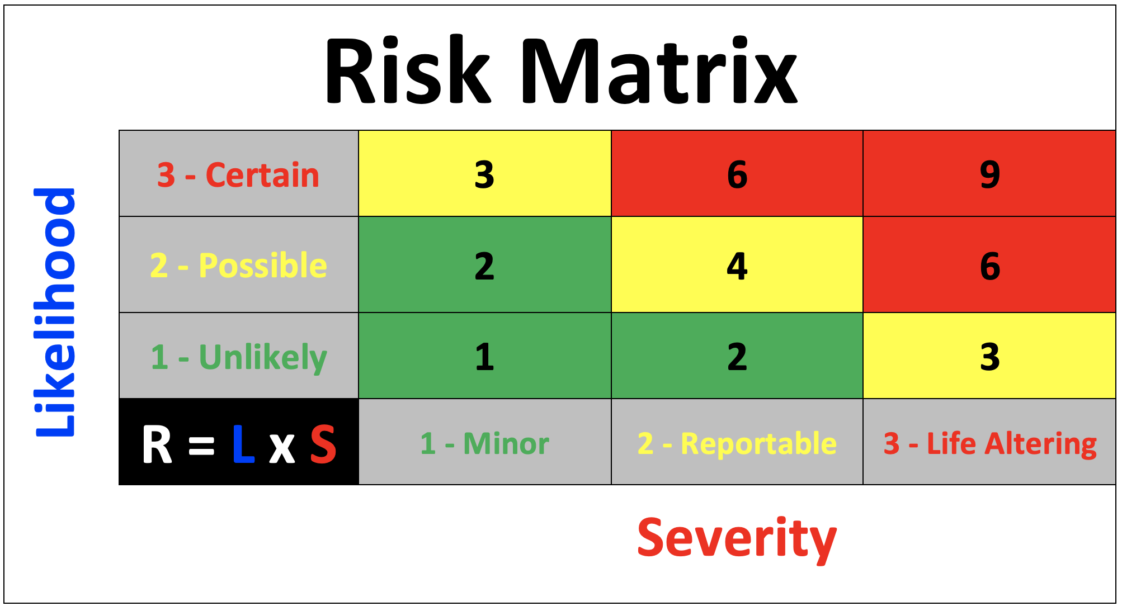
What is a Risk Matrix?
A RISK MATRIX is a matrix that is used during risk assessment to define the level of risk by considering the category of LIKELIHOOD against the category of consequence SEVERITY.

Slide 3
Why use a Risk Matrix?
Organizations may use a different list of categories, letters, colors, or numbers for severity, likelihood, risk assessment codes, etc.
The purpose and concepts are intended to produce the same results in that we are attempting to semi-quantify risks from the lowest risk to highest risk
Each HAZARD that gets identified, a team will determine the associated degree of risk in terms of LIKELIHOOD and SEVERITY
The result of the risk assessment is a PRIORITIZED LIST OF HAZARDS, which ensures that controls are first identified for the most serious threat to worker safety

Slide 4
Likelihood
This is an assessment of the LIKELIHOOD that a POTENTIAL CONSEQUENCE may occur as a result of a hazard.
In our UP-Risk Matrix, LIKELIHOOD categories are assigned to the following criteria:
1 - Unlikely
2 - Possible
3 - Certain

Slide 5
Severity
This is an assessment of the POTENTIAL CONSEQUENCE that can occur as a result of a hazard and is defined by the degree of injury, illness, property damage, loss of assets (time, money, personnel), or effect on the mission or task.
Consideration must be given to exposure potential.
In our UP-Risk Matrix, SEVERITY categories are assigned to the following criteria:
1 - Minor
2- Reportable
3- Life-Altering

Slide 7


RISK Matrix (9-Block)
Crossing the Road
Scenario #1 – LOW Likelihood and LOW Severity = LOW RISK
One bike rider traveling at 10 mph passes by every 10 minutes – LOW LIKELIHOOD of an incident
Injury from a collision with bike traveling 10 mph would be – LOW SEVERITY (comparable to truck)

Slide 8
RISK Matrix (9-Block)
Crossing the Road
Scenario #2 – HIGH Likelihood and LOW Severity = MODERATE RISK
Multiple bike riders, traveling at 10 mph pass by every minute – HIGH LIKELIHOOD of an incident
Injury from a collision with bike traveling 10 mph would be – LOW SEVERITY (comparable to truck)

Slide 9

RISK Matrix (9-Block)
Crossing the Road
Scenario #3 – LOW Likelihood and HIGH Severity = MODERATE Risk
One 66,000 pounds Cement Truck traveling at 45 mph passes by every 10 minutes – LOW LIKELIHOOD of an incident
Injury from a collision with 66,000 pounds Cement Truck traveling at 45 mph would be – HIGH SEVERITY

Slide 10
RISK Matrix (9-Block)
Crossing the Road
Scenario #4 – HIGH Likelihood and HIGH Severity = HIGH Risk
Multiple 66,000 pounds Cement Trucks traveling at 45 mph pass by every minute – HIGH LIKELIHOOD of an incident
Injury from a collision with 66,000 pounds Cement Truck traveling at 45 mph would be – HIGH SEVERITY

Slide 11
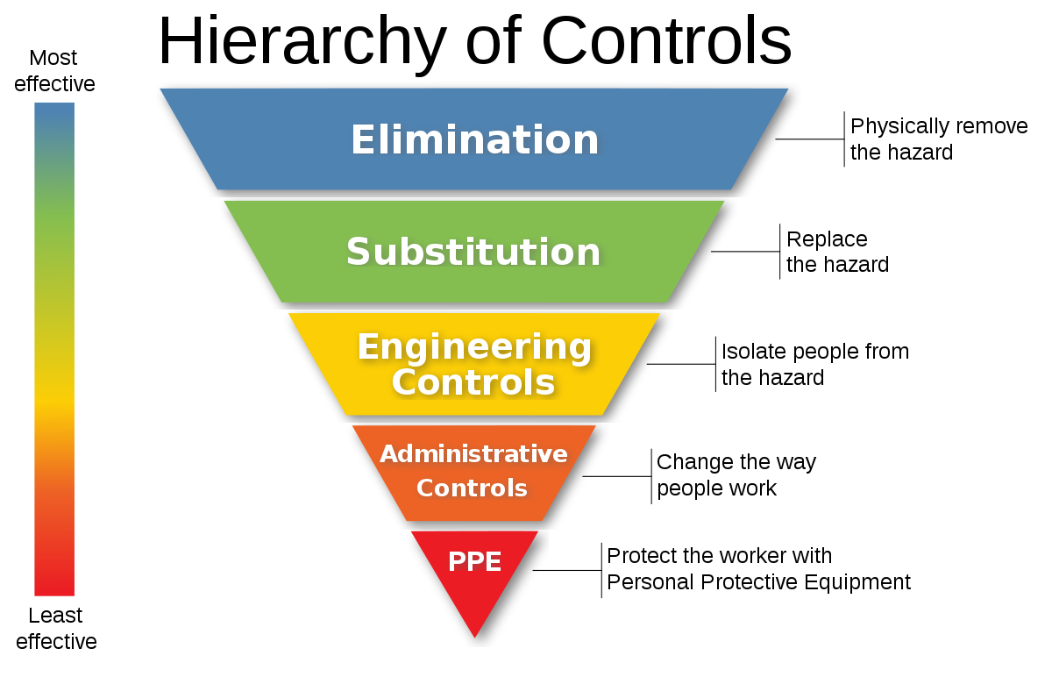



RISK Matrix (9-Block)
Crossing the Road – LIKELIHOOD REDUCED with:
ENGINEERING controls, and
ADMINISTRATIVE controls
35 MPH
Speed Limit REDUCED in the area
ENGINEERED Cross Walk with signage and environmental lighting
ENGINEERED Stop Signal(s) with Crossing control signals
Ability for pedestrian to activate safety system
Crossing indicators are SYMBOLS for all languages
Enforcement of law

Slide 12
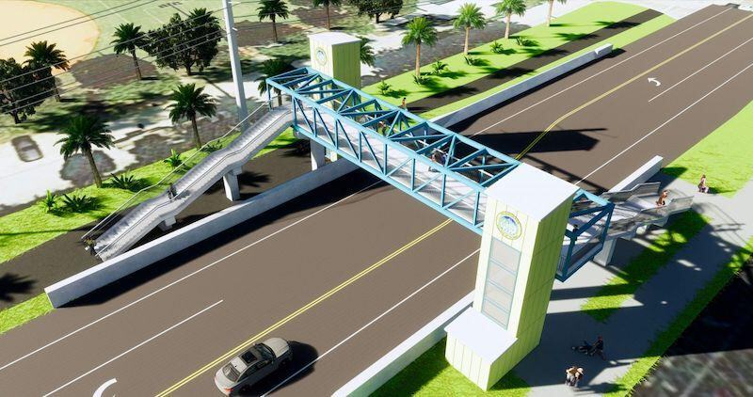
RISK Matrix (9-Block)
When RISKS can NOT be CONTROLLED within established tolerances, then we ELIMINATE or SUBSTITUTE to control the risks at ALL COSTS!

Slide 13
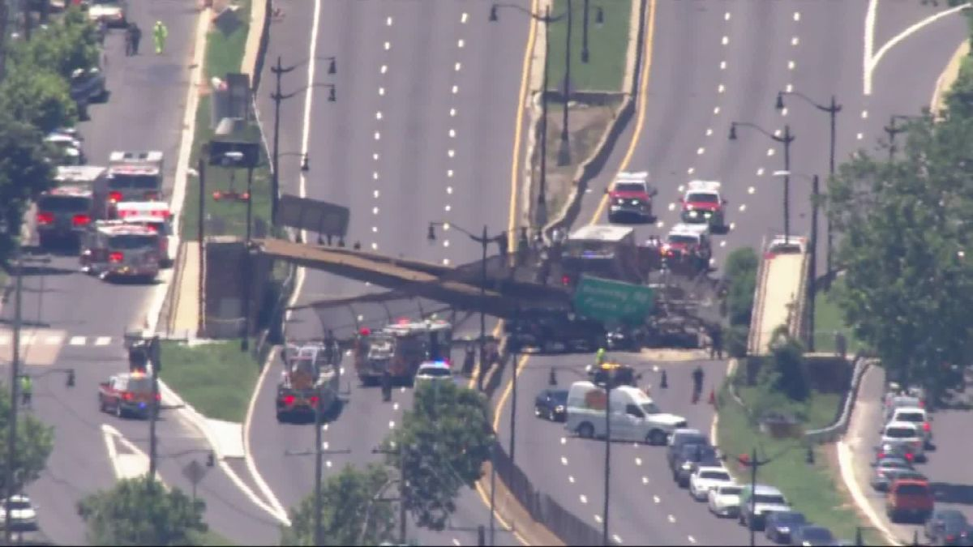
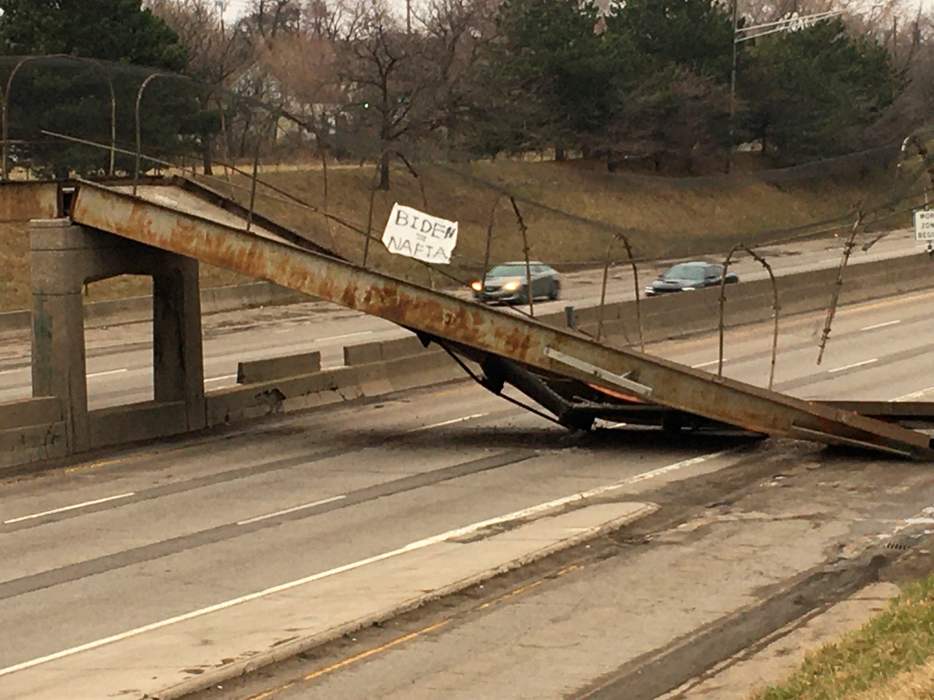
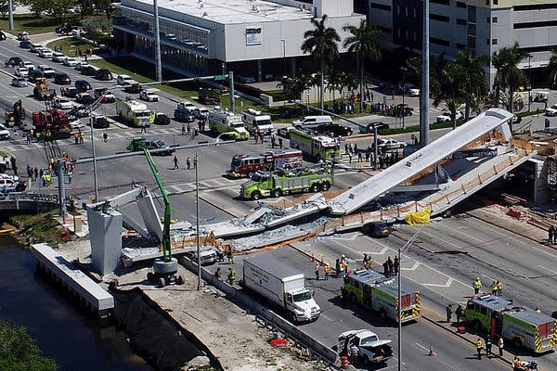
RISK IS EVERYWHERE!
But as we discussed earlier… RISK IS EVERYWHERE! Even with pedestrian bridges, Design, Construction, Operations, and Maintenance play a VITAL role in our success of controlling the risk of simply crossing a road
June 2021 - A pedestrian bridge that likely was struck by at least one vehicle collapsed onto Interstate 295 in Washington, DC, injuring several people and blocking the highway in both directions, officials said Wednesday.
March 2020 - A section of the Townsend Pedestrian Bridge in Detroit collapsed early Friday morning across the westbound lanes of I-94 in Detroit.
March 2018 - The N.T.S.B. blamed engineers for a faulty design — and the state for poor oversight — in the collapse of a new pedestrian bridge that killed six.

Slide 14

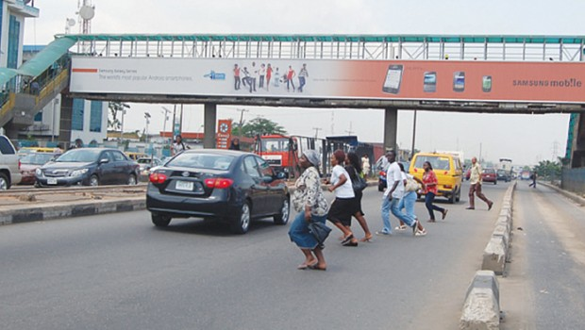
Behavioral aspects to controlling risks
NEVER think this is a baseball game…
just because we build this $12,000,000 ped-bridge, does not mean everyone will use it!

