Slide 1

Safety Management System (SMS)

Slide 2

SMS Approach
Provide a set of organizational values, management principles and safety philosophies that address the specialized needs of the org to operate safely
Assist the organization to achieve the desired safety objectives by providing choices for optimizing their resources for positive outcomes
Use a
Risk-based approach
Implement a rigorous performance measurement system for ongoing assessment of the effectiveness of managing safety risks
Establish and maintain a positive safety culture that involves all participants
Promote sustainability of safety through continuous improvement

Slide 3
Definition of SMS
The term “Safety Management System” has many definitions as does “Safety Culture”
A good definition of SMS is:
“An organized set of programs, principles, processes and procedures for the allocation of resources to achieve the condition where safety risks are managed to acceptable levels”
“Acceptable Levels” is reflective of UP’s Risk Tolerances

Slide 4

Definition of Safety,
Management, & System
Safety, Management, and System are defined as follows:
Safety - condition to which risks of harm arising out operations are managed to acceptable levels
Management - the allocation of resources to achieve specific goals (leading/directing, planning, organizing, improving, performance measurement)
System - organized set of programs, processes and procedures used to deliver services

Slide 5
Intent of a SMS
The intent of a SMS is to assist the organization in achieving their desired safety objectives by providing them choices on how to achieve that outcome
This methodology is known as a performance-based approach
The goal should not be to only meet the minimum regulatory requirements
SMS should embody safety as a core value, where safety management is critical to the overall business performance
Following a SMS approach provides the tools and methods necessary to achieve a more PROACTIVE AND PREDICTIVE approach to safety and risk management, addressing risks at their source

Slide 6
Components of a SMS
A SMS defines the safety culture (framework) of the organization and includes:
  Senior leadership commitment,
  Front-line engagement,
  Management accountability and
  Continual safety process improvements derived from data-driven risk assessment

Slide 7
The Four Pillars of an SMS
SMS Policies & Procedures
Policies and Objectives
Risk
Management
Hazard Identification
Safety Promotion
Safety Culture
Safety Assurance
Reviews & Audits
Risk Assessment
Risk Mitigation
Risk Analysis
Safety Education and Training
Risk Communication and Awareness
Incident Investigations
Near-Miss Reporting
Data Collection & Analysis
Change Management
Organizational Structure
Roles and Responsibilities
SMS Processes

Slide 8
Specific Principles & Criteria for developing a SMS
The Role of Safety Management Policy Within the SMS
The Safety Management Policy Statement is of primary importance
It should declare the intention of the organization to safeguard the safety of employees, customers, and contractors/suppliers
The policy sets out the safety culture expected in the organization by establishing the commitment of senior management to incorporate and continue to improve safety in all of the organization’s activities and provide meaningful opportunities for employees to be engaged in the safety effort
The policy should reflect the mission, vision and values of safety within the organization
The policy should also state the authority under which it is issued and establish a method of accountability within the organization for those tasked with responsibility to implement the plan

Slide 9
Specific Principles & Criteria for developing a SMS
The Role of Safety Management Policy Within the SMS
The policy should be signed by chief executive and/or the Board of Directors and should include the following:
  Safety is a CORE VALUE and a vital business component
  Commitment to continuous improvement
  Statement about providing resources for managing safety
  Comply with applicable federal, state and local safety regulations
  Be documented, implemented, and maintained
  Be communicated to all employees with the intent that employees are made aware of their safety obligations
  Commitment to an employee safety reporting system
  Encouragement for employee reporting of safety concerns, including conditions under which exemptions from disciplinary actions are applicable
  Definition of unacceptable operational behaviors
  Commitment to a risk-based approach to managing safety
  Be reviewed periodically to ensure that it remains relevant and appropriate to the organization

Slide 10
Specific Principles & Criteria for developing a SMS
The subcomponents of Pillar 1 Safety Management Policy are:
  Safety Management Policy Statement
  Safety Accountabilities and Responsibilities
  Integration with Public Safety and Emergency Management
  SMS Documentation and Records

Slide 11
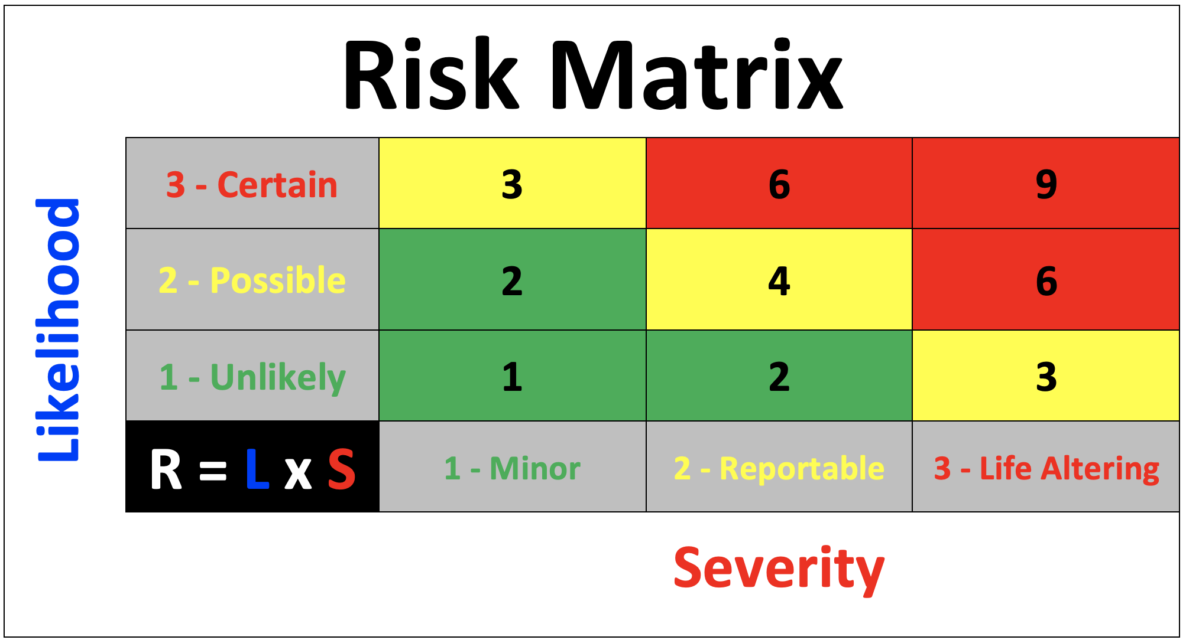
Specific Principles & criteria for developing a SMS
The Role of Risk Management in the SMS
Risk Management is a SYSTEM of:
  Hazard Identification and Evaluation,
  Management to control hazards to an acceptable level of risk, and
  Evaluation of the results
Hazards are defined as a condition, act, process or operation that has the potential to cause harm or danger or damage
The subcomponents of Safety Risk Management are:
  Hazard Identification and
  Risk Evaluation/Quantification

Slide 12
Specific Principles & Criteria for developing a SMS
The Risk Management Process is a core element within the SMS
Steps within the Risk Management Process include:
Hazard Identification- identification of as many credible hazards that may result in harm or damage to the operating system
Risk Estimation- likelihood and consequences of various risk scenarios
Risk Evaluation- ranking of the risk in terms of acceptability
Risk Control- options for mitigating the risk are considered, including feasibility
Risk Mitigation- plan for placing risk control measures into action, including documentation of the process
Risk Monitoring- evaluation of the effectiveness of the risk decision and control measures over time
SMS Policies & Procedures
Risk
Management
Safety Promotion
Safety Assurance

Slide 13
Specific Principles & Criteria for developing a SMS
The Role of Risk Management in the SMS
The organization should allow a broad range of methods for IDENTIFYING and ASSESSING hazards including:
  Formal Hazard Analysis (FMEA, LOPA, What-If, Fault-Tree, etc.)
  Informal Analysis (JHA/JSA, Hazard Assessment by Checklist, etc.)
It is important to note that safety does NOT mean the elimination of all risks!
  For example, a railroad that has at-grade highway-rail or pedestrian grade crossings can never eliminate the risk at those crossings
However, using the Risk Management Process, the hazards to persons or equipment can be minimized to an acceptable level by use of various types of engineering controls and signage

Slide 14
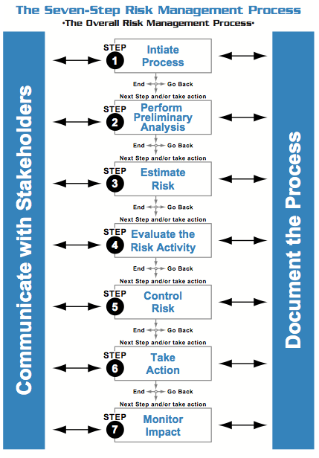
Specific Principles & Criteria for developing a SMS

Slide 15
Specific Principles & Criteria for developing a SMS
The Role of Safety Assurance in the SMS
Safety assurance determines how well the SMS is meeting the organization’s expectations
It consists of a series of processes and activities that monitor the internal processes as well as its operating environment to detect changes or deviations that can affect risk mitigations or cause additional risks
Safety Assurance includes:
auditing,
analysis,
document reviews, and
evaluations
to make sure that safety performance criteria are met and that risk controls are effective

Slide 16
Specific Principles & Criteria for developing a SMS
The Role of Safety Assurance in the SMS
The subcomponents of Safety Assurance are:
  Safety Performance Monitoring and Measurement
  Measurement of Change
  Continuous Improvement
Safety Assurance includes the following activities:
Developing performance metrics/goals
Conducting safety assessments/audits

Slide 17
Specific Principles & Criteria for developing a SMS
The Role of Safety Assurance in the SMS
Safety assessments include safety studies, safety surveys, investigations, peer reviews and safety audits
  Safety Studies are analyses that are conducted to gain an understanding of broad safety issues
  Safety Surveys use questionnaires, interviews, and checklists to provide qualitative information
  Investigations are conducted for certain incidents such as when serious accidents occur
  Peer Reviews are conducted by highly experienced personnel who conduct on-site interviews and review documents to provide observations and recommendations
  Safety Audits evaluate conformance to established plans and procedures, oftentimes associated with regulatory compliance

Slide 18
Specific Principles & Criteria for developing a SMS
The Role of Safety Promotion in the SMS
Safety promotion does not refer to awards, incentives or slogans
Safety promotion has the wider meaning of how the safety concepts, philosophy and culture of the organization are integrated into the way business is conducted in a visible, purposeful and proactive manner
Implementation of safety goals and objectives through programmatic controls with identified performance targets can be shown to promote a positive safety culture

Slide 19
Specific Principles & Criteria for developing a SMS
The Role of Safety Promotion in the SMS
The subcomponents of Safety Promotion are:
Safety Communication
Competencies and Training
There are several important concepts included in safety promotion that drive the level of effectiveness:
Safety Training
Safety Communication
Safety Vigilance

Slide 20
Specific Principles & Criteria for developing a SMS
The Role of Safety Promotion in the SMS
Effective, proactive identification and management of risks depends on communicating organization wide commitment, beginning with training from senior leadership to the front-line worker to:
  Identify risks,
  Then be alert to take action against those risks, and
  Then to circle back through multiple communication channels to initiate review and update the plan and controls

Slide 21
Specific Principles & Criteria for developing a SMS
The Role of Safety Promotion in the SMS
Here are the types of training courses that will be required:
SMS approach;
Operational Safety;
Emergency Management;
Safety; and
SMS tools

Slide 22
Specific Principles & Criteria for developing a SMS
SMS Approach
SMS Policies and Objectives
SMS Roles and Responsibilities
Operational Safety
Situational Awareness
Emergency Management
NIMS
Crisis Management
SMS Processes
Safety Culture
Performance Management
Fitness for Duty
Work Zone Safety
Incident Reporting
Emergency Response Plans & Procedures
SMS Tools
Hazard ID
Risk Assessment
Incident Investigation
Corrective Action Plans
Safety Audits
Mitigation Plans

Slide 23

Specific Principles & Criteria for developing a SMS
The Role of Safety Promotion in the SMS
Safety Vigilance
Crucial to the success of the SMS, is the establishment of a positive safety culture and an environment conducive to achievement of the organization’s safety objectives, is the ability of an organization to retain a healthy respect for, and be wary of, hazards that could develop into risks
It is especially important for employees to be knowledgeable about risks that are considered accident PRECURSORS and be enabled to report or act on these hazards
Being watchful and maintaining a vigilant attitude are characteristics of a positive safety culture and affect the values, attitudes and behaviors of all employees
These activities support the higher reliability of the safety effort to become sustainable over the long term

Slide 24

Specific Principles & Criteria for developing a SMS
SMS Implementation Phases
The implementation of a SMS is normally a multi-year process
Many organizations use a phased approach to SMS implementation
One method of phased implementation (extracted from Safety Management Guide, International Civil Aviation Organization, 2012) is to use four (4) phases related to time and resources:
  Phase I occurs in the first 12 months
  Phase II occurs in the second 12 months
  Phase III occurs 12 months from Phase II
  Phase IV occurs 12 months from Phase III

Slide 25

Specific Principles & Criteria for developing a SMS
SMS Implementation Phases Activities
Phase I
Establish the SMS implementation team
Identify the SMS accountable executive
Define the scope of the SMS
Perform an analysis to understand how the existing safety processes compare to SMS requirements
Develop an SMS Implementation Plan
Establish a key person responsible for administration and maintenance of the SMS
Establish SMS training program for personnel
Initiate SMS communication channels

Slide 26
Specific Principles & Criteria for developing a SMS
SMS Implementation Phases Activities
Phase II
Establish safety policy and objectives
Define safety management responsibilities and accountabilities within the organization
Establish SMS coordination committee
Establish emergency response plan
Initiate progressive development of SMS documentation

Slide 27
Specific Principles & Criteria for developing a SMS
SMS Implementation Phases Activities
Phase III
Establish voluntary hazards reporting
Establish risk management procedure
Establish incident reporting and investigation
procedure
Establish safety data collection and processing system
Develop high consequence safety performance indicators, identify accident precursors and associated targets and alert settings
Establish management of change procedure that includes risk assessment
Establish internal review program
Establish external review program

Slide 28
Specific Principles & Criteria for developing a SMS
SMS Implementation Phases Activities
Phase IV
Enhance existing disciplinary procedure/policy with consideration of unintentional errors/mistakes form deliberate/gross violations
Integrate Hazards ID from investigation reports with the voluntary hazard reporting procedure
Integrate Hazard ID and risk management procedures with contractors where applicable
Develop lower consequence safety performance indicators and associated targets and alerts
Establish or integrate SMS information into existing internal and external review programs
Establish operational and safety culture review/survey programs where appropriate
Ensure SMS training program for all relevant personnel is ongoing and relevant
Promote safety information sharing and exchange internally and externally

Slide 29
Evaluation of the SMS
Employees assess their supervisor’s concern about safety
Employees are regularly surveyed regarding their perspective on the safety climate
A joint union-management committee identifies and resolves safety issues
Supervisors’ safety attitudes are assessed, and corrective actions taken
Front-line supervisors have performance measures associated with safety responsibilities

Slide 30
Evaluation of the SMS
Supervisors conduct safety inspections and monitor the work that employees are doing
There is a process for the signing of safety briefing sheets
Front-line employees are involved in developing safety policies and procedures (hazard analysis)
Front-line employees are empowered to restrict or stop operations based on unsafe conditions
Good faith challenge processes (safety dispute resolutions) are available to workers
There is interdepartmental involvement in developing safety policies and procedures (hazard analysis)
Involved departments conduct hazard analysis when new systems or changes are introduced
They use engineering solutions as the first method of solving problems (hierarchy of control)

Slide 31
Evaluation of the SMS
A hazard tracking system is in place
The organization has a non-punitive near-miss/close call policy and a reporting, analysis, and correction system that is regularly used and trusted
Involved departments conduct hazard analysis when new systems or changes are introduced
There is a safety hotline set up to report issues, conditions, and behavioral problems
Corrective actions are taken, and the results of countermeasures are evaluated and published
Safety bulletins or newsletters are communicated across the business
There are methods for taking in information and recommendations from workers

Slide 32
Evaluation of the SMS
There is a board-level safety committee, and it discusses safety issues on a regular basis
If there is an injury, managers or executives get involved
Leadership’s safety rhetoric matches reality
An analysis of the board or executive team agenda shows that safety issues are given prominence

