Slide 1
Safety Management System (SMS)
Leading Indicators
Variability is the Enemy!

Slide 2
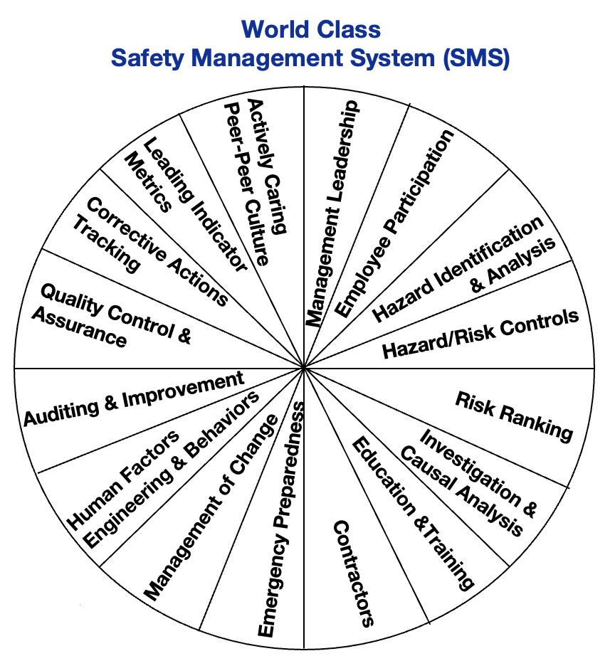
What is a Safety Management System (SMS)?
A SMS is a set of interrelated elements that establish and/or support OHS policy and objectives and mechanisms to achieve those objectives in order to continually improve occupational health and safety.

Slide 3
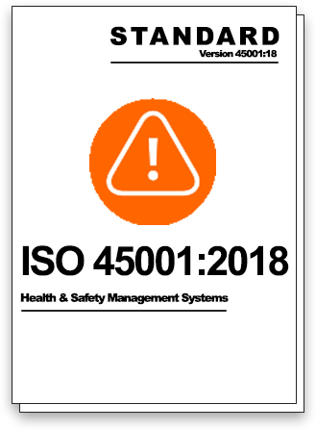
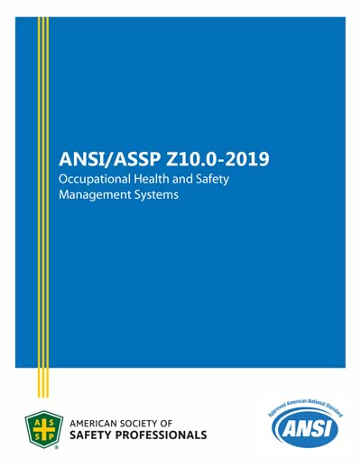
Safety Management System (SMS)
UP has adopted a Hybrid SMS that mostly comes from:
  ISO 45001
  and
  ANSI Z10

Slide 4
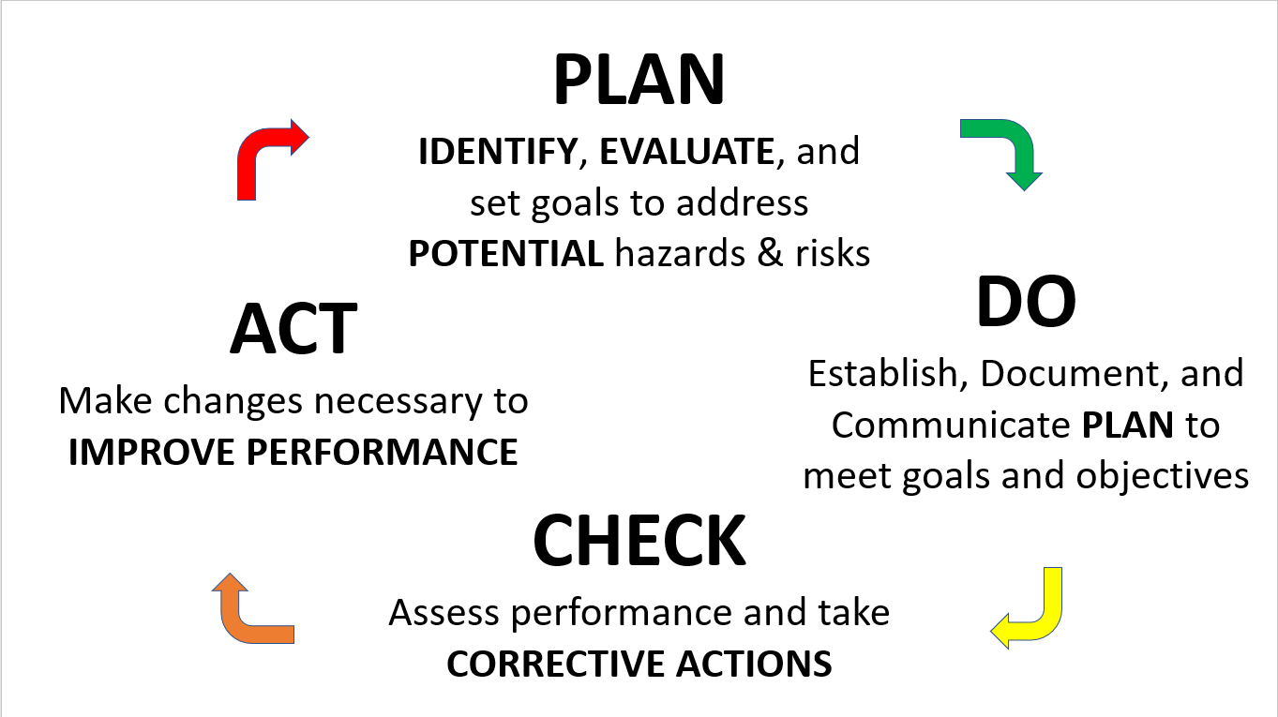
Safety Management System (SMS)
BOTH SMS models function on the same management principle of CONTINOUS IMPROVEMENT

Slide 5
Safety Management System (SMS)
The UP Regional Safety Action Plans are an off-chute of the PDCA model

Slide 6
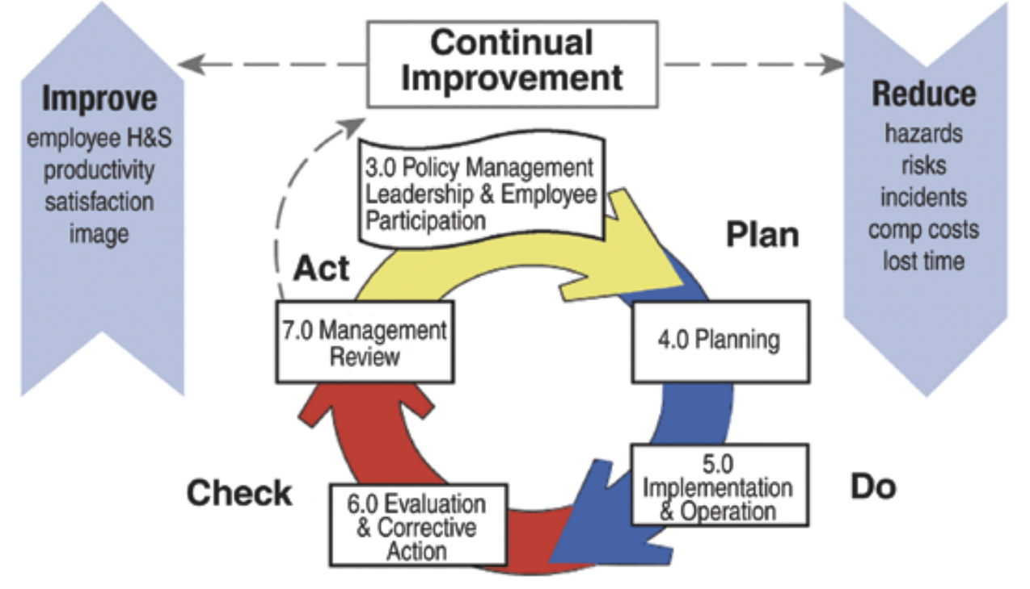

Slide 7
SMS is based on Safety Engineering Principles such as Hierarchy of Hazard Control Measures
Hierarchy of Hazard Control Measures
 | HAZARD CONTROLS
 | ELIMINATION | REMOVE HAZARDS
 | Eliminate the hazard during design
 | SUBSTITUTION | REPLACE HAZARDS
 | Substitution of less hazardous equipment, system, or energy
 | ENGINEERING CONTROLS | ISOLATE HAZARDS
 | Design options that automatically reduce risks
 | EXPOSURE CONTROLS
 | WARNINGS | PROMOTE AWARENESS
 | Automatic or manual, permanent or temporary, visible or audible warning systems, signs, barriers, and labels
 | ADMINISTRATIVE CONTROLS | MANAGE BEHAVIORS
 | Planning Processes, training, work permits, safe work practices, maintenance systems, communications, and work management
 | Personal Protective Equipment | WEAR PROTECTION
 | Available, effective, easy to use
EFFECTIVENESS

Slide 8
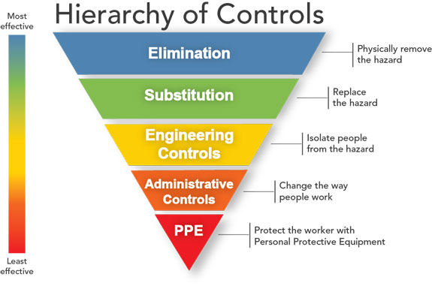
Hierarchy of Hazard Control Measures
 | HAZARD CONTROLS
 | ELIMINATION | REMOVE HAZARDS
 | Eliminate the hazard during design
 | SUBSTITUTION | REPLACE HAZARDS
 | Substitution of less hazardous equipment, system, or energy
 | ENGINEERING CONTROLS | ISOLATE HAZARDS
 | Design options that automatically reduce risks
 | EXPOSURE CONTROLS
 | WARNINGS | PROMOTE AWARENESS
 | Automatic or manual, permanent or temporary, visible or audible warning systems, signs, barriers, and labels
 | ADMINISTRATIVE CONTROLS | MANAGE BEHAVIORS
 | Planning Processes, training, work permits, safe work practices, maintenance systems, communications, and work management
 | Personal Protective Equipment | WEAR PROTECTION
 | Available, effective, easy to use
EFFECTIVENESS

Slide 9
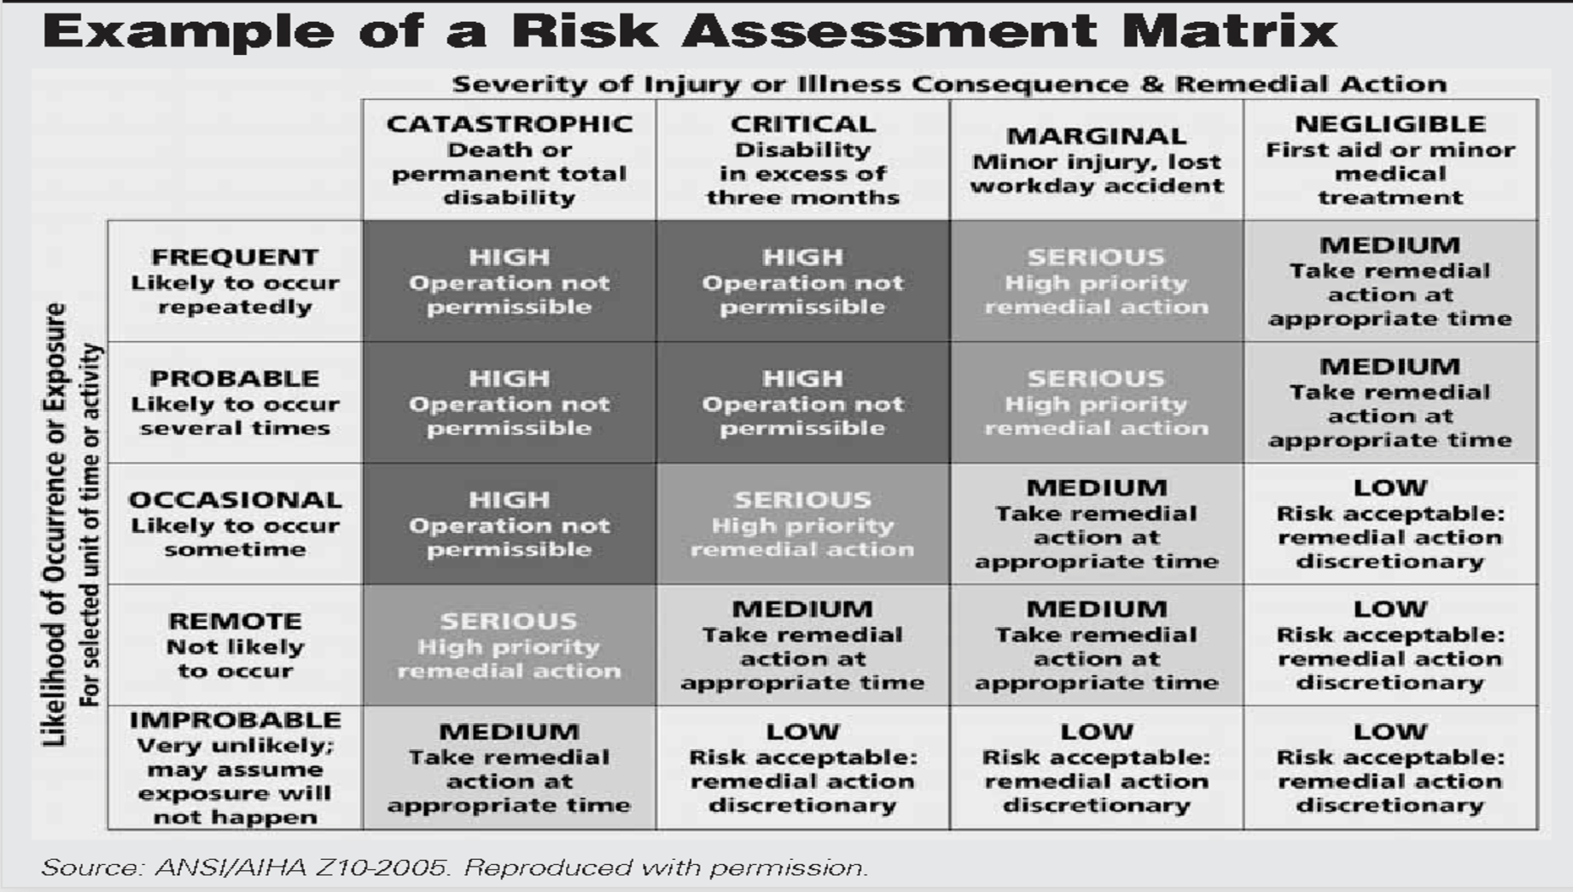

Slide 10
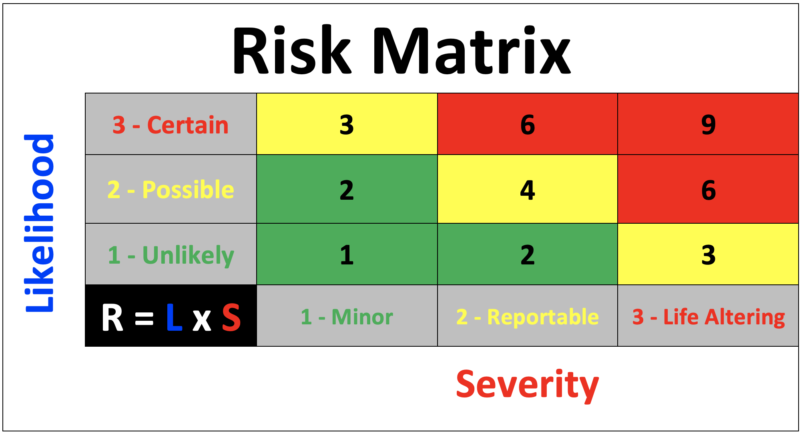

Slide 11
Severity:
Minor: The hazard may either be controlled, or would commonly result in less than minor, illness, injury or system damage.
Reportable: The hazard may commonly cause severe injury or illness or major system damage, requiring immediate corrective action.
Life Altering: The hazard may commonly cause death or major system loss, requiring immediate cessation of the unsafe activity or operation.
Likelihood:
Unlikely: Unlikely but possible to occur during standard operations
Possible: Likely to occur some time during standard operations
Certain: Likely to occur often during standard operations

Slide 12
Leading Indicators

Slide 13
Lagging Metric
&
Leading Metric
Lagging Metric - Performance measure that represents the consequences of actions previously taken or not taken (sometimes referred to as an outcome or trailing metric). Lagging metrics frequently focus on results at the end of a time period and characterize historical performance.
Leading Metric - Performance measure that is capable of influencing and/or predicting results (outcome/lagging and/or business impact metrics) and is often aimed at the prevention and control of future events or results.

Slide 14
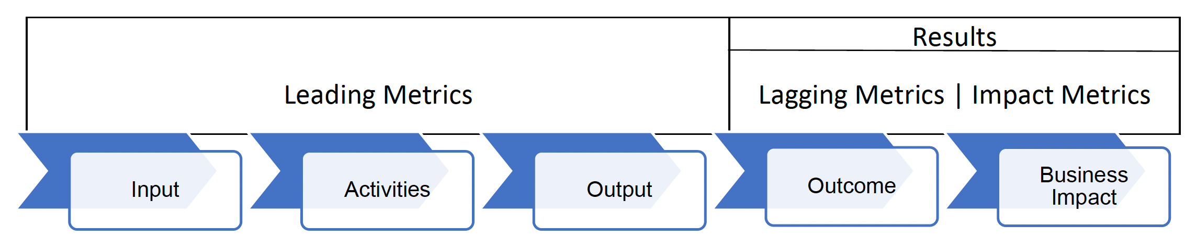

Slide 15
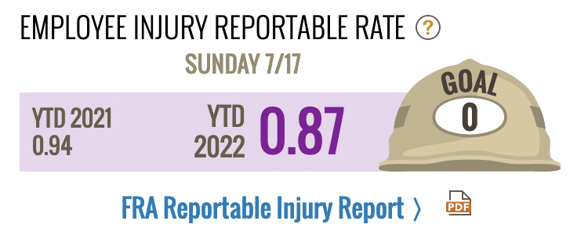
MEASURE THIS in order to Produce this

Slide 16
This is 100% in our control!
This is NOT!

Slide 17
Variability is the enemy!

Slide 18
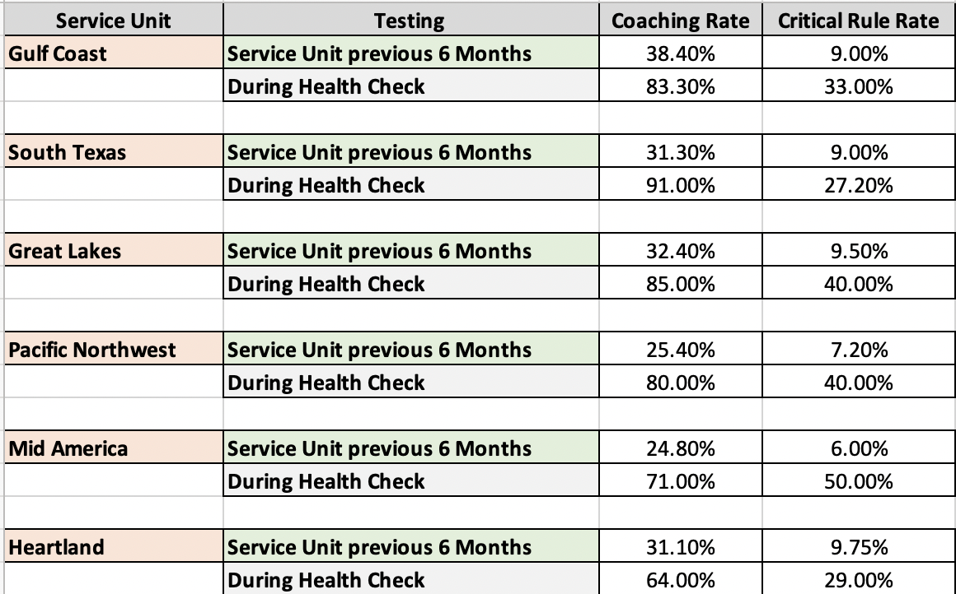
Example of Variability in a Safety Process

Slide 19
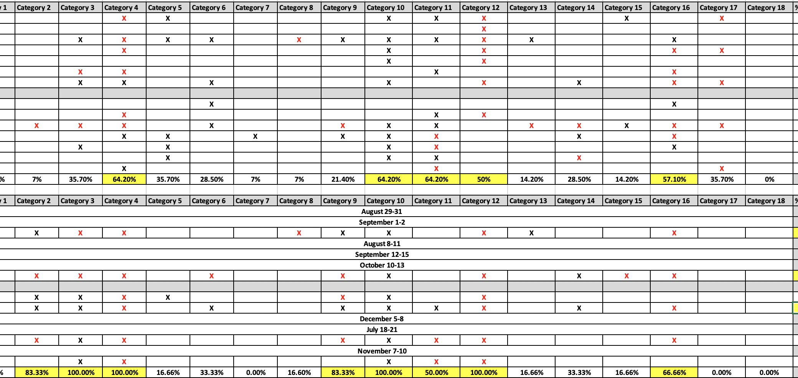

Slide 20
