Slide 1

The Journey to a
“Culture of Safety”
Safety is no longer a Priority; it has become a personal Value!

Slide 2
Historical approach to managing Safety
Safety Management has long been heavy on compliance enforcement and light on POSITIVE REINFORCEMENT via employee ENGAGEMENT
One could say the “police state” has thrived in this profession
BALANCE between POSTIVE ENGAGEMENT and ACCOUNTABILITY is a MUST
Discipline has NEVER changed a culture;
but a culture will NEVER change without it!

Slide 3
What is a “Safety Culture”?
Safety Culture is about people and how management and crews work TOGETHER
There is no standard definition of safety culture, but there are TWO (2) main things that are common to all definitions:
  It is about people’s VALUES, ATTITUDES, BELIEFS and BEHAVIORS
    In organizations with a good safety culture, these are geared towards safety which is considered a company VALUE – NOT a priority
  It is about the spread of these VALUES, ATTITUDES, BELIEFS and BEHAVIORS
    In Organizations with a good safety culture these have spread throughout

Slide 4
What makes up a “Safety Culture”?
Safety Culture
PERSON
Knowledge, Skills, Abilities, Intelligence, Motives, Personalities
ENVIRONMENT
Equipment, Tools, Machines, Housekeeping, Heat/Cold, Engineering Standards, SOPs
BEHAVIORS
Complying, Coaching, Recognizing, Communicating

Slide 5

The Journey to World-Class Safety – the best of the best!
Individuals look out for themselves No workforce involvement Production always takes priority over health and safety Poor EHS compliance Safety Performance is not monitored or measured Accidents are seen as part of the job | Company only concerned about safety immediately after an accident Production usually takes priority over safety Safety is a Condition of Employment Safety is managed by discipline & fear Generic Safety Rules & Procedures A focus on lagging indicators | Safety essentials are in place and working Production sometimes takes priority over safety Compliance is driven by campaigns and supervisory control Some workforce involvement Monitoring is primarily focused on accident statistics Most incidents are reported/investigated | Ongoing commitment to safety is highly visible Safety usually takes priority over productivity The workforce are proactively engaged in improving safety Monitoring is focused on leading, current, & lagging indicators Root Cause Analyses are conducted for ALL types of Incidents | Safety is a VALUE A safety PARTNERSHIP has been established SAFE PRODUCTION is the number one priority LESSONS LEARNT are applied on a day-today basis Leading Safety Indicators are linked to Business Performance
Beginning I don’t care about safety as long as I don’t get caught | Developing We react a lot after an incident | Performing We are compliant – doing all we must do to comply | High Performing We work on problems we find | Excelling SAFE PRODUCTION is our way of doing things
COMPLIANCE CULTURES I follow the rules because I have to |  |  | COMMITMENT CULTURES WE follow the rules because WE want to
AUTHORITARIAN
LEADERSHIP STYLE
COACHING
REACTIVE
WORKING STYLE
PROACTIVE

Slide 6
Comparing the Maturity of a Culture
People are the PROBLEM
People are
the SOLUTION
LEARNING & SPEAKING UP is INHIBITED
Focus is on BEHAVIORS
Intrinsic “Speak Up” Culture
Focus is on RELATIONSHIPS
and INQUIRY
Immature
Culture
Mature
Culture
FEAR & EXTRINSIC motivation
REWARD
and
PUNISHMENT
High
PSYCHOLOGICAL SAFETY
Increased TRUST & LEARNING

Slide 7
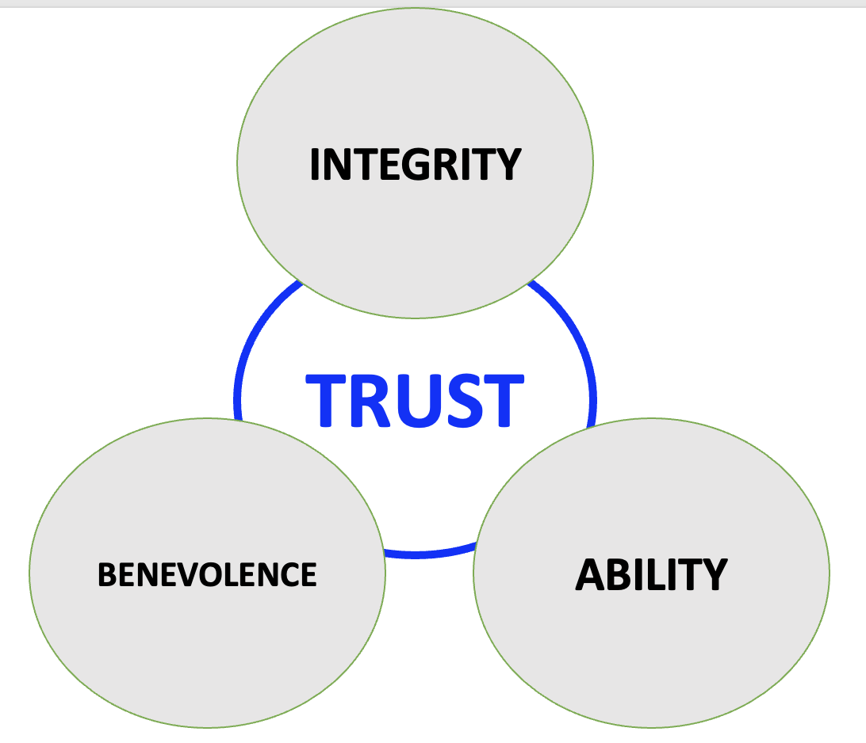
Building Trust
One of the most frequently cited models of TRUST suggest that trust is based on a worker's perceptions about THREE (3) key factors:
ABILITY (perceived competence)
INTEGRITY (perceived honesty and openness)
BENEVOLENCE (perceived degree of care shown)

Slide 8
Employ more POSITIVE consequences
In many cultures, discipline takes a leading role in enforcing safety rules
  psychological research shows that negative consequences do NOT motivate lasting behavior change (did getting that speeding ticket ensure you never exceed the posted speed limit ever again)
A behavior may change temporarily to AVOID a negative consequence, but the change will not be sustained
  employee is likely to perform the desired behavior only when threatened
Negative consequences lead to FAILURE AVOIDANCE, not SUCCESS SEEKING, which hinders safety goals that seek to exceed compliance

Slide 9
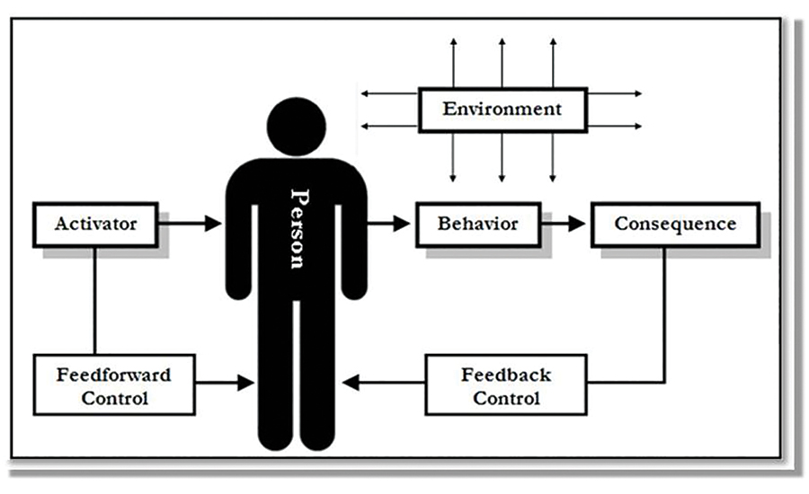
Improve with Behavioral Feedback
Feedback must focus on a SPECIFIC behavior
As a consequence (for motivation), feedback specifies:
  what behavior to stop and
  what behavior to keep performing
But as an activator (for direction), it’s not feedback but feedforward. Feedforward reminds an individual to perform a particular task in a certain way
In order to be most effective, feedback needs to be:
  SINCERE,
  SPECIFIC,
  SIGNIFICANT, and
  SOON
Activator-Behavior-Consequence (ABC) model

Slide 10
Give more Supportive than Corrective Feedback
Although errors and mistakes tend to receive more attention, SUPPORTIVE FEEDBACK is more effective at motivating desirable behaviors
Positive Reinforcement of SAFE Behaviors is 3-5x’s more effective at sustaining SAFE Behaviors than is correcting unsafe behaviors
Dr. E. Scott Geller

Slide 11
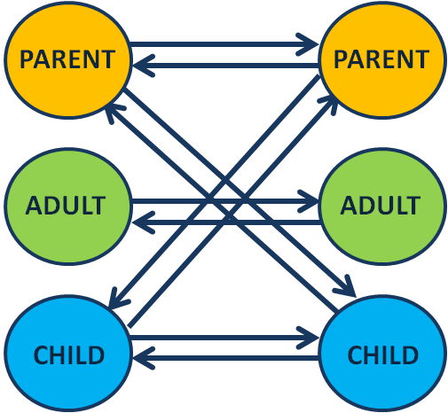
Engagement MUST be Adult-to-Adult model
Transactional Analysis (TA)

