Slide 1
Human Factors Engineering
Using Roadway Signs Working Example

Slide 2
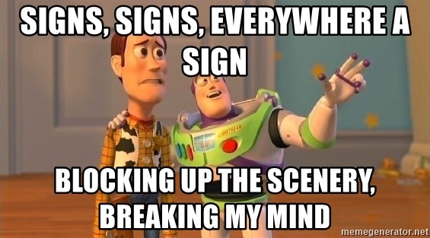

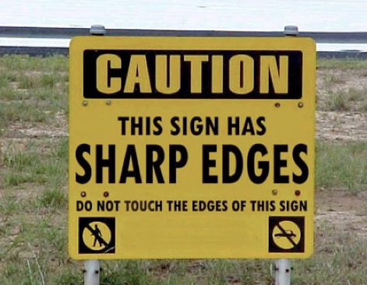
Fundamentals
Sign, sign
Everywhere a sign
Blockin' out the scenery
Breakin' my mind
Do this, don't do that
Can't you read the sign?

Slide 3
Fundamentals
Safety Signs/Labels have two (2) MAJOR DESIGN characteristics:
  SHAPE
  COLOR (Background and Font/Symbols)
We are going to use “street signs” this HFE training to demonstrate how BOTH of these play significant roles in how people respond to “signs”

Slide 4

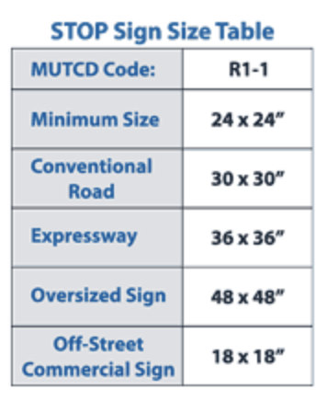
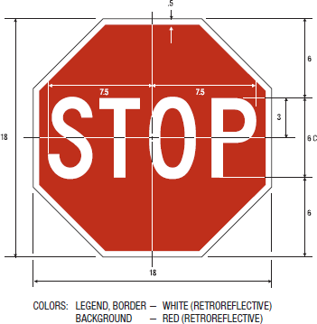
Fundamentals - Shapes
Octagon
STOP signs are the ONLY OCTAGON-shaped road signs
ALL STOP signs are a RED OCTAGON
They may or may not feature the word “STOP”
Did you know the first STOP signs were YELLOW?
Do you know why they were changed to RED?
The MUTCD provides size requirements for stop signs. They are as follows:
24” x 24” is the ideal size for stop signs used in parking lots and on private roads
30” x 30” is the minimum stop size requirement for official roadways
30” x 30” is the required size for stop signs located on single and conventional roadways
36” x 36” is how big stop signs are required to be when in place at a multi-lane approach
36” x 36” is the size requirement for stop signs located at dangerous intersections
On expressways, stops signs must be 36” x 36” or larger
48” x 48” is considered oversized for stop signs and is used in situations where speed, volume or other factors require the need for increased noticeability

Slide 5
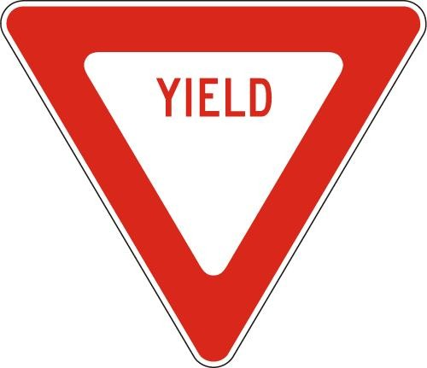
Fundamentals - Shapes
Triangle
YIELD signs are RED and WHITE inverted triangles (the tip of the triangle points downward)
ALL YIELD signs are triangles
The standard and minimum size of a Yield sign shall be 36 inches on each side of the equilateral triangle. The corners of the sign shall be rounded with a radius of 11/2 inches.

Slide 6
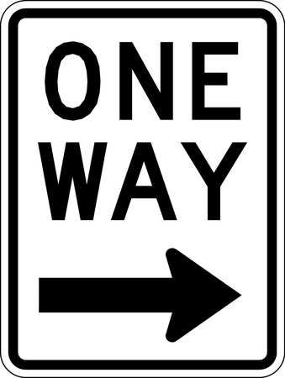

Fundamentals - Shapes
Rectangle
(Longer Dimension Vertical)
Rectangle
This shape is used for regulatory signs and guide signs
Vertical rectangles indicate REGULATORY signs
Horizontal rectangles are usually guide signs, some warning signs, and some temporary traffic control signs
Rectangle
(Longer Dimension Horizontal)

Slide 7
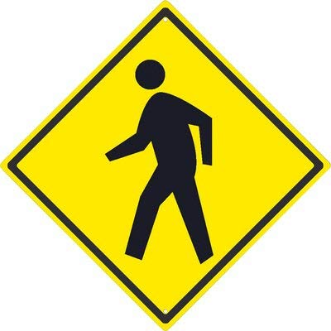

Fundamentals - Shapes
Diamond
Reserved EXCLUSIVELY for warning signs, including temporary work zone signs
A diamond-shaped sign means you must reduce speed and proceed with caution

Slide 8

Fundamentals - Shapes
Pentagon
Used to mark school zones
Warn drivers to reduce speed and look out for children

Slide 9

Fundamentals - Shapes
Circle
Yellow and Black circular signs printed with an “X” warn drivers that they are approaching a railway crossing

Slide 10

Fundamentals - Shapes
Pennant
These signs look somewhat like elongated, triangular flags
They mark the start of a “no passing zone”

Slide 11



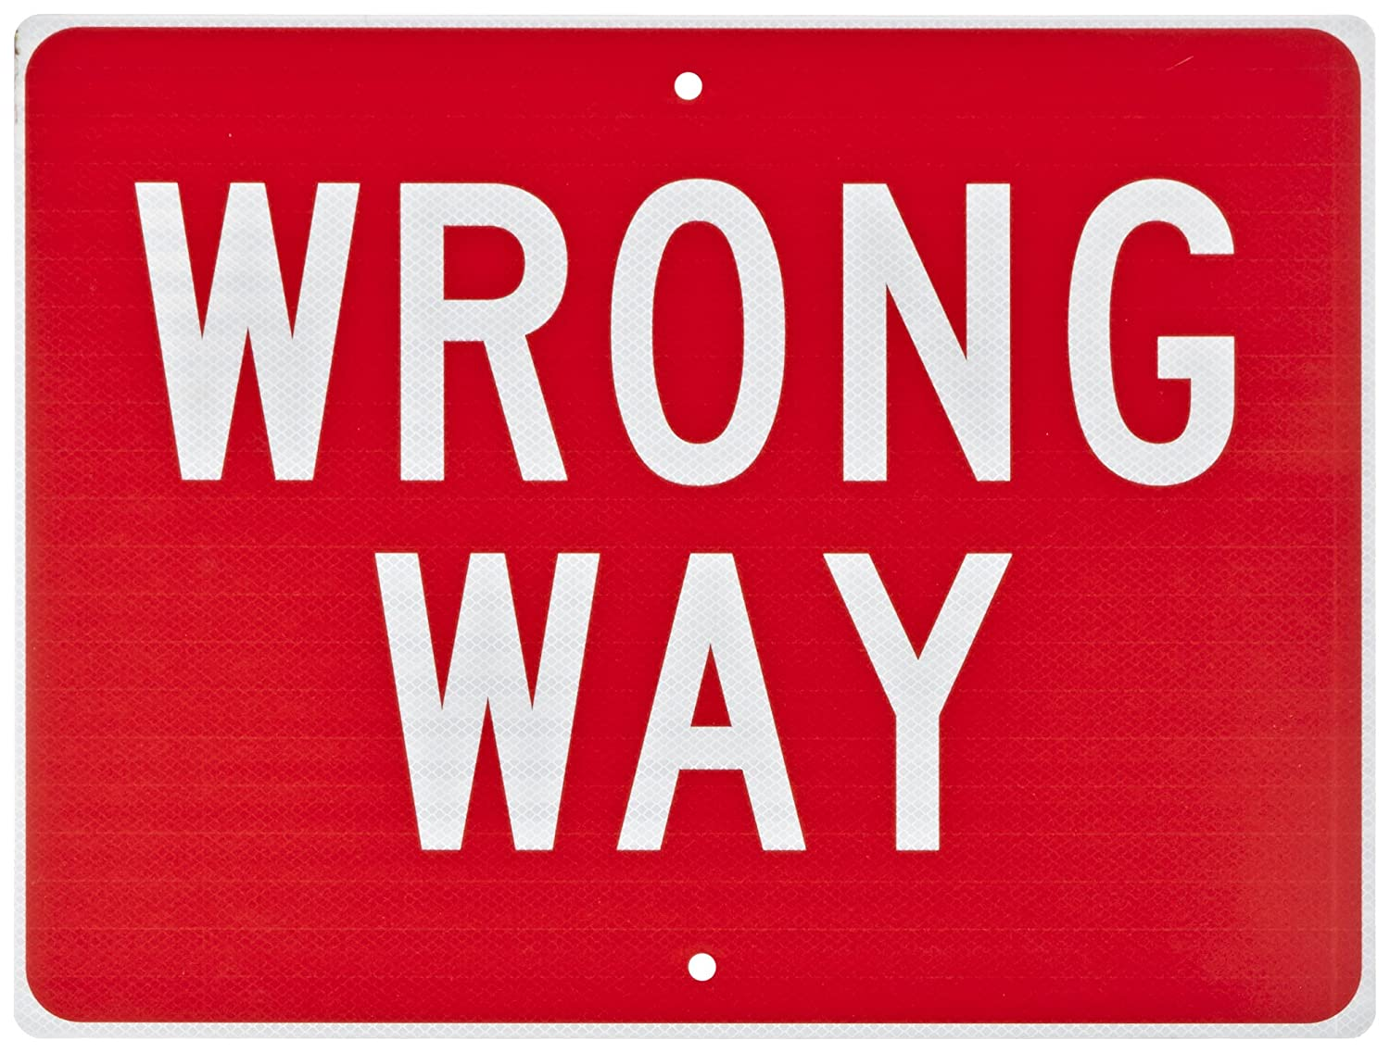
Fundamentals - Colors
RED
All RED road signs are important regulatory signs
They issue instructions which drivers MUST OBEY, for instance:
  STOP,
  YIELD,
  DO NOT ENTER, and
  WRONG WAY

Slide 12

Fundamentals - Colors
RED AND WHITE
Red and white signs signify that motorists must prepare to stop
The only road signs that use red and white without any other colors are
  STOP signs,
  YIELD signs,
  DO NOT ENTER signs, and
  WRONG WAY signs

Slide 13



Fundamentals - Colors
ORANGE
Warning signs used around construction or maintenance sites are all orange

Slide 14

Fundamentals - Colors
YELLOW
Most WARNING signs are colored yellow
warn drivers about adverse conditions and hazards on the roadway

Slide 15

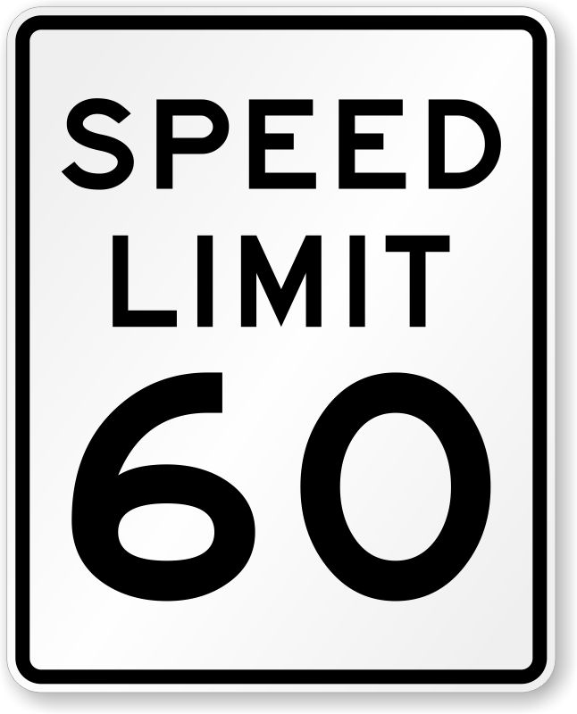

Fundamentals - Colors
BLACK AND WHITE
These are usually general regulatory signs, which prohibit certain actions, give instructions or state the road rules in that area
Certain route markers are also black and white

Slide 16


Fundamentals - Colors
Green
Green guide signs tell drivers about location, often including directions and distances to upcoming destinations

Slide 17



Fundamentals - Colors
Brown
Brown guide signs mark recreational facilities, parks, historical sites and other attractions

Slide 18

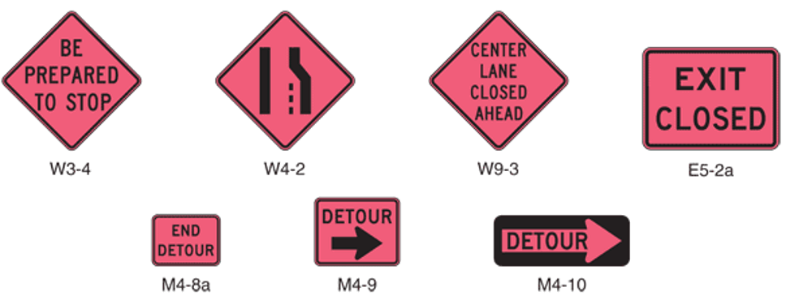
Fundamentals - Colors
Pink
Coral-colored signs are used around incident sites
These temporary signs are used to direct motorists around
  hazardous spills,
  flooded roads,
  fallen trees,
  Mudslides, and
  car accidents

Slide 19

Variability is our ENEMY!
Imagine…
Each town along your 300-mile trip has its own street sign designs
They use their own variety of shapes and colors
For example:
A town uses…
RECTANGLE shaped GREEN colored STOP sign
versus
OCTAGON shaped RED colored STOP sign
STOP
vs.

Slide 20
Variability is our ENEMY!
Imagine your child drives through a STOP sign that is a GREEN Vertical Rectangle because they were not TRAINED or INFORMED that shape and color is a STOP sign.
They can an accident by their act.
As a parent, would you question the use of a STOP sign that is not the universal SIZE, SHAPE, and COLOR as the cause of the human error?
There is SOUND and SCIENTIFIC reasons we have the Manual on Uniform Traffic Control Devices (MUTCD) in the USA
STOP
vs.

Slide 21
Industrial Safety Signs
For the same reason we have The Manual on Uniform Traffic Control Devices for our roadways, we ALSO HAVE A STANDARD for the signs in our workplaces.
Unfortunately, the use of safety signs in workplace is far less uniformed in their application leading to much confusion

Slide 22
Industrial Safety Signs
1910.145, Specifications for accident prevention signs and tags
These specifications apply to the design, application, and use of signs or symbols that indicate and, insofar as possible, define specific hazards that could harm workers or the public, or both, or to property damage
These specifications are intended to cover ALL safety signs except those designed for streets, highways, and railroads
These specifications do NOT apply to plant bulletin boards or to safety posters

Slide 23
Industrial Safety Signs
Sign Design
ALL signs shall be furnished with rounded or blunt corners and shall be free from sharp edges, burrs, splinters, or other sharp projections
The ends or heads of bolts or other fastening devices shall be located in such a way that they do not constitute a hazard

Slide 24

Industrial Safety Signs
Danger Signs
There SHALL BE NO VARIATION in the type of design of signs posted to warn of specific DANGERS and RADIATION HAZARDS
ALL employees (and Contractors) shall be instructed that DANGER signs indicate immediate danger and that special precautions are necessary

Slide 25
Industrial Safety Signs
Danger Signs
The colors RED, BLACK, and WHITE shall be those of opaque glossy samples as specified in
  Table 1, "Fundamental Specification of Safety Colors for CIE Standard Source 'C,' " of ANSI Z53.1-1967 or
  Table 1, "Specification of the Safety Colors for CIE Illuminate C and the CIE 1931, 2 Standard Observer," of ANSI Z535.1-2006(R2011)

Slide 26
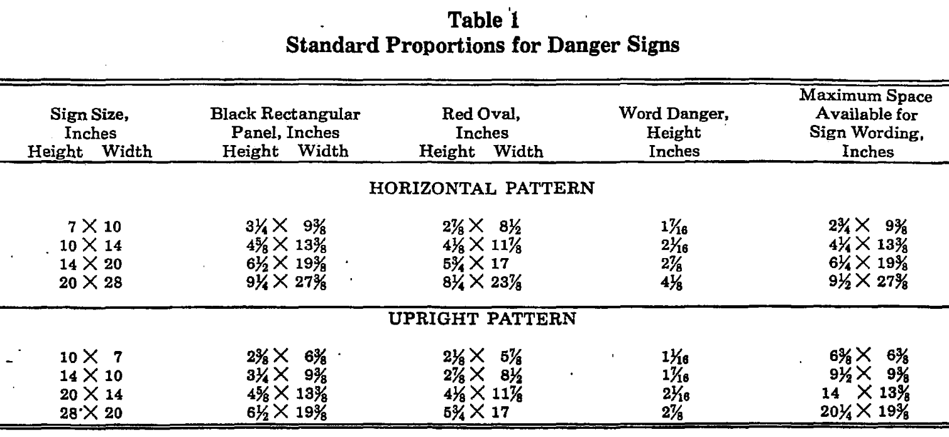
Industrial Safety Signs

Slide 27

Industrial Safety Signs
Caution Signs
Caution signs shall be used ONLY to warn against potential hazards or to caution against unsafe practices
ALL employees (and contractors) shall be instructed that caution signs indicate a possible hazard against which proper precaution should be taken

Slide 28
Industrial Safety Signs
Caution Signs
The standard color of the background shall be YELLOW; and the panel, BLACK with YELLOW LETTERS
ALL letters used against the YELLOW background MUST be BLACK
The colors shall be those of opaque glossy samples as specified in Table 1 of ANSI Z53.1-1967 or Table 1 of ANSI Z535.1-2006(R2011)

Slide 29
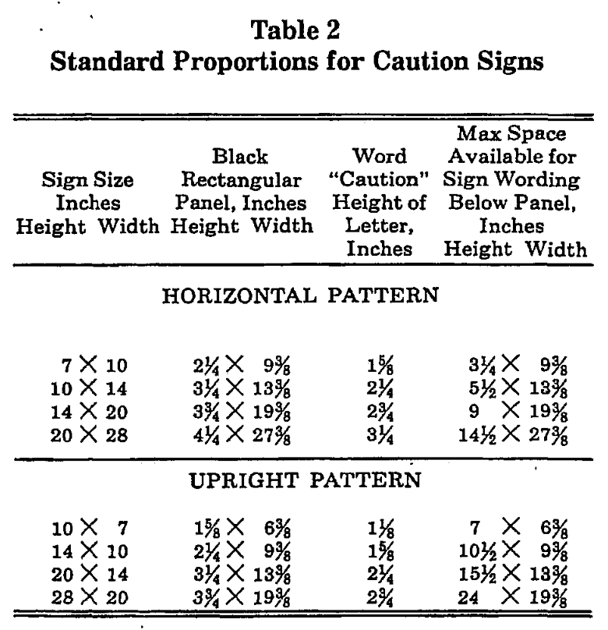
Industrial Safety Signs

Slide 30

Industrial Safety Signs
Safety Instruction Signs
The standard color of the background shall be WHITE; and the panel, GREEN with WHITE letters
Any letters used against the white background shall be BLACK
The colors shall be those of opaque glossy samples as specified in Table 1 of ANSI Z53.1-1967 or in Table 1 of ANSI Z535.1-2006(R2011)

Slide 31
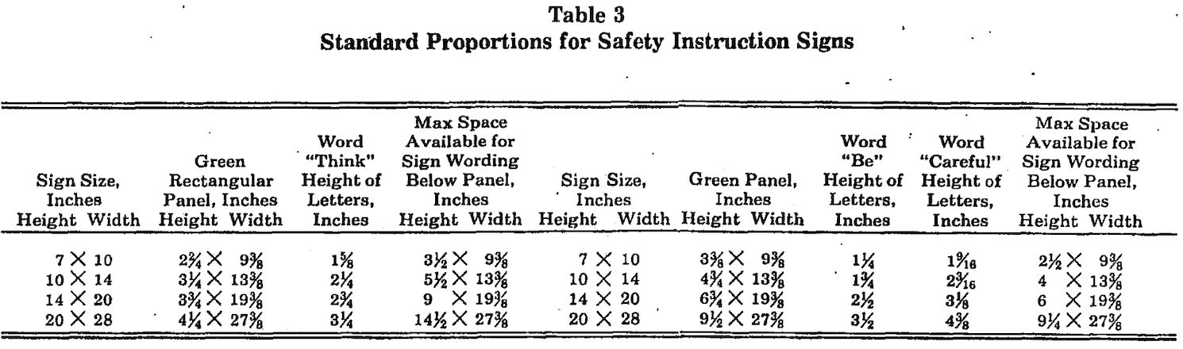
Industrial Safety Signs

Slide 32

Industrial Safety Signs
Slow-Moving Vehicle Emblem
This emblem consists of a fluorescent YELLOW-ORANGE triangle with a DARK RED reflective border
The YELLOW-ORANGE fluorescent triangle is a highly visible color for daylight exposure
The reflective border defines the shape of the fluorescent color in daylight and creates a hollow red triangle in the path of motor vehicle headlights at night
The emblem is intended as a unique identification for, and it shall be used only on, vehicles which by design move 25 m.p.h. or less on the public roads

Slide 33
Industrial Safety Signs
Slow-Moving Vehicle Emblem
The emblem is NOT a clearance marker for wide machinery nor is it intended to replace required lighting or marking of slow-moving vehicles
Neither the color film pattern and its dimensions nor the backing shall be altered to permit use of advertising or other markings
The material, location, mounting, etc., of the emblem shall be in accordance with the American Society of Agricultural Engineers Emblem for Identifying Slow-Moving Vehicles, ASAE R276, 1967, or ASAE S276.2 (ANSI B114.1-1971)

Slide 34
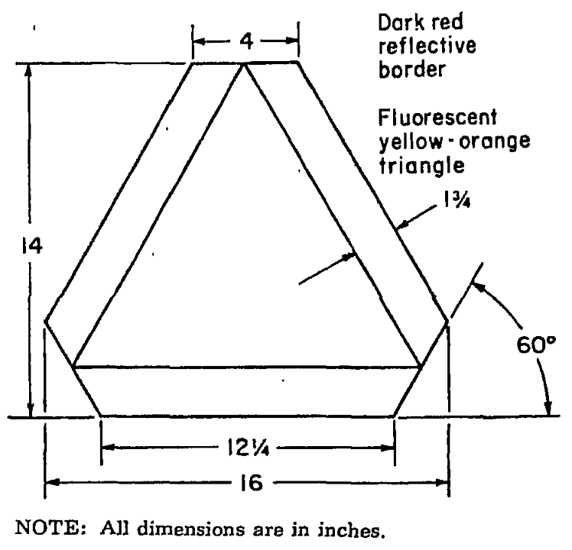
Industrial Safety Signs
Slow-Moving Vehicle Emblem

Slide 35

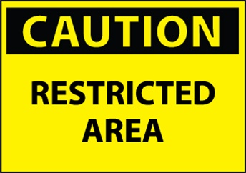
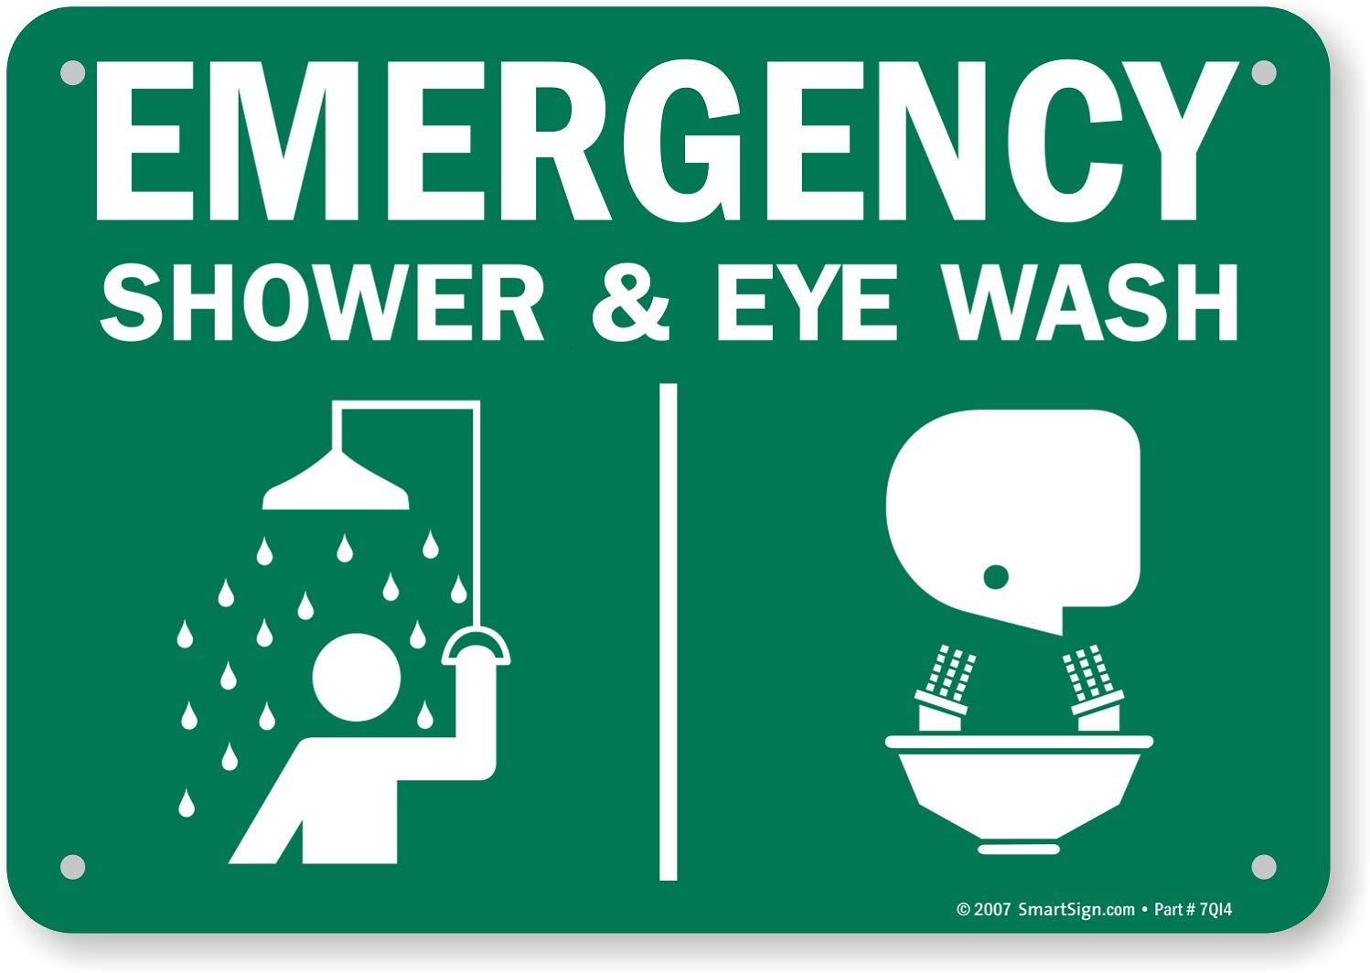


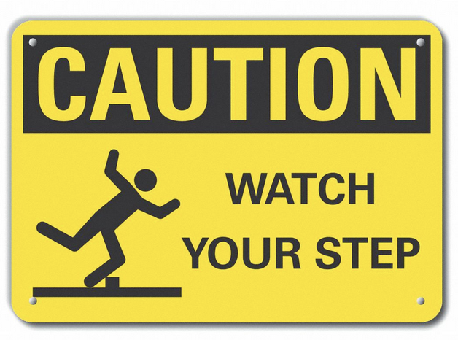
Industrial Safety Signs

