Slide 1


Human Performance
The strategic approach to improving it

Slide 2
Strategic Approach
The strategic approach to improving human performance within safety embraces two (2) primary challenges:
  Anticipate, Prevent, Catch, and Recover from ACTIVE errors
  IDENTIFY and Eliminate LATENT organizational weaknesses that give rise to human error and degrade controls against error and the consequences of error

Slide 3
Strategic Approach -IDENTIFYING Errors
Preventable errors will NOT be eliminated if opportunities to err are not METHODICALLY identified
Even if opportunities to err are systematically identified and prevented, people may still err in unanticipated and creative ways
  additional means are necessary to protect against errors that are not prevented or anticipated
Reducing the “error rate” minimizes the FREQUENCY but NOT the SEVERITY of events

Slide 4
Strategic Approach - CONTROLS
Only CONTROLS can effectively reduce the SEVERITY of the error outcome
Controls/Safeguards arranged in a LAYERED fashion - assure that if 1 fails, the remaining controls will function as needed to reduce the impact on the incident
To improve human performance and facility performance, efforts should be made to
  REDUCE errors at all levels of the organization, and
  ENHANCE THE INTEGRITY of controls/safeguards discovered to be weak or missing

Slide 5
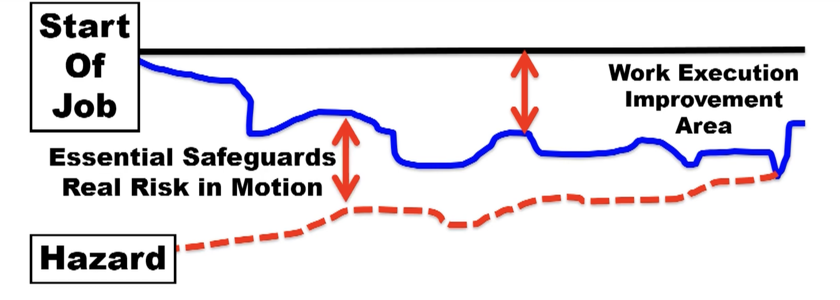
Strategic Approach - REDUCING ERROR
An effective ERROR-REDUCTION strategy focuses on work execution because these occasions present workers with opportunities to harm key assets, reduce productivity, and adversely affect quality through human error

Slide 6
Strategic Approach - REDUCING ERROR
Work execution involves workers having direct contact with the facility, when they touch the equipment and when knowledgeable workers touch the paper that influences the facility (procedures, instructions, drawings, specifications, etc.)
The human performance objective is to ANTICIPATE, PREVENT, or CATCH active errors, especially at critical steps, where error-free performance is absolutely necessary
While various work planning methods may be used, opportunities for reducing error are particularly prevalent in what is herein expressed as PREPARATION, PERFORMANCE, and FEEDBACK

Slide 7
Strategic Approach - PREPARATION
Identifying the SCOPE OF WORK, ASSOCIATED HAZARDS, and what is to be AVOIDED, including critical steps
  Job-Hazard reviews:
    identifying potential job challenges to error-free performance
  Task assignment:
    putting the right people on the job in light of the job’s task demands
  Task Previews and Pre-job briefings:
    identifying the scope of work including critical steps, associated hazards, and what must be avoided by ANTICIPATING possible ACTIVE ERRORS and their consequences

Slide 8
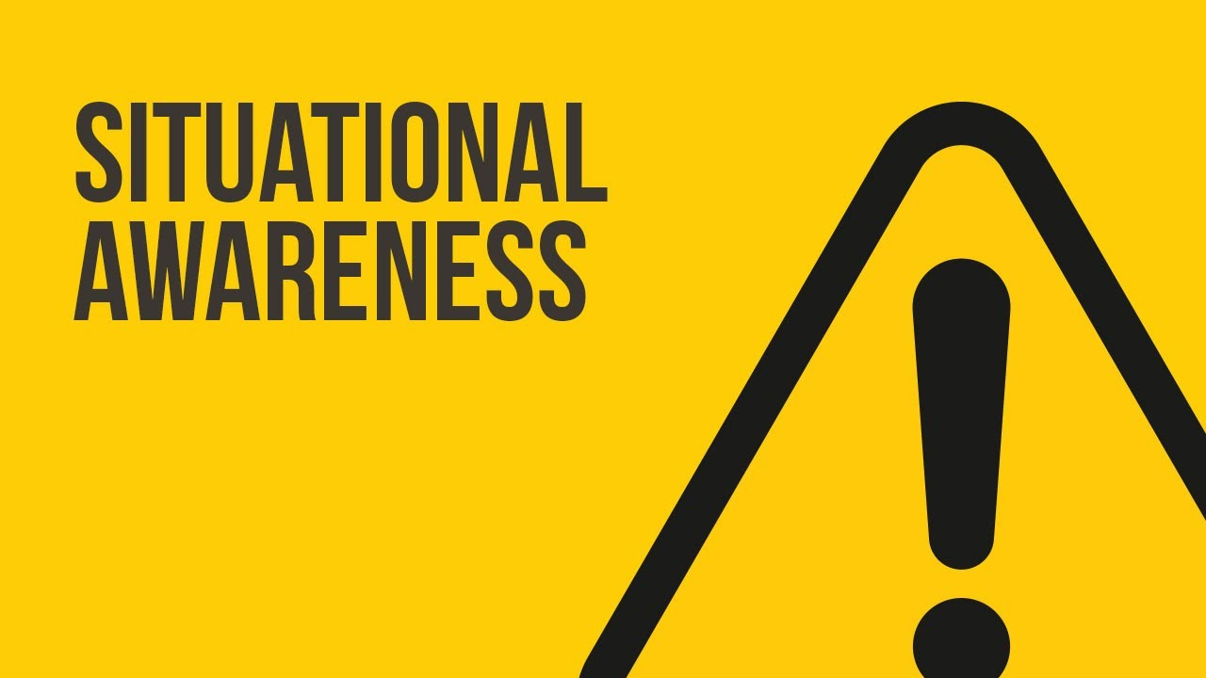
Strategic Approach - PERFORMANCE
Performing work with a sense of uneasiness (work against compliancy)
Maintaining SITUATIONAL AWARENESS
Rigorous use of HUMAN PERFORMANCE tools for important human actions, avoiding unsafe or at-risk work practices
Supported with QUALITY SUPERVISION and TEAMWORK (e.g., peer-to-peer)

Slide 9
Strategic Approach - FEEDBACK
Reporting
  conveying information on the quality of work preparation, related resources, and workplace conditions to supervision and management
Behavior Observations (COMMIT/TSC)
  workers receiving COACHING and REINFORCEMENT on their performance in the field through observations by managers and supervisors

Slide 10
Strategic Approach – MANAGING CONTROLS
Incidents involve breaches in risk controls/safeguards
Errors will still occur when opportunities to err are systematically IDENTIFIED and ELIMINATED
Management must take an aggressive approach to ensure risk controls/safeguards function as intended

Slide 11
Strategic Approach – MANAGING CONTROLS
The TOP PRIORITY to ensure safety from human error is to
  IDENTIFY,
  ANALYZE,
  ASSESS RISK, and
  ELIMINATE
  Risks/hazards in the workplace

Slide 12
Strategic Approach – MANAGING CONTROLS
Hazards are most often closely related to failures with risk controls/safeguards
  These failures MUST be found and corrected BEFORE a consequence
The most important aspect of this strategy is an ASSERTIVE & ONGOING verification & validation of risk controls/safeguards
  Ongoing self-assessments are employed to scrutinize controls, and the vulnerabilities are mended using the corrective action program (CAP)

Slide 13
Strategic Approach – MANAGING CONTROLS
Hierarchy of Hazard Control Measures
 | HAZARD CONTROLS
 | ELIMINATION | REMOVE HAZARDS
 | Eliminate the hazard during design
 | SUBSTITUTION | REPLACE HAZARDS
 | Substitution of less hazardous equipment, system, or energy
 | ENGINEERING CONTROLS | ISOLATE HAZARDS
 | Design options that automatically reduce risks
 | EXPOSURE CONTROLS
 | WARNINGS | PROMOTE AWARENESS
 | Automatic or manual, permanent or temporary, visible or audible warning systems, signs, barriers, and labels
 | ADMINISTRATIVE CONTROLS | MANAGE BEHAVIORS
 | Planning Processes, training, work permits, safe work practices, maintenance systems, communications, and work management
 | Personal Protective Equipment | WEAR PROTECTION
 | Available, effective, easy to use
EFFECTIVENESS

Slide 14
Strategic Approach – MANAGING CONTROLS
Cultural Norms
These are the ASSUMPTIONS, VALUES, BELIEFS, and ATTITUDES and the related leadership practices that encourage either
  high standards of performance or mediocrity,
  open or closed communication, or
  high or low standards of performance
Personnel in Highly Reliable Organizations (HROs) practice error-PREVENTION rigorously, regardless of:
  their perception of a task’s risk and simplicity, (compliancy)
  how routine it is, and
  how competent the performer is
The INTEGRITY of this safeguard depends on:
  people’s appreciation of the human’s role in safety,
  the respect they have for each other, and
  their pride in the organization and the facility

Slide 15
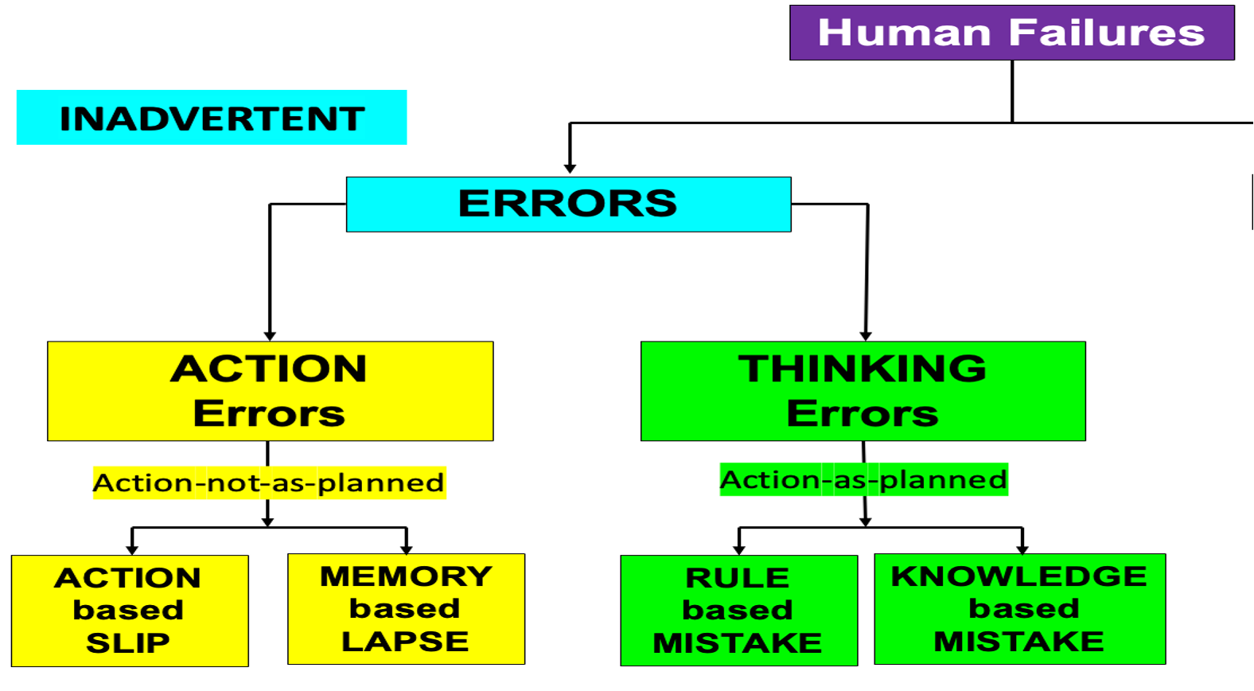
Strategic Approach – MANAGING CONTROLS
Oversight
Accountability for personnel and facility safety and ethical behavior in all facets of operations, maintenance, and support activities is achieved by a kind of “social contract” entered into willingly by workers and management where a “JUST CULTURE” prevails
  In a JUST CULTURE, people who make honest ERRORS and MISTAKES are NOT BLAMED; while those who WILLFULLY VIOLATE standards and expectations are held accountable
  Workers willingly accept responsibility for the consequences of their actions, including the rewards or consequences

Slide 16
Strategic Approach – MANAGING CONTROLS
Oversight
Employees and Contractors feel empowered to report ERRORS, MISTAKES, & NEAR MISSES
This accountability helps verify safety margins, risk controls/safeguards, SMS integrity, and performance quality
PERFORMANCE IMPROVEMENT activities facilitate the accountability of line managers through STRUCTURED & ONGOING ASSESSMENTS of human performance, data trending, field observations, and use of the CAPs
Integrity of risk controls/safeguards depends on management’s commitment to high levels of human performance and consistent CAP follow-through to correct problems and identified vulnerabilities

