Slide 1
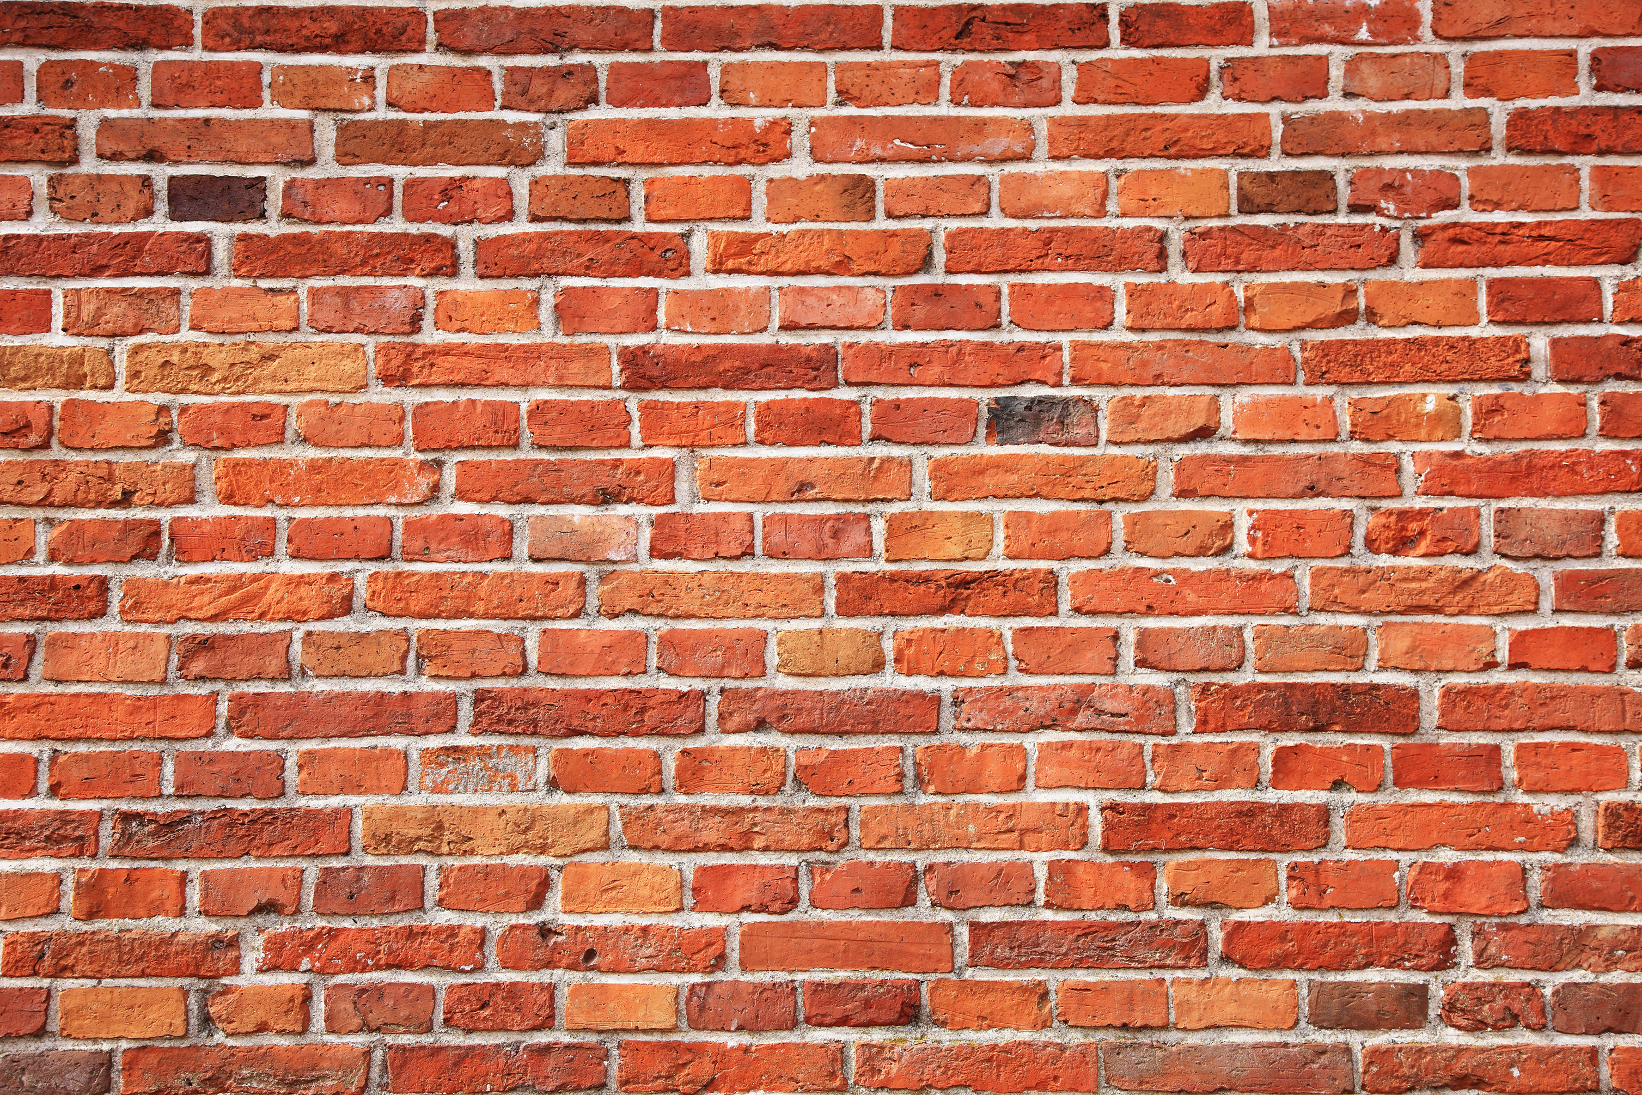
Is 5 psi a lethal energy source?
You better bet your _____ it is!
Take this brick wall for example…
Using a ruler, draw a grid making square 1” X 1” onto the entire surface of this 6’ X 8’ wall (surface)

Slide 2
Is 5 psi a lethal energy source?
Now we have our grid of 1” X 1” squares across the surface of the wall
Now apply 5 pounds of energy/force in EACH one of those square inch blocks and we now have…
5 pounds per square inch (psi)
Anyone think 5 psi is not a heck of a lot of energy?
Think anyone could hold up that wall with just 5 psi applied to it?

