Slide 1
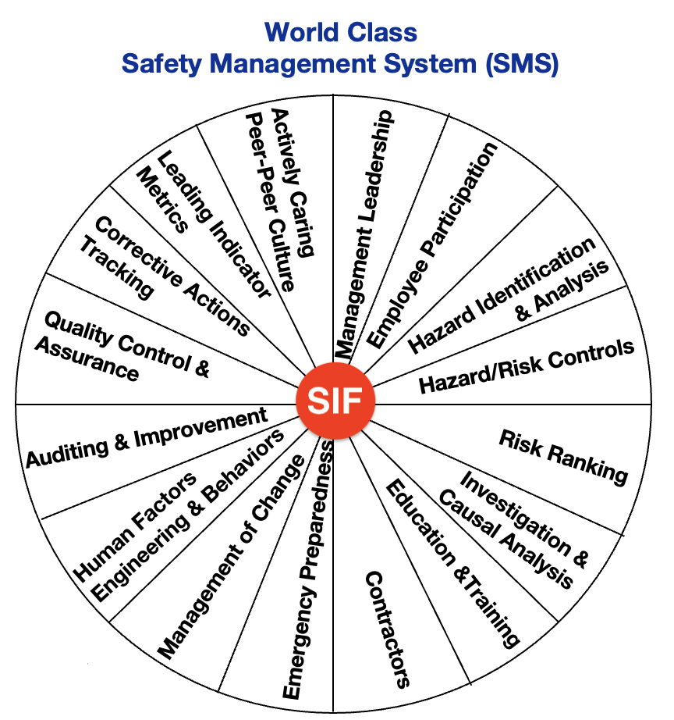
PREVENTING
Serious Injuries and Fatalities (SIF)
Managing RISKS rather than Injury Rates

Slide 2
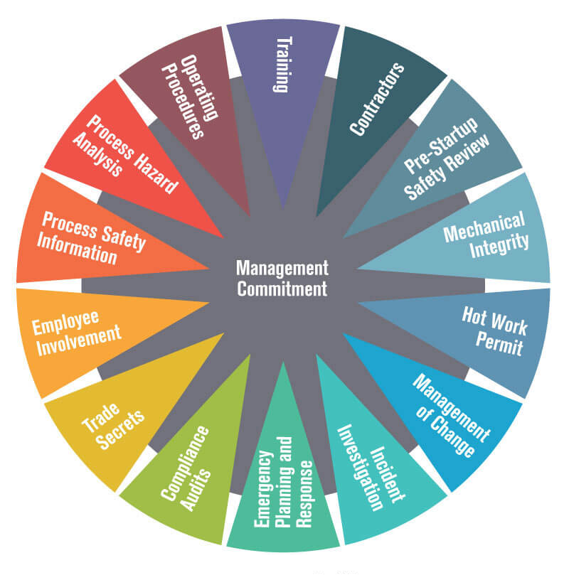
Where did SIF come from?
OSHA’s Process Safety Management Standard
On January 4th, 2012, the American Society of Safety Engineers’ (ASSE) President Terrie Norris, issued a call to action…
“A statistical plateau of worker fatalities is not an achievement”…
“But evidence that this nation’s effort to protect workers is stalled. These statistics call for nothing less than a new paradigm in the way this nation protects workers.”

Slide 3
Why is the SIF approach necessary in HIGH-RISK workplaces?
Despite extensive prevention efforts, many industries still have a high serious injury and fatality rates – even though they have very low TRIR
The reduction in minor/moderate/serious severity incidents rates is an important target but is NOT a sufficient indicator of the potential for serious injuries and fatalities (SIF)
Safety Management Systems provide a “safety net” for people against risks, but special focus needs to always be given for situations that present the potential for SIF events

Slide 4
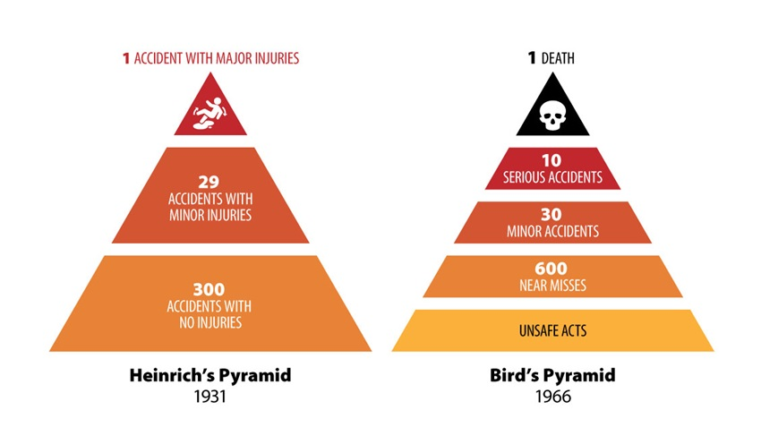
Reducing Minor Injuries is NOT Predictive of Reducing SIFs
The Mercer/BST study group found that “pillars” of the safety profession may form barriers to SIF prevention
H.W. Heinrich’s 80-year-old safety pyramid is NOT predictive
  Not all injuries have SIF potential
  Reducing injuries at the bottom of the triangle (minor injuries) does not assure a reduction of SIFs at the top of the triangle

Slide 5
Reducing Minor Injuries is NOT Predictive of Reducing SIFs
A 2007 Rand study stated that there is no relationship between OSHA injury rates and Fatalities
  The absence of minor injuries is NOT predictive of an absence of SIFs
  The presence of minor injuries is NOT an indicator of potential fatalities
About 20% of recordable injuries have the potential to be SIFs

Slide 6
Reducing Minor Injuries is NOT Predictive of Reducing SIFs
Injury data can NOT be the sole or primary metric for driving and assessing safety performance
The long-standing assumption that most injuries result from unsafe acts, fueled and reinforced by flawed incident investigations, is INCORRECT and UNSUPPORTED
These beliefs are proving to be downright harmful
The problem is this:
traditional safety efforts often fail to address SIFs
because they’re not designed to!
These design lapses are due in part to current measurement systems that create a “blind spot” for SIF prevention

Slide 7
Reducing Minor Injuries is NOT Predictive of Reducing SIFs
In many of the catastrophic events in recent years—Columbia, Challenger, BP Texas City, Upper Big Branch Mine, Deepwater Horizon —indicators of impending disaster were available but obscured by years of data showing the rate of recordable injuries was low, very low or improving
Systematic assessment of SIF potential enables SIF measurement and prevention
SIF prevention strategies must address less serious injuries with HIGH POTENTIAL for serious consequences and specific causes and correlates of SIF events

Slide 8
Reducing Minor Injuries is NOT Predictive of Reducing SIFs
Several
Fatalities
Fatality
Life-Altering Injuries
Moderate
Injuries
Minor
Injuries
No Injuries
The “Traditional Safety Pyramid is NOT predictive
A reduction of injuries @ the bottom of the Triangle does NOT assure a reduction of SIFs
NOT ALL injuries have SIF potential
21%
Potentially
SIF
Minor Incident
with HIGH PSIF

Slide 9
The Critical Importance of Precursors
The key is to IDENTIFY, ANALYZE, and MITIGATE SIF precursors
Precursor data are a vitally important tool to assess risks and give signals of impending problems
Use of precursor information eliminates leadership’s blind spot, gives visibility to previously hidden information
Precursors represent a leading indicator (not a reactionary measure) that reduces the potential to miss unmitigated exposures with high potential for SIFs
A SIF PRECURSOR generally has three (3) key aspects: it is a high-risk situation where management controls are absent, ineffective, or not complied with, and will result in a serious injury or fatality if allowed to continue

Slide 10
The Critical Importance of Precursors
Addressing SIF precursors calls for flawless execution of
  pre-job planning and risk assessment,
  job safety analysis,
  behavior observations,
  assessments and audits, and
  risk tolerance

Slide 11
The Critical Importance of Precursors
Enhancements are needed for incident investigation and root cause analysis processes
Remember, what categorizes a precursor is NOT its immediate outcome, but its POTENTIAL to produce a serious outcome
Two employees each suffer a minor cut. The actual outcomes are identical. But one cut occurred as a worker hustled across a busy office and sideswiped a sharp-edged desk. The other cut occurred when the worker slipped and nearly fell from the top of a rail car.
To identify which of these two events is a precursor, ask yourself what would happen if the situations were repeated. The office worker would likely see a similar or better outcome. But the potential exists for the rail worker to suffer a fall from a height, resulting in a fatality or serious injury.

Slide 12
Assess Systems Integrity and Conformance
Safety Management Systems should be examined to determine their effectiveness at identifying and mitigating precursors
A pipe leaks,
it contains flammable material,
no one reports the leak,
no inspection identifies it,
the leaking material finds an ignition source, and
there is a fire
The chance that this was the first and only time any of these events has occurred is low; it is much more likely that leaks have occurred previously, the reporting of leaks is sporadic, and inspections are not comprehensive
Both the DESIGN of the safety management systems targeting SIFs (their integrity), and the QUALITY of how they are implemented (conformance) need to be assessed

Slide 13
Four (4) steps to PREVENT SIFs
Educate the organization on the prevention of SIFs
  Everyone at all levels of the organization must be aware and alert to the fact that just managing injury rates is not enough
  The company is still vulnerable to SIF exposures

Slide 14
Four (4) steps to PREVENT SIFs
MEASURE SIFs and PSIFs as a KPI (rate)
The SIF rate is the number of serious and fatal
injuries—and recordable injuries with reasonable potential to be an SIF—divided by hours worked
  Data on the SIF rate should be gathered for the past 2-3 years and from this point forward
  The SIF rate must have high visibility throughout the
  organization

Slide 15
Four (4) steps to PREVENT SIFs
DEVELOP and IMPLEMENT Safety Management System (SMS) elements to:
  IDENTIFY Hazards and SIF Precursors
  ANALYZE the Hazards and SIF Precursors
  ASSESS the level of RISK they pose
  MITIGATE RISK from Hazards and SIF Precursors
This is the basis of the SIF PREVENTION strategy

Slide 16
Four (4) steps to PREVENT SIFs
Embed findings from SIF assessments into existing safety management systems, including
  pre-task risk assessment,
  observation and feedback, and
  incident investigations
  so these systems now address SIF Precursors
  Enhance your incident investigation and root cause analysis protocols
  Go beyond obvious errors to find LATENT CONDITIONS that may represent SIF precursors

