Slide 1
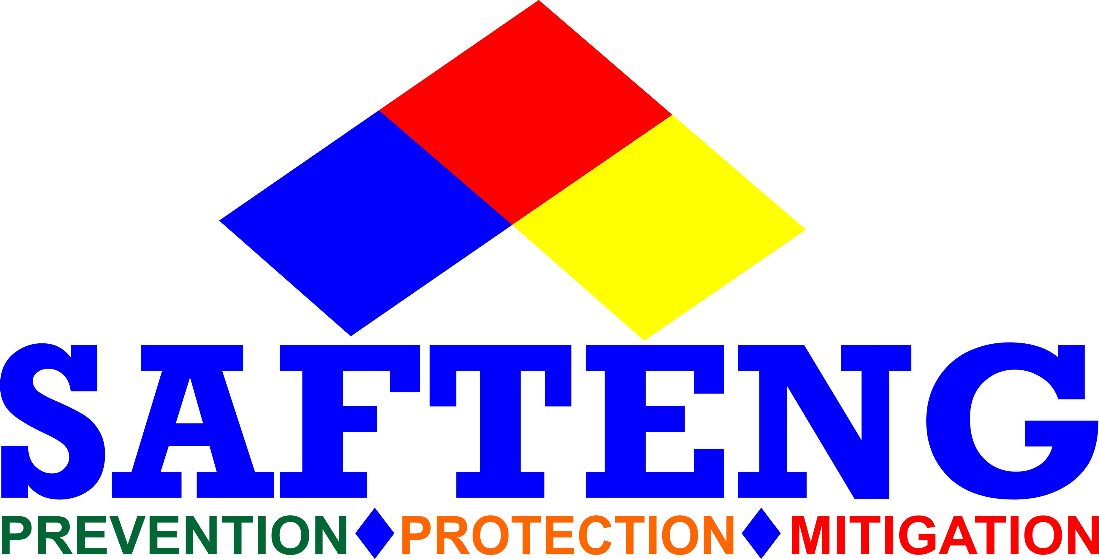
Risk Management inside a SMS
Managing Risk vs. Managing injury rates

Slide 2
SMS and Risk Management
The Risk Management component of an SMS can be divided into four (4) areas:
Hazard Identification process,
Hazard Analysis process
Risk Assessment process
Mitigation/Control measures

Slide 3
SMS and Risk Management
Safety is a condition in which the risk of harm or damage is limited to an acceptable level (i.e., risk tolerance)
Safety Management is centered on a SYSTEMATIC APPROACH:
IDENTIFYING hazards,
ANALYZING those hazards,
ASSESSING a level of RISK to the hazard(s)
DESIGNING RISK MITIGATION/CONTROL measures to reduce the risks to within the risk tolerance of the business

Slide 4
SMS and Risk Management
The hazards creating risk are identified through SMS processes
The process of moving from hazard identification to risk assessment and risk mitigation is a risk management process

Slide 5
Hazard Identification Process
A hazard is any situation or condition that has the potential to cause adverse consequences
A Hazard ID process is the formal means of:
  Collecting and Recording,
  Analyzing,
  Acting on, and
  generating feedback about hazards
In a mature SMS hazard identification is an ongoing process

Slide 6
Hazard Identification Process
The scope of Hazard ID is across the operational activities of the organization with data derived from reactive and proactive schemes
  Reactive schemes include data from accidents, incidents, and data monitoring
  Proactive schemes include nearmiss reporting, confidential reporting, safety surveys, safety audits/assessments
Managed group sessions can also be used to identify hazards

Slide 7
Hazard Analysis Process
Following the IDENTIFICATION of a hazard, a form of HAZARD ANALYSIS is required to assess its potential for harm or damage
The HAZARD ANALYSIS is performed using a recognized HA methodology such as:
  Failure Modes & Effects Analysis (FMEA)
  What-If Analysis
  Job-Safety Analysis/Job Hazard Analysis

Slide 8
Risk Assessment Process
Risk Assessment involves two (2) considerations:
  Likelihood: The likelihood of the hazard causing consequences
  Severity: The severity of the potential consequences
Risk Assessment and Mitigation Processes analyze and eliminate, or mitigate to an acceptable level, risks that could threaten the safety of an organization

Slide 9
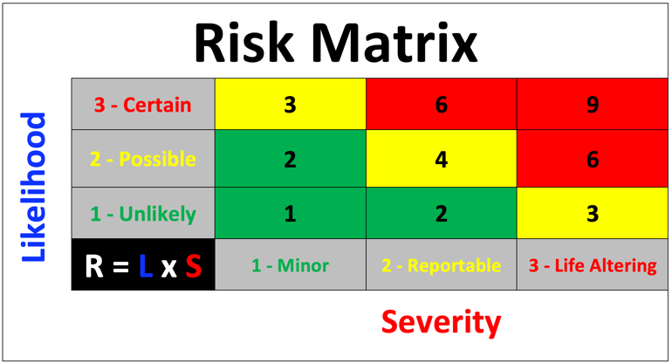
Risk Assessment Process
Risk is the assessed potential for adverse consequences resulting from HAZARDS if its potential to cause harm is realized
A HAZARD has the potential to cause harm, while RISK is the likelihood of that harm being realized within a specific time-scale
Risk Assessment involves considering the LIKELIHOOD and SEVERITY of any adverse consequences resulting from an identified HAZARD
A Risk Matrix is useful for assessing hazard

Slide 10
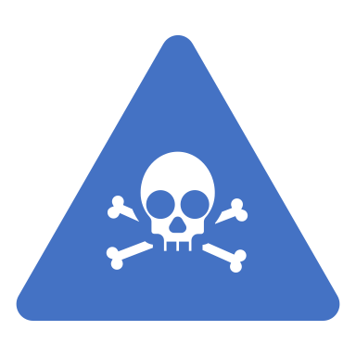
Risk Mitigation Process
Risks should be managed to be As Low As Reasonably Practicable (ALARP)
For a risk to be ALARP, it must be possible to demonstrate that the cost involved in reducing the risk further would be grossly disproportionate to the benefit gained
The ALARP principle arises from the fact that infinite time, effort and money could be spent in the attempt of reducing a risk to zero (does not exist!)

Slide 11
Risk Mitigation Process
Risk must be balanced against the time, cost, and difficulty of taking measures to reduce or eliminate the risk
The level of risk can be lowered by:
  reducing the SEVERITY of the potential consequences, or
  reducing the LIKELIHOOD of occurrence, or by
  reducing BOTH
Corrective Action Plans (CAPs) will consider any existing safeguards and their inability to achieve an acceptable level of risk
Corrective actions should be subject to further risk assessment as outlined above, in order to determine that the risk is now acceptable and that no further risk has been introduced into operational activities

Slide 12
Continuous Improvement of the SMS
CI should determine the immediate causes of below-standard performance and their implications in the operation of the SMS
CI should be achieved through:
evaluation of facilities, equipment, documentation and procedures through safety audits and surveys,
evaluation of an individual’s performance to verify the fulfilment of their safety responsibilities,
reactive evaluations to verify the effectiveness of the system for control and mitigation of risk, (e.g., incidents, accidents, and investigations), and
tracking organizational changes to ensure that they are effective

