Slide 1
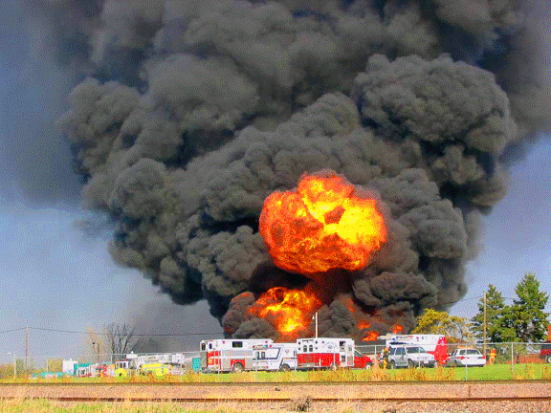
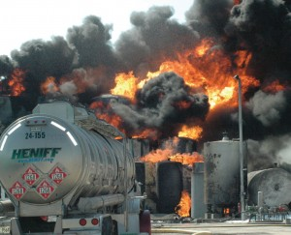
Flammable Liquids 101
STATIC ELECTRICITY and a NON-CONDUCTIVE
Flammable Liquid did all of this!

Slide 2
Classification of
Flammables & Combustibles
Classified/Categorized according to their FLASHPOINT(S)
  This is important to know because the quantity of flammable and combustible liquids that can be stored in any one location is determined by the Class/Category of the flammable liquid(s)

Slide 3
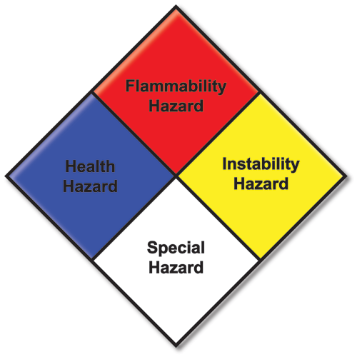
Classification of
Flammables & Combustibles
NFPA 704 | NFPA Terminology (Classification) |  |  | OSHA Terminology (Categorization)
 | Class | Flash Point | Boiling Point | Category | Flash Point | Boiling Point
4 | IA | <73°F | <100°F | 1 | <73.4°F | <95°F
3 | IB | <73°F | >100°F | 2 | <73.4°F | >95°F
 | IC | 73-100°F |  | 3 | 73.4 - 140°F
2 | II | 100-140°F
 | IIIA | 140-200°F |  | 4 | 140 - 199°F
1 | IIIB | >200°F |  | NOT COMBUSTIBLE
0 | NOT COMBUSTIBLE

Slide 4
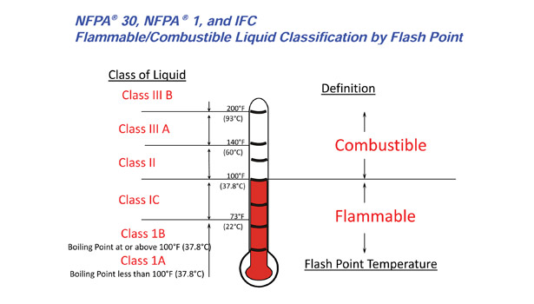
Flammable Liquid CLASSES

Slide 5
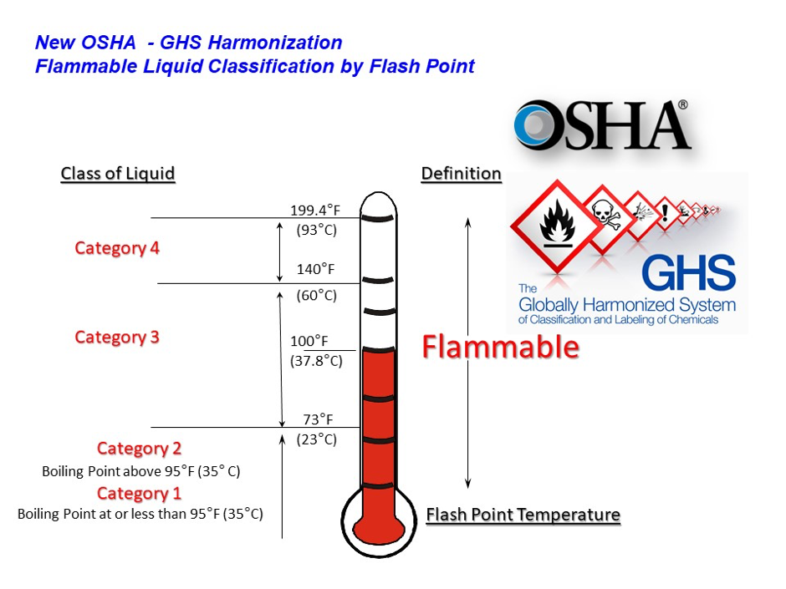
Flammable Liquid CATEGORIES

Slide 6
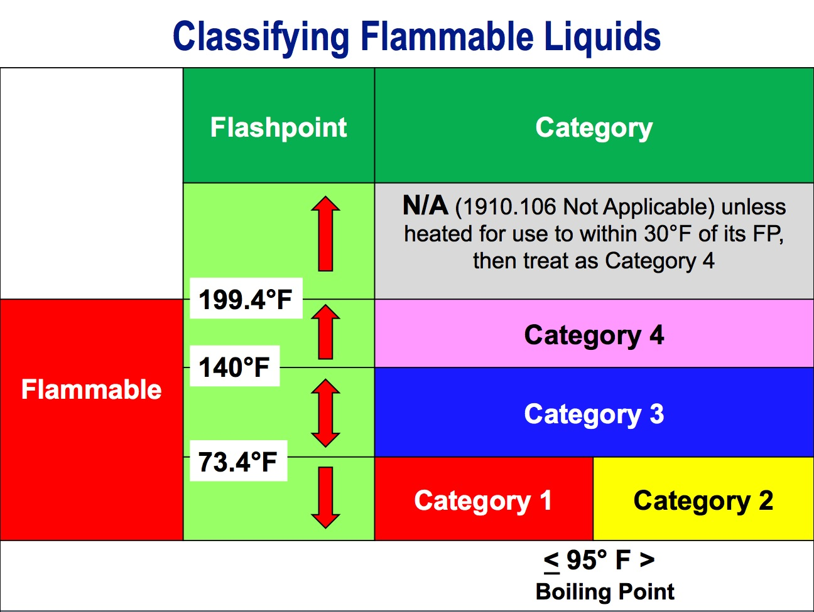

Slide 7
Vapor Pressure
pressure an evaporating vapor exerts when it is in equilibrium with the liquid below it, at a given temperature
most common way to measure volatility
  a higher vapor pressure is more volatile and evaporates vapor faster
Vapor pressure is most often shown in units of millimeters of mercury (mm Hg), atmospheres (atm), or pounds per square inch (psi), with 1 atm equal to 760 mm Hg or 14.7 psi
Substances with vapor pressures higher than 760 mm Hg are naturally occurring gases

Slide 8
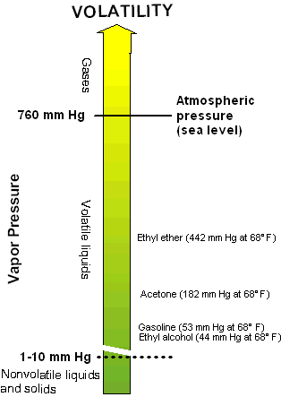
Vapor Pressure
HIGHER the VP, the HIGHER the potential vapor concentration to reach LEL
a material with a HIGH vapor pressure is more likely to be an inhalation or fire/explosion hazard
Higher temperatures increase vapor pressure
  vapor evaporates faster from the liquid's surface
Water = ~25 mm Hg
>85 mm Hg – significant inhalation risk
The LOWER the BP - the HIGHER the VP

Slide 9
Vapor Pressure & Flammability
High Vapor Pressure
  Produces lots of vapor
  Product travels further before it dilutes
  Product enters flammable range later
  Risk further from source
Low Vapor Pressure
  Smaller amount of vapor produced
  Product enters flammable range sooner
  Risk closer to source

Slide 10
Boiling Point
Temperature at which the equilibrium vapor pressure of a liquid is equal to the prevailing atmospheric pressure
A chemical is a liquid if its BP is above the ambient temperature and its melting point is below ambient
The material is a GAS if it’s BP is BELOW 68°F

Slide 11
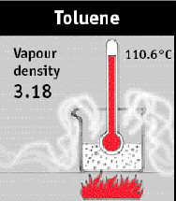
Vapor Density
Relative density of a vapor or gas to air
Air = 1
    <1 rises
    >1 sinks

Slide 12
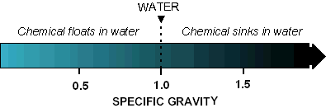
Specific Gravity
Relative density of a liquid to water
Water = 1
    <1 floats
    >1 sinks
How much vapor might evaporate when a liquid spills into water depends on:
  whether the liquid sinks, floats, or is neutrally buoyant
  whether it is soluble or insoluble, and
  whether the liquid is spilled all at once or more slowly

Slide 13
Flammable Properties
Flash Point
Lower Explosive Limit (LEL)
Upper Explosive Limit (UEL)
Flammability Range
Fire Point
Auto-Ignition Temperature
Non-Conductive Flammable Liquids
Minimum Ignition Energy

Slide 14
Flammable Properties
Flash point is defined by OSHA, NFPA, and DOT in the
U.S. Code of Federal Regulations (CFR) as:
“The minimum temperature at which a liquid gives off
vapor within a test vessel in sufficient
concentration to form an ignitable mixture
with air near the surface of the liquid.”
A LOW FP (below room temperature 72ºF) indicates a highly flammable liquid

Slide 15
Flammable Properties
Lower Explosive Limit (LEL) (or LFL)
MINIMUM concentration of a gas or vapor in air which will ignite if an ignition source is present
Less than the LEL, mixture is TOO LEAN
0%
100%
LEL
UEL

Slide 16
Flammable Properties
Upper Explosive Limit (UEL) (or UFL)
MAXIMUM concentration of a gas or vapor in air which will ignite if an ignition source is present
Greater than the UEL, mixture is TOO RICH
0%
100%
LEL
UEL

Slide 17
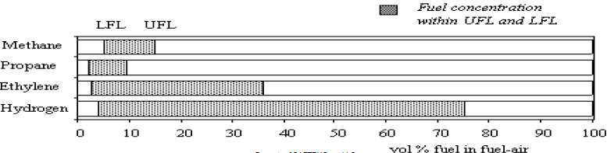
Flammable Properties
Flammability Range
between the LEL and UEL
Concentration within the flammability range will burn or explode if an ignition source is present
MIDWAY between LEL and UEL is the most hazardous

Slide 18
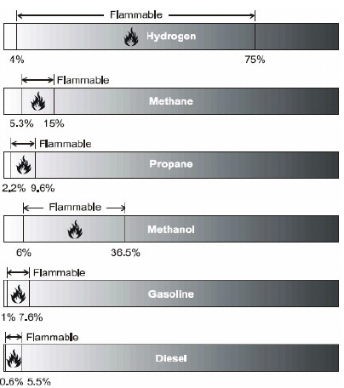
Flammability Properties

Slide 19
Flammable Properties
Fire Point
A slightly higher temperature than Flash Point
vapor continues to burn after being ignited

Slide 20
Flammable Properties
Autoignition Temperature
Minimum temperature to which a substance must be heated before it will spontaneously burn independently of the source of heat
  For example, ethanol has an auto ignition temperature of 798°F and a flash point of 54°F
Silane: 70°F
White phosphorus: 93°F
Carbon disulfide: 212°F
Diethyl ether: 338°F
Diesel: 410°F
Paper: 451°F
Gasoline: 475°F
Magnesium: 883°F
Butane: 900°F
Hydrogen: 1060°F

Slide 21
Non-Conductive Flammable Liquids
Flammable liquids can present a static electricity hazard depending on their ability to generate static electricity AND how well they CONDUCT electricity (CONDUCTIVITY)

Slide 22
Non-Conductive Flammable Liquids
Solvents and fuels produced from petroleum (e.g., benzene, toluene, mineral spirits, gasoline, jet fuel) can build up a charge when they are poured or flow through pipes/hoses and CANNOT CONDUCT electricity well enough to discharge it when in contact with a conducting material, like a metal pipe or container, that is grounded

Slide 23
Non-Conductive Flammable Liquids
Solvents soluble in water do NOT build up static
  Examples include alcohols and ketones like acetone
There are non-conductive liquids that have low enough vapor pressures and high enough flash points that they do NOT form ignitable vapor-fuel air mixtures
  common example is fuel oil and diesel fuels (i.e. there may be a static buildup as this liquid is pumped, but if the concentration of vapor in the air space in the tank is below the LEL (or if the flash point is higher than the actual temperature), there is no ignition

Slide 24
Non-Conductive Flammable Liquids
However, when NON-conductive liquids are transferred into NON-conductive containers (e.g., plastic, glass), even CONDUCTIVE SOLVENTS may build up a charge because the NON-conductive container decreases the rate at which the charge in the solvent dissipates

Slide 25
Non-Conductive Flammable Liquids
Prevention of Explosions and Fires
  INERT tank head space
  If possible, add an ANTI-static agent
  REDUCE pumping flow velocity during filling or transferring non-conductive liquids
    NFPA 77 and API 2003 recommend the flow velocity of the incoming liquid should be NO GREATER than 3 ft/sec until the fill pipe is submerged either two (2) pipe diameters
    tank, transfer lines, pump, floats, etc. must be PROPERLY BONDED AND GROUNDED
  Inspect and replace, as appropriate, floats with level measuring devices which will not promote sparks inside the tank [from CSB report on Barton Solvents]

Slide 26
What is “MIE”?
Minimum Ignition Energy
  The smallest amount of energy needed to create a spark that can ignite the most easily ignitable flammable mixture of gas, mist or dust in air. (UK’s HSE Simple Definition)
What are the MIE’s of your flammable liquids?

Slide 27
Minimum Ignition Energy
The potential source of ignition MUST deliver a certain minimum amount of energy to initiate a flame front in the fuel/air mixture
VERY LOW energy levels can be sufficient to ignite solvent vapor/air mixtures (~0.01 – 1.0 milli joules)
Typical MIE’s are:
Flammable Liquid/Vapors | MIE (milli Joule or mJ)
Acetone | 1.15
Acetylene | 0.017
Butane | 0.25
Ethylene Oxide | 0.06
Gasoline | 0.8
Hydrogen | 0.011
Isopropyl Alcohol | 0.65
Methanol | 0.14
Propane | 0.25
Toluene | 0.24
Xylene(s) | 0.20
  Almost all flammable liquids have MIE’s less than 1.0 mJ

Slide 28
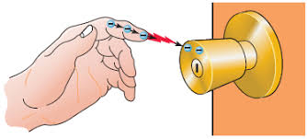
Electrostatic Discharges
(Static Electricity)
How big of a spark do you feel when you get shocked by the doorknob or car door?
There are four (4) ways to generate a static charge:
  Triboelectrification (Discuss)
  Liquid Shear Charging (Discuss)
  Induction Charging
  Corona Charging
Getting shocked by a doorknob is around 15 mJ’s, most people do not even feel a shock less than 10 mJ’s

Slide 29
Electrostatic Discharges
(Static Electricity)
charge on the containment system is dissipated quickly by grounding, BUT the charge in the liquid REMAINS and is slowly dissipated, depending on the conductivity of the liquid
  Typical grounding and bonding guidance can be found in NFPA 77, “Recommended Practice on Static Electricity”
Conductivity of a liquid…
  Conductive >100 Pico siemens/meter (pS/m)
  Semi-Conductive 50 – 100 pS/m
  NON-CONDUCTIVE <50 pS/m
Static charges can accumulate in non-conductive AND semi-conductive liquids
  In such liquids, high potential differences can be created that can discharge as sparks capable of causing ignition of solvent vapors

Slide 30
Electrostatic Discharges
(Static Electricity)
Discharges can occur from INSULATED conductors (plant items, drums), bulk liquids, mists, and insulating plastic materials
Once static charges have accumulated in a liquid, they will dissipate over time
  “RELAXATION TIME”
  inversely related to the conductivity of the liquid
    LOWER the conductivity, the LONGER it will take to dissipate charge
    For example, a liquid with a conductivity of 0.5 pS/m (e.g., classical mineral spirits) has a relaxation time of about 36 seconds in a given container, while dearomatized mineral spirits and aromatic solvents in the same container have relaxation times of 4-5 minutes and a few seconds, respectively!!!

Slide 31
Electrical Classifications
Hazardous Locations
HAZLOC

Slide 32
What is a Hazardous Location?
Hazardous Locations are areas where flammable liquids, gases or vapors or combustible dusts exist in sufficient quantities to produce an explosion or fire.
In hazardous locations, specially designed equipment and special installation techniques must be used to protect against the explosive and flammable potential of these substances.

Slide 33
Ignition Prevention Principles
Three (3) principles ensure that electrical equipment does not become a source of ignition
  Limit the energy
  Isolate the hazard
  Confine the explosion

Slide 34
Ignition Prevention Principles
1) Limit the energy
Intrinsically safe equipment
2) Isolate the hazard
Pressurization and purging
Oil immersion
Hermetic sealing
3) Confine the explosion
    Explosion-proof enclosure
    Dust ignition-proof enclosure
    Conduit and cable seals

Slide 35
Ignition Prevention Principles
1) Limit the energy
Intrinsically safe equipment
2) Isolate the hazard
Pressurization and purging
Oil immersion
Hermetic sealing
3) Confine the explosion
    Explosion-proof enclosure
    Dust ignition-proof enclosure
    Conduit and cable seals

Slide 36
Electrical Classifications
1910.119(d)
68.65
Three (3) Classes (I, II, III)
  Each Class has two (2) Divisions (1 and 2)
Seven (7) groups (A, B, C, D, E, F, G)
Six (6) temperature ratings (T1 - T-6)

Slide 37
Electrical Classifications
1910.119(d)
68.65
Class: Denotes PHYSICAL characteristics of the materials
Division: Classifies the LIKELIHOOD OF THE PRESENCE of the hazardous condition
Group: Categorizes the materials by relatively similar HAZARDOUS CHARACTERISTICS
Ignition Temperature: Temperature at which material will ignite (independent of GROUP classification)

Slide 38
Electrical Classifications
1910.119(d)
68.65
National Electrical Code
Articles 500 and 505 of the NEC CLASSIFY a location in which a combustible material is or may be present in the atmosphere in SUFFICIENT CONCENTRATIONS to produce an ignitible mixture

Slide 39
Electrical Classifications
1910.119(d)
68.65
In a CLASS I HAZLOC, the combustible material present is a:
  FLAMMABLE GAS,
  FLAMMABLE LIQUID–PRODUCED VAPOR, or
  COMBUSTIBLE LIQUID–PRODUCED VAPOR
mixed with air that could burn or explode

Slide 40
Electrical Classifications
1910.119(d)
68.65
CLASS I is subdivided into either:
Class I, Division 1
or
Class I, Division 2
NOTE: Outside of the USA, “Zones” are used rather than Divisions

Slide 41
Electrical Classifications
1910.119(d)
68.65
A CLASS I, DIVISION 1 location is a location:
In which ignitible concentrations of flammable gases/vapors can exist under NORMAL OPERATING CONDITIONS, or
In which ignitible concentrations of such flammable gases/vapors, may exist FREQUENTLY because of REPAIR OR MAINTENANCE OPERATIONS or because of LEAKAGE, or
In which BREAKDOWN OR FAULTY OPERATION of equipment or processes might release ignitible concentrations of flammable gases/vapors AND might also cause simultaneous failure of electrical equipment in such a way as to directly cause the electrical equipment to become a source of ignition

Slide 42
Electrical Classifications
1910.119(d)
68.65
CLASS I, DIVISION 1
A condition for Div 1 is whether the location is LIKELY TO HAVE an ignitible mixture present UNDER NORMAL CONDITIONS
  For instance, the presence of a combustible material in the immediate vicinity of an open top tank is normal and requires a Division 1 classification
Normal does NOT necessarily mean the situation that prevails when everything is working properly
  FREQUENT MAINTENANCE AND REPAIR is necessary AND quantities of a flammables are released as a result of the maintenance, the location is DIVISION 1
In any event, the classification of the location, as related to equipment maintenance, is influenced by the MAINTENANCE PROCEDURES and FREQUENCY of the maintenance

Slide 43
Electrical Classifications
1910.119(d)
68.65
A CLASS I, DIVISION 2 location is a location:
In which flammable gases/vapors will NORMALLY be confined within CLOSED CONTAINERS/SYSTEMS from which they can escape ONLY in case of ACCIDENTAL RUPTURE OR BREAKDOWN of such containers/systems or in case of ABNORMAL OPERATION of equipment, or
In which ignitible concentrations of flammable gases/vapors are NORMALLY PREVENTED by positive mechanical ventilation and which might become hazardous through FAILURE OR ABNORMAL OPERATION OF THE VENTILATING EQUIPMENT, or
ADJACENT to a Class I, Division 1 location, and to which ignitible concentrations of flammable/vapors might occasionally be communicated unless prevented by ADEQUATE POSITIVE-PRESSURE VENTILATION from a source of clean air and effective safeguards against ventilation failure are provided

Slide 44
Electrical Classifications
1910.119(d)
68.65
CLASS I, DIVISION 2
The criterion for a Div 2 location is whether the location is LIKELY to have ignitible mixtures present ONLY under ABNORMAL conditions
  The term abnormal is used here in a limited sense and does NOT include a catastrophic release
For example, consider a vessel containing a flammable liquid that releases material ONLY under ABNORMAL CONDITIONS
  In this case, there is no Div 1 location because the vessel is NORMALLY tight; to release vapor, the vessel would have to leak, and that would be ABNORMAL; thus, the vessel is surrounded by a DIV 2 location*
*there is a 5’ Div 1 bubble around the vessel’s vents

Slide 45
Electrical Classifications
1910.119(d)
68.65
CLASS I, DIVISION 2
The Div 2 classification is also applicable to conditions NOT involving equipment failure
For example, consider an area classified as Div 1 because of the normal presence of an ignitible mixture
  One side of the Div 1 boundary cannot be hazardous and the opposite side not be hazardous as well
  When there is NO WALL, a surrounding transition Div 2 location separates a Div 1 location from an UNCLASSIFIED LOCATION
In cases in which an UNPIERCED BARRIER, such as a blank wall, COMPLETELY PREVENTS the spread of the gas/vapor, the area classification does NOT extend beyond the barrier

Slide 46
Electrical Classifications
1910.119(d)
68.65
HAZLOC Groups
Combustible materials are classified into four (4) Class I, Division GROUPS:
  Group A
  Group B
  Group C
  Group D
An alphabetical listing of selected combustible materials, with their group classification and relevant physical properties, is provided in NFPA 497, Table 4.4.2

Slide 47
Electrical Classifications
1910.119(d)
68.65
HAZLOC Groups A-D (Vapors/Gases)
Group | Type of Hazardous Material
Group A | acetylene
Group B | Hydrogen, butadiene, ethylene oxide, propylene oxide and acrolein
Group C | carbon monoxide, ether, hydrogen sulfide, morphline, cyclopropane, ethyl, isoprene, acetaldehyde and ethylene or gases of equivalent hazard
Group D | gasoline, acetone, ammonia, benzene, butane, ethanol, hexane, methanol, methane, vinyl chloride, natural gas, naphtha, propane or gases of equivalent hazard

Slide 48
Electrical Classifications
1910.119(d)
68.65
Electrical installations within HAZLOCs can use various “PROTECTION TECHNIQUES” (13 in all, see NFPA 70)
EXPLOSIONPROOF ENCLOSURES, PRESSURIZED EQUIPMENT, and INTRINSICALLY SAFE CIRCUITS are APPLICABLE TO BOTH Division 1 and Division 2 locations
NON-INCENDIVE EQUIPMENT is permitted in Division 2 locations ONLY
NOTE: Portable electronic products (PEPs) meeting the requirements for PEP-1 or PEP-2 of ISA-RP12.12.03, Standard for Portable Electronic Products Suitable for Use in Class I and II, Division 2, Class I, Zone 2 and Class III, Division 1 and 2 Hazardous (Classified) Locations, are considered suitable for use in Division 2 and Zone 2 locations.

Slide 49
Electrical Classifications
1910.119(d)
68.65
The decision to classify an area as a HAZLOC is based on the possibility that an ignitible mixture COULD OCCUR
Having decided that an area should be a HAZLOC, the next step is to determine which classification methodology should be utilized:
NEC Articles 500 and 501, Class, Division, Group
or
NEC Article 505, Class, Zone, Group

Slide 50
Electrical Classifications
1910.119(d)
68.65
UNCLASSIFIED LOCATIONS
It is NOT USUALLY necessary to classify the following locations:
Locations that have ADEQUATE VENTILATION, where materials are contained within suitable, well-maintained CLOSED PIPING systems
Locations that LACK adequate ventilation, BUT where PIPING SYSTEMS are WITHOUT valves, fittings, flanges, and similar accessories that may be prone to leaks
Locations where combustible materials are STORED in SUITABLE and CLOSED containers
Locations where the use of flammables liquids or gases, will NOT produce gas or vapor sufficient to reach 25% of the LFL

Slide 51
Electrical Classifications
1910.119(d)
68.65
UNCLASSIFIED LOCATIONS
ADEQUATE VENTILATION include the following situations:
OUTSIDE location
A building, room, or space that is SUBSTANTIALLY OPEN and FREE OF OBSTRUCTION to the NATURAL PASSAGE of air, either vertically or horizontally, could be
  roofed over with no walls,
  roofed over and closed on one side, or
  provided with suitably designed windbreaks
An enclosed or partly enclosed space provided with VENTILATION EQUIVALENT TO NATURAL VENTILATION (with adequate safeguards against failure of the ventilation system)

Slide 52
Electrical Classifications
1910.119(d)
68.65
Unclassified Locations
Open flames and hot surfaces associated with the operation of certain equipment, such as boilers and fired heaters, provide inherent thermal ignition sources
  Electrical classification is NOT APPROPRIATE in the immediate vicinity of these facilities

Slide 53
Electrical Classifications
1910.119(d)
68.65
Extent of Classified Locations
The extent of a Div 1 or Div 2 location requires careful consideration of the following factors:
  The combustible material
  Vapor Density of the material
  LFL of the material
  Temperature of the material
  Process or Storage pressure
  Size of release
  Ventilation

Slide 54
Electrical Classifications
1910.119(d)
68.65
Extent of Classified Locations
First step is to IDENTIFY THE MATERIALS and their VAPOR DENSITIES
The following guidelines apply:
  In the absence of walls, enclosures, or other barriers, and in the absence of air currents or similar disturbing forces, the combustible material will disperse
  Heavier-than-air vapors will travel primarily downward and outward; lighter-than-air vapors will travel upward and outward
  If the source of the vapors is a single point, the horizontal area covered by the vapors will be a circle

Slide 55
Electrical Classifications
1910.119(d)
68.65
Extent of Classified Locations
First step is to IDENTIFY THE MATERIALS and their VAPOR DENSITIES
  For HEAVIER-THAN-AIR vapors RELEASED AT OR NEAR GRADE LEVEL, ignitible mixtures are most likely to be found below grade level; next most likely at grade level; with decreasing likelihood of presence as height above grade increases
  For LIGHTER-THAN-AIR gases, the opposite is true: there is little or no hazard at and below grade level but greater hazard above grade level

Slide 56
Electrical Classifications
1910.119(d)
68.65
Extent of Classified Locations
First step is to IDENTIFY THE MATERIALS and their VAPOR DENSITIES
  In cases where the source of the combustible material is ABOVE GRADE LEVEL or BELOW GRADE LEVEL or in cases where the combustible material is released under pressure, the limits of the classified area are altered SUBSTANTIALLY

Slide 57
Electrical Classifications
1910.119(d)
68.65
Extent of Classified Locations
The VOLUME of combustible material released is of EXTREME IMPORTANCE in determining the extent of a hazardous (classified) location, and it is this consideration that necessitates the greatest application of sound engineering judgment
However, one CANNOT lose sight of the purpose of this judgment; the area is classified solely for the installation of electrical equipment

Slide 58
Electrical Classifications
1910.119(d)
68.65
MARKINGS
Equipment used in HAZLOC must be distinctively marked in accordance with the classified area in which it can be installed/used
The minimal marking MUST indicate the following:
  Class
  Division
  Group
  Maximum safe operating temperature or temperature range

Slide 59
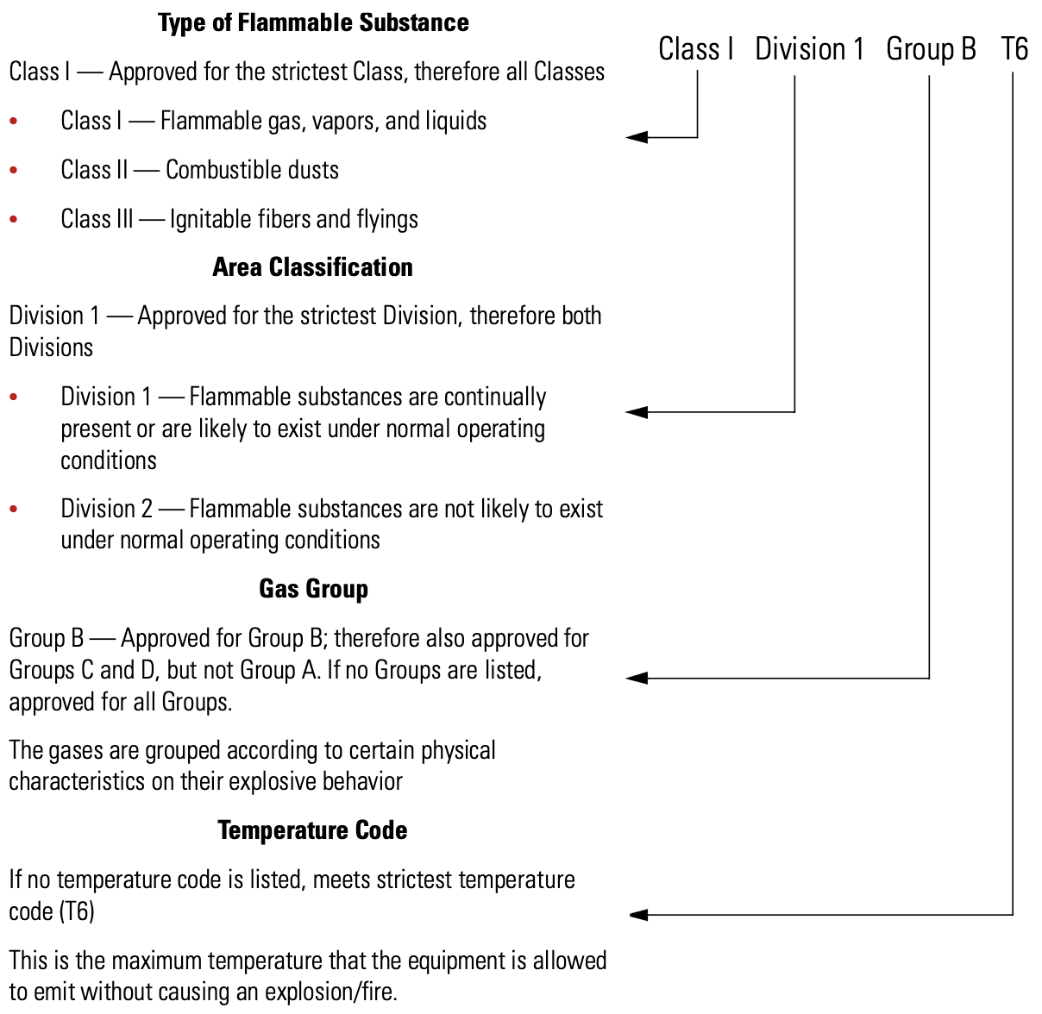
Electrical Classifications
1910.119(d)
68.65
MARKINGS

Slide 60
Classes, Areas, Zones Comparison
1910.119(d)
68.65
Zone 0 | Zone 1 | Zone 2
Where ignitable concentrations of flammable gases, vapors, or liquids are present CONTINUOUSLY OR FOR LONG PERIODS of time under normal operating conditions. | Where ignitable concentrations of flammable gases, vapors, or liquids: Are LIKELY to exist under normal operating conditions May exist FREQUENTLY because of repair, maintenance operations, or leakage | Where ignitable concentrations of flammable gases, vapors, or liquids: Are NOT LIKELY to exist under normal operating conditions Occur for only a short period of time Become hazardous only in case of an accident or some unusual operating condition
Division 1 |  | Division 2
Where ignitable concentrations of flammable gases, vapors, or liquids: Are likely to exist under normal operating conditions Exist frequently because of maintenance/repair work or frequent equipment failure |  | Where ignitable concentrations of flammable gases, vapors, or liquids: Are not likely to exist under normal operating conditions Are normally in closed containers where the hazard can only escape through accidental rupture or breakdown of such containers or in case of abnormal operation of equipment

Slide 61
Class 1 Protection Methods Comparison
1910.119(d)
68.65
Zone 0 | Zone 1 | Zone 2
Intrinsically safe (Class I, Division 1) (U.S. only) | Encapsulation Flame-proof Increased safety Intrinsically safe Oil Immersion Powder-filled Purged/Pressurized Any Class I, Zone 0 method Any Class I, Division I method (U.S. only) | Energy limited Hermetically sealed Nonincendive Non-sparking Restricted breathing Sealed device Any Class I, Zone 0 or 1 method Any Class I, Division 1 or 2 method (U.S. only)
Division 1 |  | Division 2
Explosion-proof Intrinsically safe (2 fault) Purged/Pressurized (Type X or Y) |  | Hermetically sealed Nonincendive Non-sparking Oil immersion Sealed device Purged/Pressurized (Type Z) Any Class I, Zone 1 or 2 method (U.S. only) Any Class I, Division 1 method

Slide 62
Electrical Classifications
1910.119(d)
68.65
Using NFPA 497 and 33 Diagrams
Relative Magnitudes of Process Equipment and Piping That Handle Combustible Materials
Process Equipment | Small (Low) | Moderate | Large (High)
Size (gal) | <5000 gal | 5000–25,000 gal | >25,000 gal
Pressure (psi) | <100 psi | 100-500 psi | >500 psi
Flow Rate (gpm) | <100 gpm | 100-500 gpm | >500 gpm

Slide 63
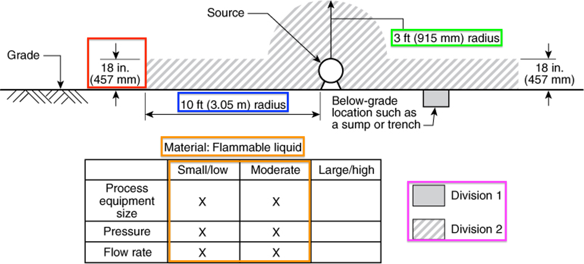
Electrical Classifications
1910.119(d)
68.65
Figure 5.10.1(a) Leakage Located OUTDOORS, AT GRADE
The material being handled is a FLAMMABLE LIQUID

Slide 64
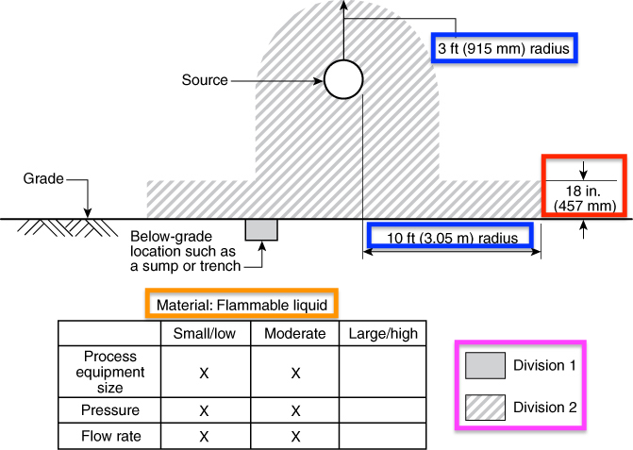
Electrical Classifications
1910.119(d)
68.65
Figure 5.10.1(b) Leakage Located OUTDOORS, ABOVE GRADE
The material being handled is a FLAMMABLE LIQUID

Slide 65
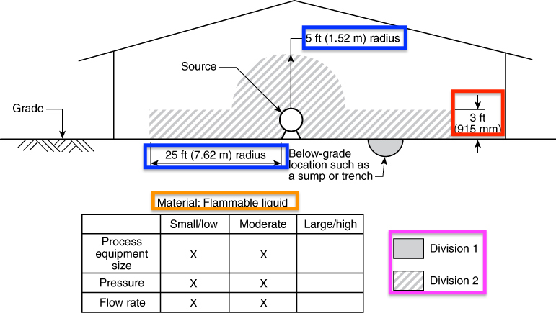
Electrical Classifications
1910.119(d)
68.65
Figure 5.10.1(c) Leakage Located INDOORS, AT FLOOR LEVEL
ADEQUATE VENTILATION is provided. The material being handled is a FLAMMABLE LIQUID.

Slide 66
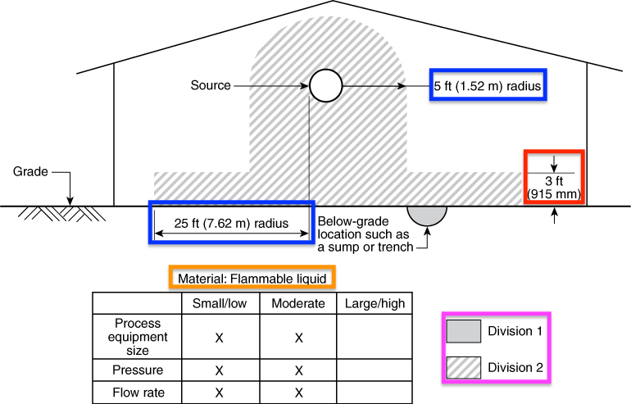
Electrical Classifications
1910.119(d)
68.65
Figure 5.10.1(d) Leakage Located INDOORS, ABOVE FLOOR LEVEL
ADEQUATE VENTILATION is provided. The material being handled is a FLAMMABLE LIQUID.

Slide 67
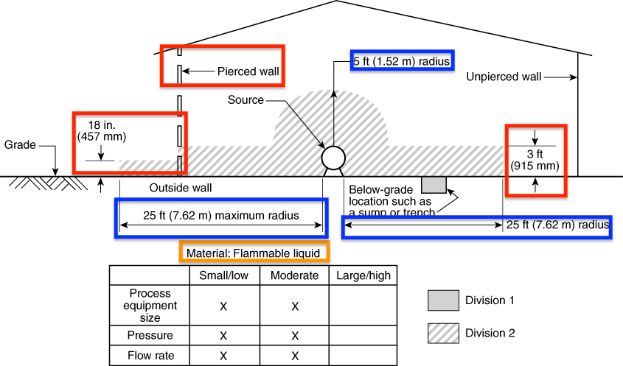
Electrical Classifications
1910.119(d)
68.65
Figure 5.10.1(e) Leakage Located INDOORS, AT FLOOR LEVEL, ADJACENT TO AN OPENING IN AN EXTERIOR WALL
ADEQUATE VENTILATION is provided. The material being handled is a FLAMMABLE LIQUID.

Slide 68
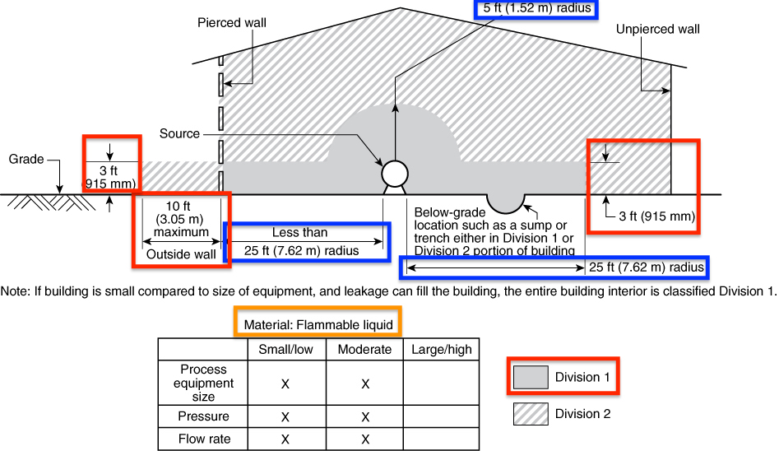
Electrical Classifications
1910.119(d)
68.65
Figure 5.10.1(f) Leakage Located INDOORS, AT FLOOR LEVEL, ADJACENT TO AN OPENING IN AN EXTERIOR WALL
Ventilation is NOT adequate. The material being handled is a FLAMMABLE LIQUID

Slide 69
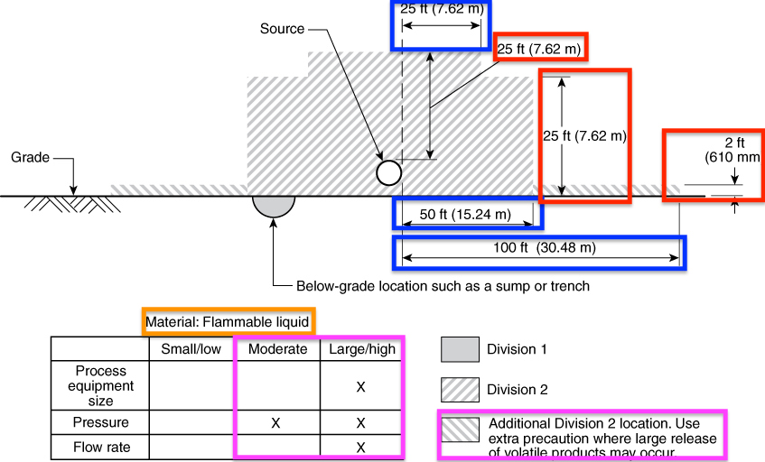
Electrical Classifications
1910.119(d)
68.65
Figure 5.10.1(g) Leakage Located OUTDOORS, AT GRADE
The material being handled is a FLAMMABLE LIQUID.

Slide 70
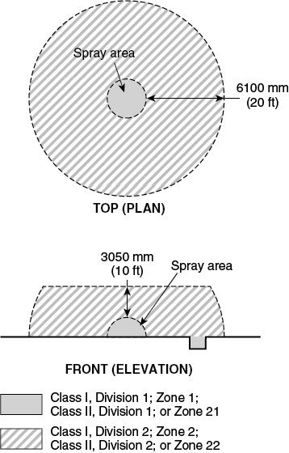
Electrical Classifications
1910.119(d)
68.65
NFPA 33, Figure 6.5.1 Electrical Area Classification for Unenclosed Spray Areas
If spray application operations are conducted within a CLOSED-TOP, OPEN-FACE or OPEN-FRONT booth or room, as shown in Figure 6.5.2(a) or Figure 6.5.2(b), any electrical wiring or utilization equipment located outside the booth or room but within 3 ft of any opening shall be suitable for Class I, Division 2; Class II, Division 2, whichever is applicable

Slide 71
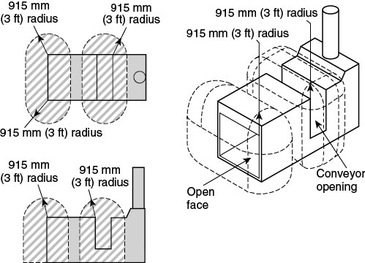
Electrical Classifications
1910.119(d)
68.65
NFPA 33, Figure 6.5.2(a) Class I, Division 2; Class II, Division 2 Locations ADJACENT TO AN OPEN-FACE OR OPEN-FRONT SPRAY BOOTH OR SPRAY ROOM
If spray application operations are conducted within a CLOSED-TOP, OPEN-FACE or OPEN-FRONT booth or room any electrical wiring or utilization equipment located OUTSIDE the booth or room but WITHIN 3 FT OF ANY OPENING shall be suitable for Class I, Division 2; Class II, Division 2 locations, whichever is applicable

Slide 72
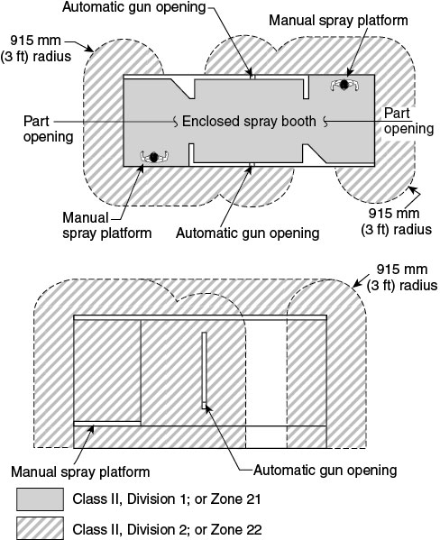
Electrical Classifications
1910.119(d)
68.65
NFPA 33, Figure 6.5.2(a) Class I, Division 2; Class II, Division 2 Locations ADJACENT TO AN OPEN-FACE OR OPEN-FRONT SPRAY BOOTH OR SPRAY ROOM
If spray application operations are conducted within a CLOSED-TOP, OPEN-FACE or OPEN-FRONT booth or room any electrical wiring or utilization equipment located OUTSIDE the booth or room but WITHIN 3 FT OF ANY OPENING shall be suitable for Class I, Division 2; Class II, Division 2 locations, whichever is applicable

Slide 73
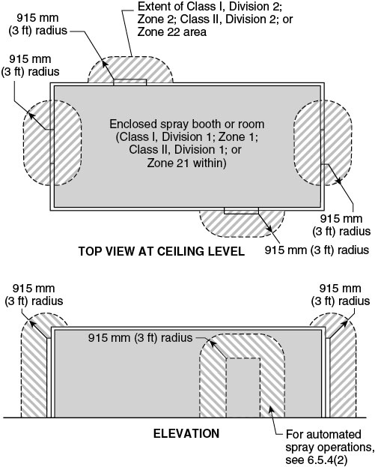
Electrical Classifications
1910.119(d)
68.65
NFPA 33, Figure 6.5.4 Class I, Division 2; Class II, Division 2; Locations Adjacent to an Enclosed Spray Booth or Spray Room

Slide 74
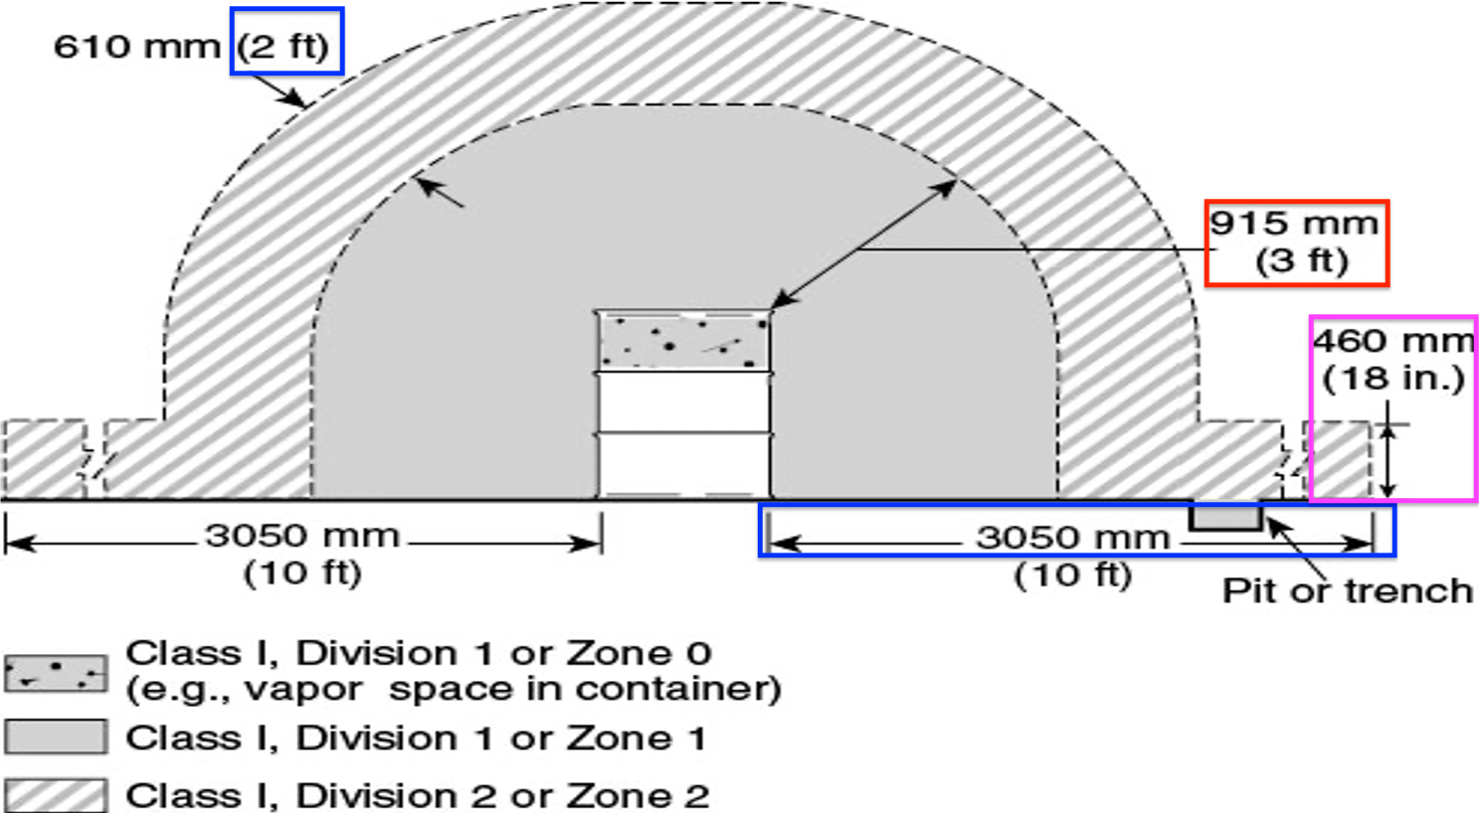
Electrical Classifications
1910.119(d)
68.65
NFPA 33, Figure 6.5.5.2 Electrical Area Classification for CLASS I LIQUID OPERATIONS AROUND OPEN CONTAINERS (Supply Containers, Waste Containers, Spray Gun Cleaners, and Solvent Distillation Units)

Slide 75
Bonding and Grounding
Bonding - For the purpose of controlling static electric hazards, the process of connecting two or more conductive objects together by means of a conductor so that they are at the SAME ELECTRICAL POTENTIAL, but not necessarily at the same potential as the earth
Grounding - The process of connecting a conductive object to the ground, so that the object is at zero (0) electrical potential

Slide 76
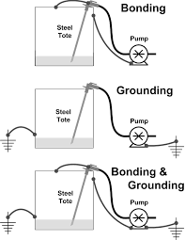
Bonding and Grounding

Slide 77
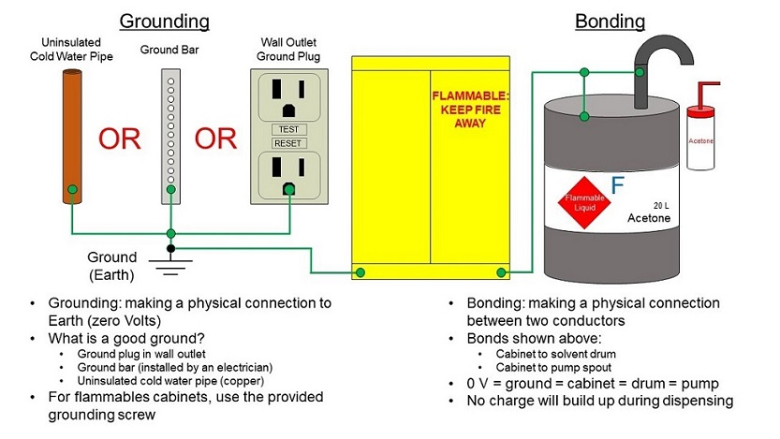
Bonding and Grounding

Slide 78
Bonding and Grounding
A conductive object can be grounded by a direct conductive path to earth or by bonding it to another conductive object that is already connected to the ground
Some objects are INHERENTLY bonded or inherently grounded because of their contact with the ground
  Examples of inherently grounded objects are underground metal piping and large metal storage tanks resting on the ground (not concrete!)

Slide 79
Bonding and Grounding
To PREVENT the accumulation of static electricity in conductive equipment, the total resistance of the ground path to earth should be sufficient to dissipate charges
  A resistance of 1 megohm (10⁶ ohms) or less generally is considered adequate
Where the bonding/grounding system is all metal, resistance in continuous ground paths typically is LESS THAN 10 ohms
  Greater resistance usually indicates that the metal path is not continuous, usually because of loose connections or corrosion

Slide 80
Class 1 Area
Flow Chart
Division 1
In which ignitable concentration of flammable gases or vapors:
Exists under normal operating conditions
Exists frequently because of
  Repair operations
  Maintenance operations
  Leakage
Are released through breakdown or faulty operation of
equipment or processes in which the breakdown causes
electrical equipment to become a source of ignition.
Division 2
In which ignitable concentration of flammable gases or vapors:
Are normally confined within closed containers when
  Handled
  Processed
  Used
Are normally prevented by positive mechanical ventilation
Are adjacent to a Class I, Division 1 location
Groups |  | Groups
A | B | C | D
Acetylene | Hydrogen, Butadiene, Ethylene Oxide, Propylene Oxide, Acrolien | Ethylene, Cyclopropane, Ethyl Ether | Propane, Acetone, Ammonia, Benzene, Butane, Ethanol, Gasoline, Hexane, Methanol, Methane, Naptha, Natural Gas, Toluene

