Slide 1
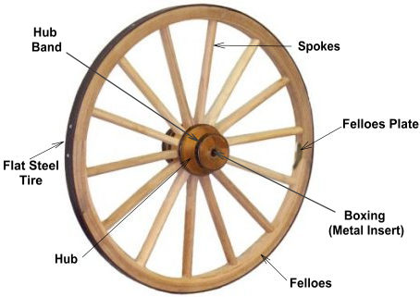
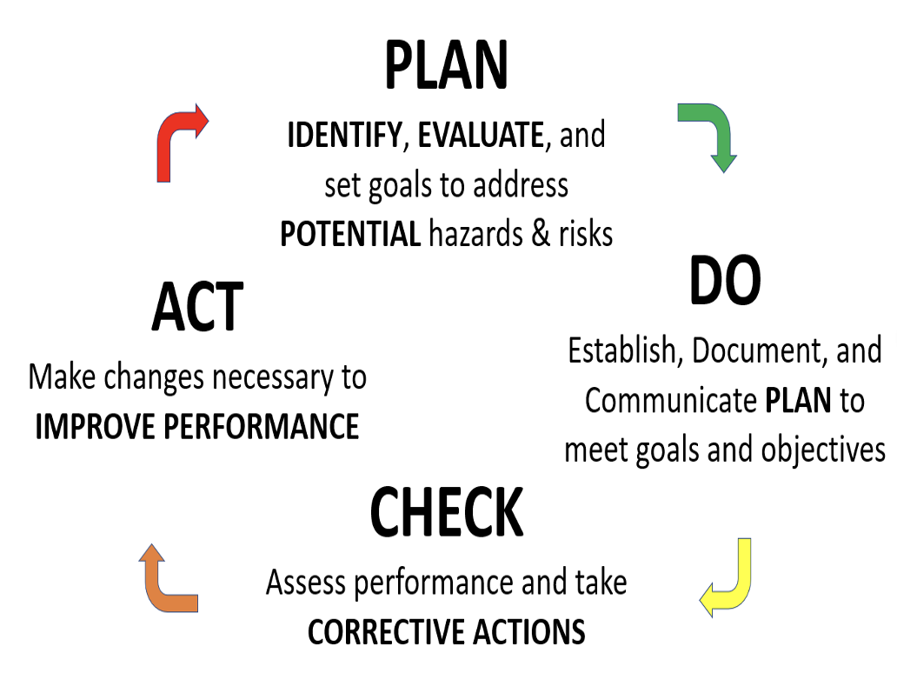
Safety Management System (SMS) is a “Wagon Wheel”

Slide 2
View the Safety Management System (SMS) as a “Wagon Wheel”
Spokes:
A spoke is a bar or rod that connects the center of a wheel to its rim.
The purpose of spokes is to support the structure of the wheel.
If the spokes of the SMS are NOT designed, implemented, and managed properly, they can be WEAK and therefore their numbers mean very little
The STRENGTH of the SMS is 95% dependent on the strength of EACH spoke!!!
The design implies the MORE spokes, the STRONGER the wheel
Assumption: All spokes can bear the forces applied to them!

Slide 3
Core SMS Elements = 4 spoke wheel
2. Hazard Analysis
3. Risk Assessment
4. Risk Reduction
1. Hazard Identification
A 4- spoke wheel may provide all the strength necessary to achieve the level of risk the business wants.
However, if just one of these four spokes weakens then our SINGLE failure is MAGNIFIED

Slide 4
Supporting SMS Elements STRENGTHEN the wheel
The supporting SMS elements provide the strength to the SMS to achieve sustainable progress through a CONTINUOUS IMPROVEMENT mindset
We can have a couple of “weakened” spokes in this 16-spoke model and still be managing risks well
NOTE: In this example, the business has chosen the Serious Injuries & Fatalities (SIF) SMS approach
Actively Caring &
Peer-to-Peer Culture
Management Leadership
Leading Indicator Metrics
Employee Participation
Corrective Actions Tracking
Hazard Identification
& Analysis
Quality Control & Assurance
Hazard/Risk Reduction
SIF
Continuous Improvement
Investigation Investigation & Causal Analysis
Human Factors & Behaviors
Assessing Risk & Ranking
Management of Change
Education &Training
Emergency Preparedness
Contractors

Slide 5

SMS Failures
It should be evident as to what this image is representing
This is the state of many SMS’s that were “implemented” but NEVER utilized as the tool to “manage risks”
Thus, it will be said “we have an SMS”, but one could argue it is NOT a functioning SMS and it is in a broken/weakened state

Slide 6
SMS failures
What does this weakened state of the SMS indicate to us?
By looking at this damaged SMS, which SINGLE SMS Element can we say is failing?
  Which SMS element is intended to IDENTIFY these weakened SMS elements/gaps in the SMS?
Failure to IDENTIFY and CLOSE these gaps is a LATENT ORGANIZATIONAL FAILURE
IDENTIFYING AND CLOSING THE GAPS is a continuous effort to ensure the SMS is strong

