Slide 1
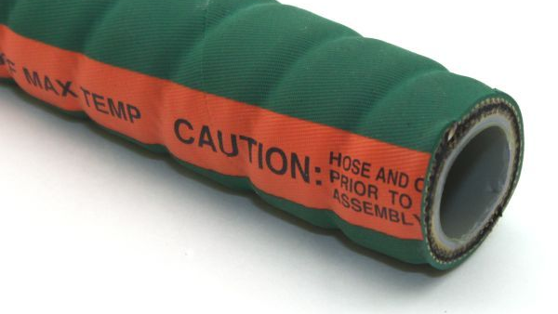

MAINTENANCE, TESTING, and INSPECTION of
CHEMICAL HOSES
ARPM IP-11-7

Slide 2
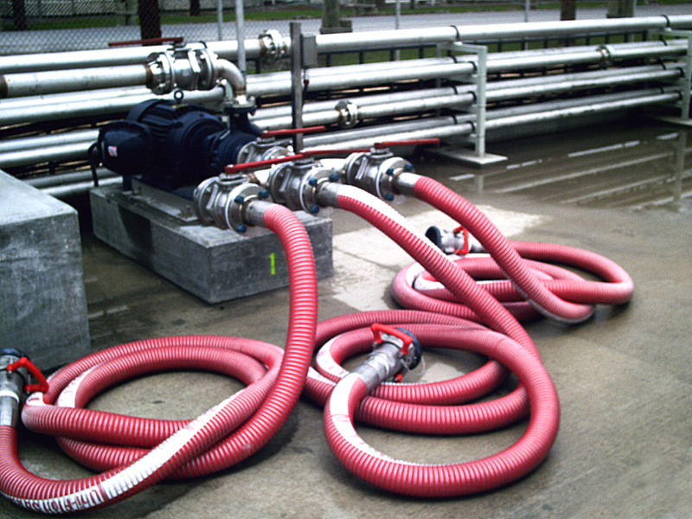
WARNING!
Failure of chemical hose in service can result in injury to personnel or damage to property. All chemical hose manufacturers recommend specific hose constructions to handle various chemicals. The manufacturer shall be consulted to determine what particular hose may be used to handle a specific chemical. Consult the hose manufacturer's literature or contact the hose manufacturer for the proper couplings to use with chemical hose.
Do NOT use chemical hose at temperatures or pressures above those recommended by the manufacturer.
All operators must be thoroughly trained in the care and use of this hose and must at all times wear protective clothing.
A hose or system failure could cause the release of a poisonous, corrosive, or flammable material.

Slide 3
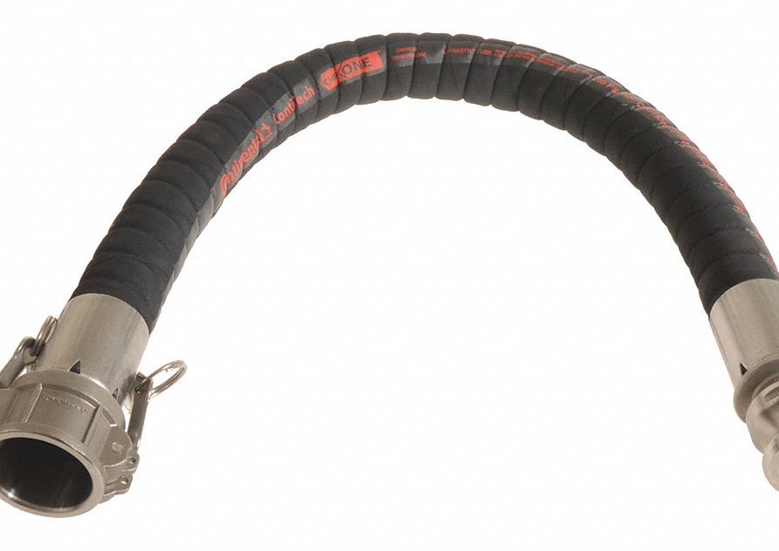
Scope
It covers hoses containing:
  carcass reinforcements of woven textile fabric;
  textile cords;
  textile or wire braids;
  flat, oval or round wire helix;
  spiral wire or cable; or
  any combinations of these reinforcements

Slide 4
Handling
Crushing or kinking of the hose can cause severe damage to the reinforcement
Care should be exercised to prevent mishandling
Do NOT drag the hose or lift a large bore hose from the middle of its length with the ends hanging down
Limit the curvature of the hose to that recommended by the manufacturer
Avoid sharp bends at the end fittings and at manifold connections

Slide 5
Operation
Pressures and temperatures are to be monitored to ensure the hose is NOT exposed to conditions above specified limits
  Exceeding specified limits could damage the hose and result in damage to property and serious bodily harm
NEVER allow chemicals to drip on the exterior of a hose or allow the hose to lie in a pool of chemicals since the hose cover may not have the corrosion resistance of the tube
  Should a corrosive material come in contact with the reinforcing material, early failure WILL result

Slide 6
Operation
If kinking or crushing occurs, examine the hose carefully.
  If the outside diameter is reduced 20% or less, the hose must be IMMEDIATELY subjected to the Visual Inspection and Pressure Test
  If the reduction in diameter is MORE THAN 20%, retire the hose from service
Care must be taken when different chemicals are conveyed in the same hose; the chemicals may react and shorten the service life of the hose
  When it is impractical to disconnect the hose line after use, drain any remaining chemical from the hose

Slide 7
Storage
Before placing the chemical hose in storage, the hose MUST BE COMPLETELY drained and any potentially explosive vapors or corrosive residues flushed out
WARNING!
Extreme care must be taken when flushing out a chemical hose with water; some chemicals, such as concentrated acids, may react with water and cause spattering.
When flushing a hose, disposal of the effluent must be made in such a manner that environmental problems are not created.

Slide 8
Storage
Chemical hoses are to be stored so that air can circulate throughout the length
The hose shall be LAID STRAIGHT on a solid support
Hose shall be stored in a COOL, DARK, DRY place at a temperature between 32℉ -100℉

Slide 9
Frequency of Inspection
Bulk Transfer Service
When the chemical hose is used in normal bulk transfer service, it shall be
  visually inspected DAILY and
  hydrostatically tested EVERY 90 DAYS
An inspection card and recording system MUST be adopted for chemical hose used in bulk transfer service applications

Slide 10
Frequency of Inspection
Bulk Transfer Service
The inspection card shall contain the following information:
  The hose,
  The manufacturer,
  The date received,
  The purchase order number and
  The date of installation
The inspection card must be used to record the test results and condition of the hose

Slide 11
Frequency of Inspection
Daily Inspection Procedure
Each day PRIOR to the day's use, a visual inspection shall be made
If any unusual appearances are noted the hose shall be subjected to a Pressure Test

Slide 12
Frequency of Inspection
New Assemblies and Hose Taken from Storage
ALL NEW hose assemblies & hose taken from storage shall be tested PRIOR to use to determine if they have been damaged in storage or shipment
  Follow the method described in the section titled Pressure Test

Slide 13
Frequency of Inspection
New Assemblies and Hose Taken from Storage
Normal Use - When the chemical hose is subjected to ORDINARY USE in bulk transfer applications, the frequency of testing shall be EVERY 90 DAYS
Abnormal Use - Hose assemblies used in bulk transfer shall also be tested IMMEDIATELY after the hose is subjected to abnormal abuse such as severe end pull, flattening or crushing by vehicles, or sharp kinking
Any hose that has been RECOUPLED shall be proof-tested and inspected before being placed in service
All physical testing shall be performed with the hose at ROOM TEMPERATURE

Slide 14
Visual Inspection And Pressure Test Procedure
Lay out the full length of the hose in a clean and preferably dry area
Inspect the outside cover of the hose for blistering, excessive abrasion or cuts, and coupling slippage
This inspection will be made when the hose is NOT UNDER PRESSURE
Covers
Any cuts, gouges, or tears in the cover, that do not expose the reinforcement, should be repaired BEFORE the hose is returned to service
  If the reinforcement is exposed, retire the hose from service
Covers may show surface cracking or crazing due to prolonged exposure to sunlight or ozone
  Such deterioration, which does not expose reinforcing material, is not a cause for retirement

Slide 15
Visual Inspection And Pressure Test Procedure
Carcass
Look for any indication of kinking or broken reinforcement as evidenced by any permanent distortion, longitudinal ridges, or bulges
If damage to the reinforcement is suspected, remove the hose from service and pressure test

Slide 16
Visual Inspection And Pressure Test Procedure
Crushed or kinked spots where the outer diameter of the hose is reduced by >20% of the normal outside diameter shall require that the hose be RETIRED
Hose containing kinked or crushed spots where the outside diameter is reduced <20% may be used if the hose passes the hydrostatic tests

Slide 17
Visual Inspection And Pressure Test Procedure
Fittings
Exposed surfaces of couplings, flanges, and nipples shall be examined for cracks or excessive corrosion
  Either condition shall cause the hose to be RETIRED FROM SERVICE
Any evidence of coupling or nipple slippage on the hose is cause for removing the hose from service

Slide 18
Pressure Test
New hose(s) and hose(s) taken from storage SHALL BE TESTED BEFORE it is placed in service
The HYDROSTATIC test and examination shall be conducted in the following manner:
  The hose shall lie in a straight and horizontal position, unrestricted so the hose can move freely when pressurized
  Water shall be used as the test liquid
    NEVER pressure test with solvents, corrosive liquids, air, or compressed gases
  Fill the hose with water with the outlet end raised and the outlet valve open to ensure the complete removal of air
  When all the air has been expelled, close the outlet valve and lower the raised end

Slide 19
Pressure Test
WARNING!
Extreme care must be taken when flushing out a chemical hose with water; some chemicals, such as concentrated acids, may react with water and cause spattering.
When flushing a hose, disposal of the effluent must be made in such a manner that environmental problems are not created.

Slide 20
Pressure Test
  For the NEW HOSE, raise the pressure to TWICE the rated working pressure and hold for 5-minutes
    During this hold period, the hose shall be examined for leaks at the couplings, fitting slippage, or any indication of weakness in the hose structure.
      The hose shall be RETIRED FROM SERVICE if any sign of leaks, fitting slippage, or weakness in the hose structure is found

Slide 21
Pressure Test
  For USED HOSE, test with pressure of 1-1/2 times the rated working pressure and hold for 5 minutes
    During this hold period, the hose shall be examined for leaks at the couplings, fitting slippage, or for any indication of weakness in the hose structure
      The hose shall be RETIRED FROM SERVICE if any sign of leaks, fitting slippage, or weakness in the hose structure is found
  Thoroughly drain the water from the hose after completion of the hydrostatic test
CAUTION!
Hose at 150% OR 200% of working pressure is hazardous if damage has occurred. Take all necessary safety precautions during the examination.

Slide 22
Electrical Continuity
When the user requires, ELECTRICAL CONTINUITY between the fittings shall be tested using a low-voltage system
The hose MUST be clean and dry for this test
The procedures outlined in Chapter 6 of the ARPM Hose Handbook, “Hose Test Methods,” can be used as a guide

