Slide 1
Safety Leadership and Culture
Source: UK HSE

Slide 2
Purpose and Expectations
This element focuses on the extent that an organization is forward-thinking and that it has clear aims and objectives about what it wants to achieve.
Together with effective leadership and governance methods organizations are to promote a consistent approach to safety management at all levels and support a positive, proactive culture of reporting and learning.
This is to be supported by establishing accountability based on well-defined authority levels and a clear understanding of responsibilities.

Slide 3
Promoting a consistent approach to safety management
The senior leader of the organization must establish and implement safety management arrangements through the organization’s SMS for the activities under their areas of responsibility.

Slide 4
Promoting a consistent approach to safety management
Leadership MUST demonstrate a commitment to the safety of the men and women who do the dirty and dangerous work within their organization by setting a clear tone from the top, promoting the vision for safety and by:
taking overall responsibility and accountability for the PREVENTION of work-related injury and ill health, as well as,
the provision of safe and healthy workplaces and activities

Slide 5
Promoting a consistent approach to safety management
Leadership MUST demonstrate a commitment to the safety of the men and women who do the dirty and dangerous work within their organization by setting a clear tone from the top, promoting the vision for safety and by:
Making sure that they
  are visible across their organization and
  by prioritizing safety alongside other strategic objectives

Slide 6
Promoting a consistent approach to safety management
Leadership MUST demonstrate a commitment to the safety of the men and women who do the dirty and dangerous work within their organization by setting a clear tone from the top, promoting the vision for safety and by:
Communicating the importance of effective safety management and of conforming to the organization's SMS requirements using a range of communication methods

Slide 7
Promoting a consistent approach to safety management
Leadership MUST demonstrate a commitment to the safety of the men and women who do the dirty and dangerous work within their organization by setting a clear tone from the top, promoting the vision for safety and by:
Regularly reviewing safety performance at leadership meetings and bidding for the necessary finance and resources to maintain a safe workplace

Slide 8
Promoting a consistent approach to safety management
Leadership MUST demonstrate a commitment to the safety of the men and women who do the dirty and dangerous work within their organization by setting a clear tone from the top, promoting the vision for safety and by:
Developing, leading and promoting a culture in the organization which supports the intended outcomes of the organization's SMS

Slide 9
Promoting a consistent approach to safety management
Leadership MUST demonstrate a commitment to the safety of the men and women who do the dirty and dangerous work within their organization by setting a clear tone from the top, promoting the vision for safety and by:
Ensuring the organization establishes and implements processes for continuous engagement via consultation, training and participation of the workforce and other stakeholders

Slide 10
Promoting a consistent approach to safety management
Leadership MUST demonstrate a commitment to the safety of the men and women who do the dirty and dangerous work within their organization by setting a clear tone from the top, promoting the vision for safety and by:
Encouraging the workforce and stakeholders to identify areas for improvement, leading to continual improvement in risk management through collaboration and innovation

Slide 11
Promoting a consistent approach to safety management
Leadership MUST demonstrate a commitment to the safety of the men and women who do the dirty and dangerous work within their organization by setting a clear tone from the top, promoting the vision for safety and by:
Promoting the open and transparent reporting of incidents (with an emphasis on Near misses), Hazards, Risks and Opportunities for Improvement

Slide 12
Promoting a consistent approach to safety management
Leadership MUST demonstrate a commitment to the safety of the men and women who do the dirty and dangerous work within their organization by setting a clear tone from the top, promoting the vision for safety and by:
Driving continuous improvement of safety performance management and effective oversight of action plans

Slide 13
Plan, Do, Check, Act approach
Plan, Do, Check, Act | Safety Management activities | Examples (not an exhaustive list)
Plan | Determine your policy Plan for implementation | Consider where you are now and where you need to be. Define what you want to achieve and who will be responsible for delivering that outcome. Define and communicate acceptable performance and the resources required.
Do | Profile risks Organize Implement your plan | Identify and assess your risks and identify control measures. Organize your activities to deliver your plan / involve workers and communicate. Implement and manage control measures. Train and instruct, to ensure everyone is competent to carry out their work and supervise to make sure that arrangements are followed.
Check | Measure performance (monitor before events, investigate after events) | Make sure your plan has been implemented. Measure and review performance. Assess how well the risks are being controlled. Investigate the causes of safety occurrences
Act | Review performance Act on lessons learned | Review your performance. Learn from measurements and findings of investigations. Revisit the plan, policy documents and risk assessments to see if they need updating. Take action on lessons learned, including from audit and inspection reports.

Slide 14
Safety Culture
Organizational Leaders set the strategic direction for safety which influences how individuals within the organization behave in relation to safety and defines the culture of the organization!

Slide 15
Safety Culture
Culture can be best understood as "the way we do things around here”
The safety culture of an organization is the product of individual and group values, attitudes, perceptions, competencies and patterns of behavior that determine the commitment to, and the style and proficiency of, an organization's health and safety management.
A safety culture builds slowly, but behaviors are influenced quickly through strong leadership, messaging, expectations, and examples, this is known as the “tone from the top”.

Slide 16
Safety Culture
Building a strong culture of safety is vital to prevent accidents, injuries and deaths.
Organizations should show genuine care to those who do the dirty and dangerous work, support open and honest reporting, and set a culture where everyone feels able to speak up before and not just after things go wrong, rather than fearing blame.
They should maintain policies and processes that develop and promote a positive safety culture throughout their organization and area of responsibility, they should share and effectively communicate good practice and any safety lessons identified in order to promote and support continuous improvement.

Slide 17
Safety Culture
The following steps should be taken by the organization to achieve this:
Leaders MUST set clear expectations and communicate a “tone from the top” based around their “duty of care” for the health, safety and wellbeing of their people

Slide 18
Safety Culture
The following steps should be taken by the organization to achieve this:
Leaders at all levels MUST be visible and proactive in promoting safety

Slide 19
Safety Culture
The following steps should be taken by the organization to achieve this:
Safety policies and procedures MUST be maintained, continually monitored and improved to mitigate human error

Slide 20
Safety Culture
The following steps should be taken by the organization to achieve this:
There MUST be open and honest reporting of health and safety concerns by stakeholders at all levels.
  A “Just Culture” that includes learning, questioning and flexible behaviors MUST be actively promoted, supported and maintained.
  A just culture is the cornerstone in ensuring that such errors are dealt with fairly and appropriately, where personnel are supported to learn from their actions.

Slide 21
Safety Culture
The following steps should be taken by the organization to achieve this:
Lessons identified within one area MUST be effectively communicated across all areas (e.g., from occurrence reporting / investigations / trends).
  Human factors should be appropriately considered to understand what lessons can be learned from occurrences and how to adapt in the future

Slide 22
Safety Culture
The following steps should be taken by the organization to achieve this:
The management of safety MUST be embedded throughout the organization, which should include two-way communication, constructive challenge, open reporting, and decision making which is transparent and responsive.

Slide 23
Safety Culture
A safety culture is not something to impose on others, but a product of facilitating and inspiring enduring safety behaviors.
Organizations with a positive safety culture will have the following characteristics:
  a low number of routine procedural violations;
  effective reporting of safety occurrences;
  effective feedback and learning from safety occurrence reporting;
  proactive rather than reactive responses to safety occurrences and regulatory interventions;
  compliance with the SMS Framework; and
  management decisions that consistently consider safety whilst planning or undertaking activities.

Slide 24
Safety Culture
The establishment of a positive safety culture within an organization is dependent on the following:
Management Commitment
This commitment produces higher levels of motivation and concern for safety throughout the organization.
It is indicated by the proportion of resources (time, money, people) and support allocated to safety management and by the status given to safety versus delivery/output, cost etc.
Active involvement of senior management in the safety system is vital.

Slide 25
Safety Culture
The establishment of a positive safety culture within an organization is dependent on the following:
Visible Management
Senior managers and leaders need to be seen to lead by example when it comes to safety.
Good leaders appear regularly on the shop floor, talk about safety and visibly demonstrate their commitment by their actions.
It is important that leaders are seen as committed to safety through both their words and their actions.

Slide 26
Safety Culture
The establishment of a positive safety culture within an organization is dependent on the following:
Good communications between all levels of personnel
Questions about safety should be part of everyday conversations.
Leaders should not only ask but, listen actively to what they are being told by personnel with regards to safety, and take it seriously.
Participation in safety is important, to build ownership of safety and exploit the knowledge that personnel have of their own work.
Personnel and leaders will be consistent, and safety is seen as a joint exercise to help change things for the better.

Slide 27
Safety Culture
The establishment of a positive safety culture within an organization is dependent on the following:
Effective decision making
Safety needs to be fully embedded within all aspects of an organization's evidence-based decision-making processes to ensure that the safety impact of any decisions is considered and understood.

Slide 28
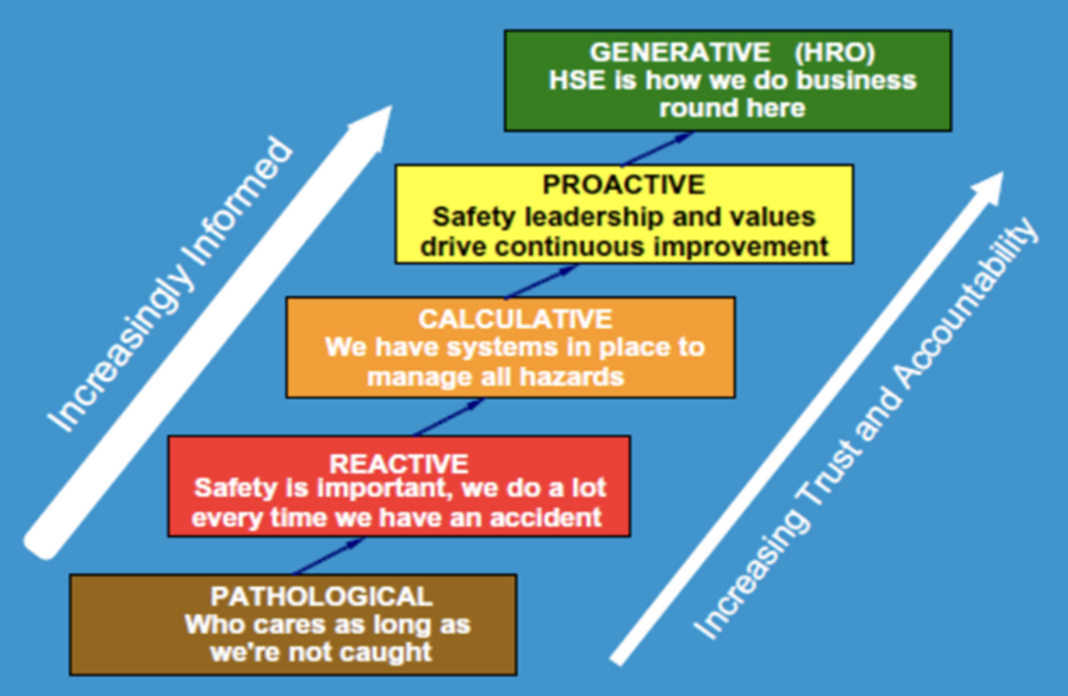
Using the Parker-Hudson Ladder in the context of culture
Pathological Safety Culture
Safety is a problem caused by the workers.
The drivers are the business and a desire not to get caught by the regulator.

Slide 29
Using the Parker-Hudson Ladder in the context of culture
Reactive Safety Culture
Organizations start to take safety seriously, but action is taken only after incidents.

Slide 30
Using the Parker-Hudson Ladder in the context of culture
Calculative Safety Culture
Safety is driven by management systems, with much collection of data.
Safety is still primarily driven by the management and imposed rather than looked for by the workforce.

Slide 31
Using the Parker-Hudson Ladder in the context of culture
Proactive Safety Culture
With improved performance, the unexpected is a challenge.
Workforce involvement starts to move the initiative away from a purely top-down approach.

Slide 32
Using the Parker-Hudson Ladder in the context of culture
Generative Safety Culture
There is active participation at all levels.
Safety is perceived to be an inherent part of the business, and safety-based solutions are welcomed as adding value and sustainability to the organization.
Safety challenges are tackled with innovative solutions.

Slide 33
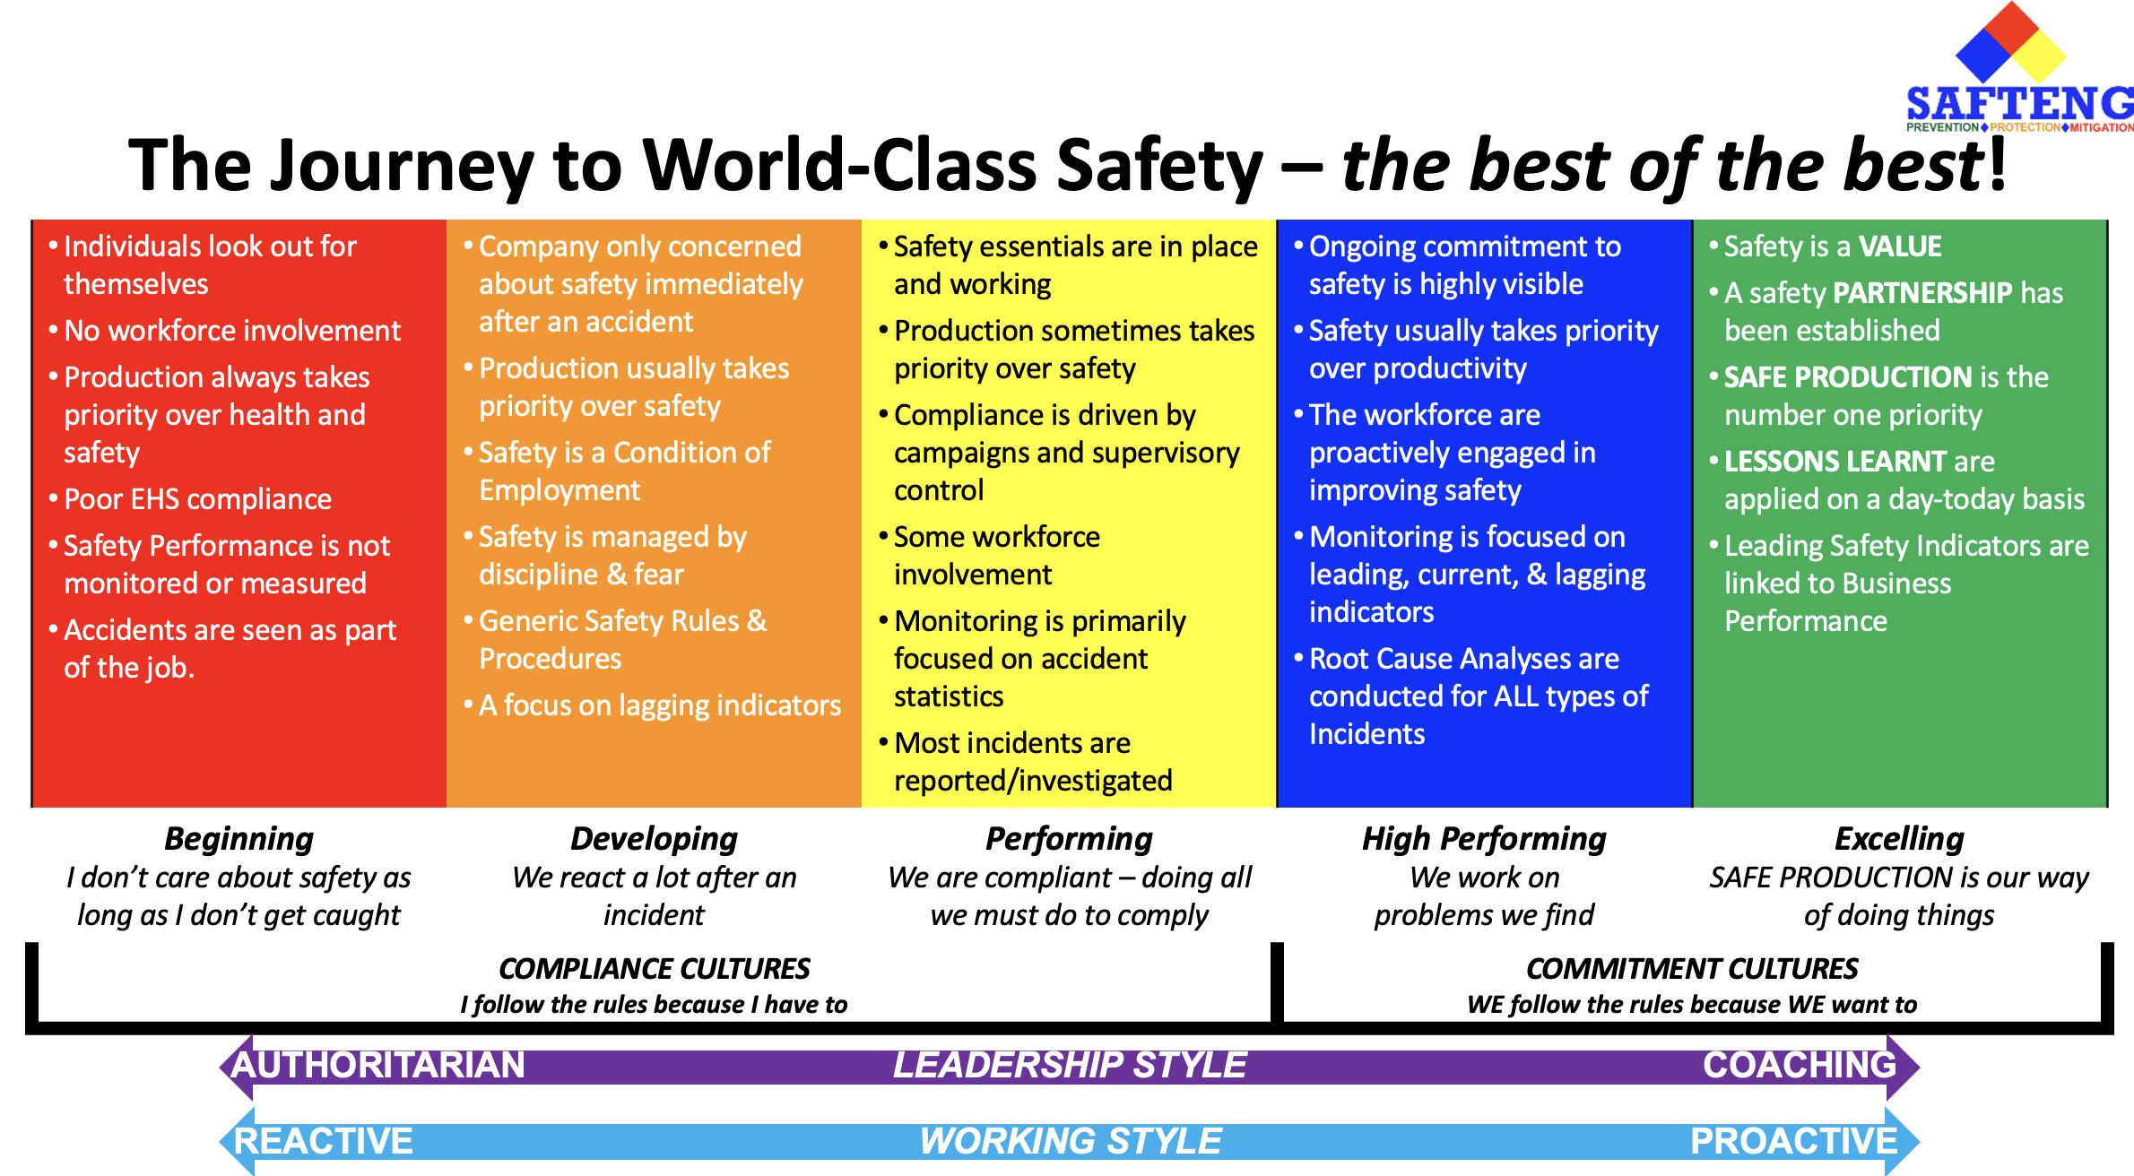

Slide 34
Leadership sets the “tone from the top” and actively demonstrate their commitment to safety
Unsatisfactory | Limited | Moderate | Substantial
There is little or no evidence of effective leadership relating to safety. Employees are not consistently aware of the organization's safety goals. | There is some, but not enough evidence of leadership messaging relating to safety that inspire others within the organization. There is some, but not enough evidence to show that employees understand how they contribute to achieving the organization's safety goals and act accordingly. | There is some evidence of leadership behaviors that inspire others within the organization to work to deliver against the safety vision of the organization. There is some evidence to show that employees know how they contribute to achieving the organization’s safety goals but with minor weaknesses in understanding the organization's relevant policies and vision of the senior team and acting accordingly. | Leadership have set a vision and a clear tone for the top on safety. Leadership is visible in the workplace and demonstrate their commitment to safety not just through words but via their individual actions and behaviors that clearly demonstrate to the workforce that they priorities safety alongside other business objectives.

Slide 35
Leadership promotes a culture of continual improvement, speaking up and embedding transparent and open reporting
Unsatisfactory | Limited | Moderate | Substantial
Leadership do no not value open and transparent reporting. There is no systematic process for open reporting and ensuring that corrective actions are completed. As such, the organization does not know if lessons are being learned from incidents and cannot demonstrate continual improvement or a learning culture. | Leadership speaks about the importance of open and transparent reporting, but this messaging is not consistent across the organization. There is some, but not enough evidence of the use of open reporting systems leading to effective corrective action, but this is not consistent. | Leadership consistently takes responsibility for developing and promoting an open and transparent reporting culture across the organization that supports effective safety risk management. There is some evidence of effective use of open reporting systems, with only minor weaknesses in the effectiveness of corrective actions undertaken. | Leaders support fairness, openness, and learning by making personnel feel confident to speak up when things go wrong, rather than fearing blame. Actions and decisions are understood before they are judged, and people are supported to learn from their actions. People are asked for their advice to help with designing the systems that could help change things for the better. Those responsible for managing incidents draw on human factors, investigations, skills, and expertise to fully understand how an incident happened, the lessons that can be learned and how to adapt in the future.

Slide 36
Leadership sets clear safety responsibilities by which the organization is measured and held to account.
Unsatisfactory | Limited | Moderate | Substantial
Some of the organization workforce do not. have defined safety roles and responsibilities. Performance on safety is not considered during the performance appraisal process. | Some of the organization workforce have defined safety roles and responsibilities. Some of the organization workforce have safety objectives defined in their annual objectives, but this is not done consistently. Performance on safety is considered during the performance appraisal process, but this is not done consistently. | Most of the organization workforce, but not all, have defined safety roles and responsibilities. Most, but not all, of the organization workforce have safety objectives defined in their annual objectives, and this is partially applied consistently. Performance on safety is consistently considered during the performance appraisal process. Leadership takes responsibility for ensuring required safety requirements are met in the organization's outputs / deliverables. | Everyone in the organization has defined safety roles and responsibilities. All of the organization workforce have safety objectives defined in their annual objectives, and this is applied consistently. Driving continual improvement in safety is valued, rewarded, and recognized by leadership.

Slide 37
Leadership is visible at all levels of the organization; including through direct interactions with the wider workforce and other stakeholders on matters of safety
Unsatisfactory | Limited | Moderate | Substantial
Leadership shows little or no consideration of safety issues or effect on outputs. Throughout the organization, individuals do not believe that leadership are interested in their safety. There is little or no communication from leadership to stakeholders regarding safety performance and issues. | Leadership considers safety risk management, but not in a consistent manner or its effects on outputs. Individuals across the organization believe that leadership are interested in their safety and are taking the necessary steps to reduce risks. Leadership communicates on safety performance and issues to stakeholders but does not welcome challenge. | Leadership shows a clear, wide-ranging understanding of the organization, including safety management and effects on outputs. Individuals across the organization express confidence that safety matters are formally discussed by leadership and regularly assessed to reduce risks. Leadership take action to equip stakeholders with sufficient and relevant information to allow them to challenge on safety issues as appropriate. | Leadership has continuous engagement with the wider workforce and other stakeholders on safety. Leadership meet and regularly review safety performance at leadership meetings beyond formal safety committee meetings. This is evident to the workforce. Leadership encourages stakeholders to identify areas for improvement, leading to continual improvement in risk management through collaboration and innovation, including providing necessary resources.

Slide 38
Corporate governance holds safety as an equal partner to other strategic objectives such as capability, cost and schedule.
Unsatisfactory | Limited | Moderate | Substantial
There is little or no evidence of understanding, at any level, of the importance of governance and reviews so that risk management objectives are delivered. There are no governance arrangements in place to demonstrate that the SMS has delivered the intended objectives, and there is no analysis of the findings of monitoring and audits by leadership. | There is, but not enough evidence of understanding and support for the role of corporate governance in setting and reviewing safety performance, but it is inconsistent. There are governance arrangements in place, but these do not always align with the organizational risk profile and strategies. Reviews are limited to simple data such as outcomes and status of actions from previous management reviews. | There is evidence but could be improved, that reviews result in effective changes to control safety risks. Corporate governance arrangements systematically include lessons learned from events in other organizations and other industries and include measures to assess the outcome of changes made. Corporate governance sometimes holds safety equally to other strategic Objectives. | Corporate governance arrangements encourage suggestions for improvement, and these routinely trigger leadership reviews. Reviews are carried out routinely and result in continual improvement of risk management. Outputs are shared widely to improve processes and encourage positive behaviors. Organizations considers safety as equal to other strategic objectives.

Slide 39
A culture is in place which fosters resilient safety management, engages people and promotes effective safety behaviors.
Unsatisfactory | Limited | Moderate | Substantial
There is little or no evidence to demonstrate that senior leadership are truly interested in safety. Rather, it appears to be viewed as a ‘tick box’ requirement which hinders rather than enables delivery of organizational priorities. There is little or no evidence that the SMS is seen as important or has been communicated outside of the team of safety specialists. | Leadership gathers anecdotal evidence about the wider organization's culture and behavior towards safety risk and considers this when designing and implementing policy. There is some, but not enough evidence of effective safety behaviors among the workforce, with limited participation in safety management activities. | Safety culture and behavior surveys are issued and completed on an ad-hoc basis; results are reviewed by the team commissioning and organizing the survey(s); and corrective actions are proposed to leadership. There is some but could be improved evidence of effective safety behaviors and engagement in safety management. | Safety culture and behavior surveys are completed and responded to on a regular basis. The outcomes are reviewed by leadership of appropriate seniority. Corrective actions are identified, implemented, and their impact is monitored. There is robust evidence of widespread effective safety behaviors and active engagement in safety management.

