Slide 1
A Culture of Safety
The endless journey
2025 Edition

Slide 2
Words that mean everything in Safety
TRUST
&
CREDIBILITY

Slide 3
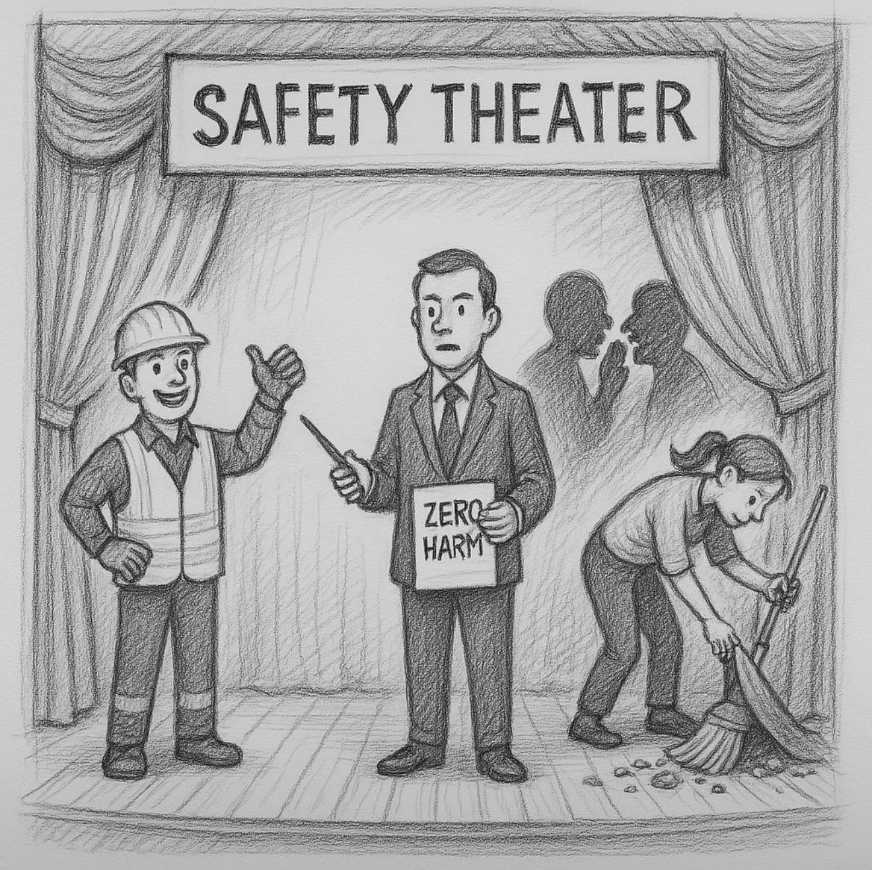
Inspired by Stefan Kühl’s metaphor, the Safety Theater is a stage where people in an organization play their parts. From left to right:
A worker in full PPE flashes a big smile for the audit,
A corporate safety manager holds up a script labeled "Zero Harm,”
Backstage, a couple of managers whisper warnings about the financial bottom line,
Meanwhile, someone diligently sweeps some hazards under the rug for the organization to perform well on the Looking Good Index...

Slide 4
Building a Culture is like raising a child
How does a parent build TRUST and CREDIBILITY with a child?
The journey of building a “culture of safety” is the exact same thing as raising a child:
Infancy Teenager Young Adult Maturity

Slide 5
What is a Culture of Safety?
A culture of safety can be described as our:
VALUES
What is important
Behaviors
The way we do things around here
Beliefs
How things work

Slide 6
The VALUE in a Culture of Safety?
A Culture of Safety has been shown to be a key predictor of safety performance
It is the difference between a safe organization and one in which “an accident is waiting to happen”
Thinking and talking about the Culture around SAFETY is essential for us to understand what we do well and where we need to improve

Slide 7
The ROADMAP for our Journey
1. Leadership and Management Commitment
2. Resourcing
3. Just Culture, Reporting and Learning
4. Risk Awareness and Management
5. Teamwork
6. Communication
7. Responsibility
8. Involvement

Slide 8
1. Leadership and Management Commitment
2. Resourcing
3. Just Culture, Reporting and Learning
4. Risk Awareness and Management
5. Teamwork
6. Communication
7. Responsibility
8. Involvement

Slide 9
Leadership and Management Commitment
Who Cares About Safety?
  Does it feel like your organization genuinely cares about safety?
    The messages within an organization determine whether people feel that safety is a genuine concern, a bureaucratic formality, or a hindrance.
  What messages about safety are received…and sent?

Slide 10
Leadership and Management Commitment
Commitment
  Do we believe that our manager or leaders are committed to safety?
    The decisions and communication of managers will send a strong message about safety – either positive or negative.
  How can managers better understand and communicate their own commitment?

Slide 11
Leadership and Management Commitment
Priorities
  What is the priority of safety for senior leaders compared to other business objectives?
    Safety must be considered alongside production, quality, cost, and the environment.
  Is senior management getting the balance right?

Slide 12
Leadership and Management Commitment
Trust
  How much do we TRUST leaders and management about safety?
    Trust is an essential ingredient of the “glue” that binds a Culture of Safety
    Trust in leadership and management is influenced by several factors, such as: 1) Consistency, 2) Credibility, and 3) Communication
  How can trust be nurtured?

Slide 13
Leadership and Management Commitment
Responding to Concerns
  How do managers and leaders respond to safety concerns?
    The level of support that staff receive from a manager and the action taken, will affect their willingness to raise concerns and speak up in the future.
  How can front-line workers feel more supported when they report safety concerns?

Slide 14
Leadership and Management Commitment
Credibility
  Do managers and/or leaders demonstrate commitment to safety in what they say and do?
    Words and actions MUST be consistent to maintain TRUST and CREDIBILITY.
  How can managers and/or leaders ensure that they are perceived as credible?

Slide 15
Leadership and Management Commitment
Encourage Safety
  Do managers and leaders encourage staff to use the safety processes?
    Processes such as safety checks, assessments, investigations, audits, and surveys are essential for safety but can also be seen as hindrances to everyday work
  How can we be sure that concerns of safety processes being a hindrance are taken seriously by managers?

Slide 16
Leadership and Management Commitment
Front-line Safety First?
  Are safety issues raised by front-line staff given appropriate urgency within the organization or practice?
    Issues that they raise need to be treated with urgency
  How can we ensure that issues raised get the attention they deserve?
Safety must become a VALUE
rather than being a PRIORITY

Slide 17
1. Leadership and Management Commitment
2. Resourcing
3. Just Culture, Reporting and Learning
4. Risk Awareness and Management
5. Teamwork
6. Communication
7. Responsibility
8. Involvement

Slide 18
Resourcing
Get Help
  Do we have sufficient professional safety support?
    Often, professional safety leadership is needed to integrate safety into the organization's activities properly
  How can we ensure we have the professional support that we need?

Slide 19
Resourcing
Upskill
  Do we have the training needed to help the organization understand the safety processes or procedures relevant to the risks within the organization?
    Is training available to help with safety activities, such as safety assessment and incident investigation, to suit a variety of roles?
  How can we ensure we have the skills we need within the organization?

Slide 20
Resourcing
RISK-BASED APPROACH is CRITICAL!
Too Little, Too Much?
  Is there enough focus on safety?
  Can there be too much?
    Sometimes, we may NOT realize that safety is slipping off the agenda
    Other times, people may get tired of too many safety messages or feel that there is too much focus on one aspect of safety
  How can we give safety the attention it needs?

Slide 21
Resourcing
RISK-BASED APPROACH is CRITICAL!
Do the Right Things Right
  Are the safety processes we use adequate?
  Which processes are working well, and which are not?
    Safety processes and procedures must be appropriate for the level of risk involved in the change or activity
  How can we make safety as practical as possible?

Slide 22
Resourcing
Train for Change
  Is adequate training provided when new systems and procedures are introduced?
    Training for changes in systems or procedures needs to be of adequate quality and duration and given at the right time
  How can we be better prepared for future changes?
The ONLY thing that is CONSISTENT in today’s workplace is
CHANGE

Slide 23
Resourcing
Safety in Numbers
  Do we have the correct number of staff to deliver a safe service?
    Having the right number of people to deliver a safe service —in total numbers or in terms of organizing rosters— is vital for safety
  How can we ensure that we get it right?
Believe it or not, FRONT-LINE Supervision plays more of a KEY role in Safety
than does the Safety Department staffing numbers!

Slide 24
Resourcing
Prioritize Resources
  Are resources for safety where they are most needed?
    Sometimes, we need to step back to check that the resources for safety are still prioritized properly
  How can we make the best use of the available resources?

Slide 25
Resourcing
Making Time for Safety
  Do projects have enough time to consider safety?
  Is it considered from the start?
    Safety in projects needs to be appropriately planned so there is enough time to integrate safety properly without unnecessary impacts on schedules
  Are we making time for safety in our work?

Slide 26
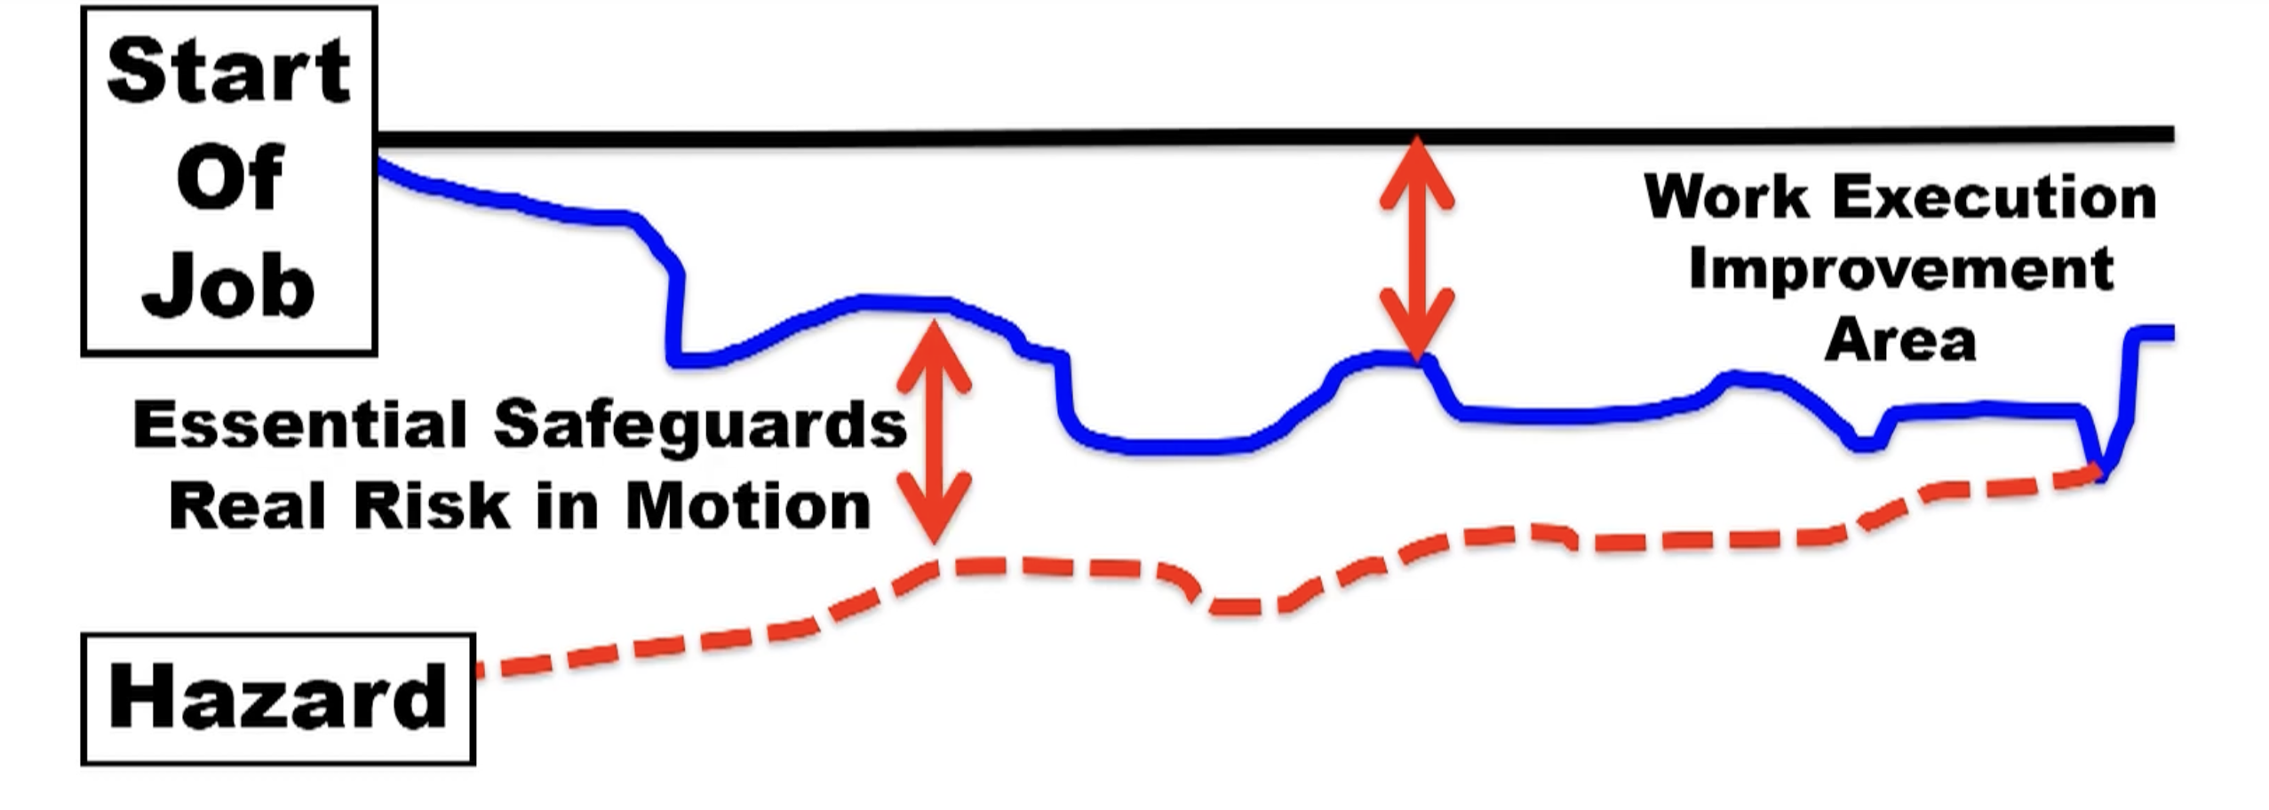
Resourcing
Right Procedures
  How do procedures compare with the way we do the work? (Work as imagined vs. Work as done)
    The way we work changes, and procedures need to reflect how the work is actually done
  How can we ensure the procedures remain realistic and accurate?

Slide 27
Resourcing
Right Equipment
  Does equipment support safe working?
    The equipment we provide, along with the people and procedures, has a prominent link to safety
    Considering safety in the concept, design, construction, operation and maintenance is critical
  How can we ensure that equipment is supporting safety?

Slide 28
Resourcing
Be Prepared
  Do we have the safety-related refresher training we need?
    Refresher training helps ensure that workers can cope with the demands of critical or rarely performed tasks, such as emergencies and deviant modes of operation
  What kind of refresher training is needed for operational and maintenance staff?

Slide 29
1. Leadership and Management Commitment
2. Resourcing
3. Just Culture, Reporting and Learning
4. Risk Awareness and Management
5. Teamwork
6. Communication
7. Responsibility
8. Involvement

Slide 30
Just Culture, Reporting and Learning
Speak Up
  Do we feel free to raise safety concerns?
    How we all react to the safety concerns of others can influence whether they raise them in the future
  Is voicing safety concerns encouraged by senior and front-line leadership?

Slide 31
Just Culture, Reporting and Learning
Follow the Trend
  What are the most frequent incident types?
    Knowing the incident trends can lead to a better understanding of the underlying conditions that need to be addressed to prevent serious incidents or accidents
  Do we know our KEY safety trends?

Slide 32
Just Culture, Reporting and Learning
Learn from Incidents
  Does the organization incorporate LESSONS from incidents into the work?
    To learn from incidents/deviations, we must look carefully at the trends, serious incidents, recommendations, and how they might apply to our work
  How can we learn from incidents?
Sharing the LEARNINGS across the entire organization!
Make the Incident Investigation element of our SMS a PROACTIVE element

Slide 33
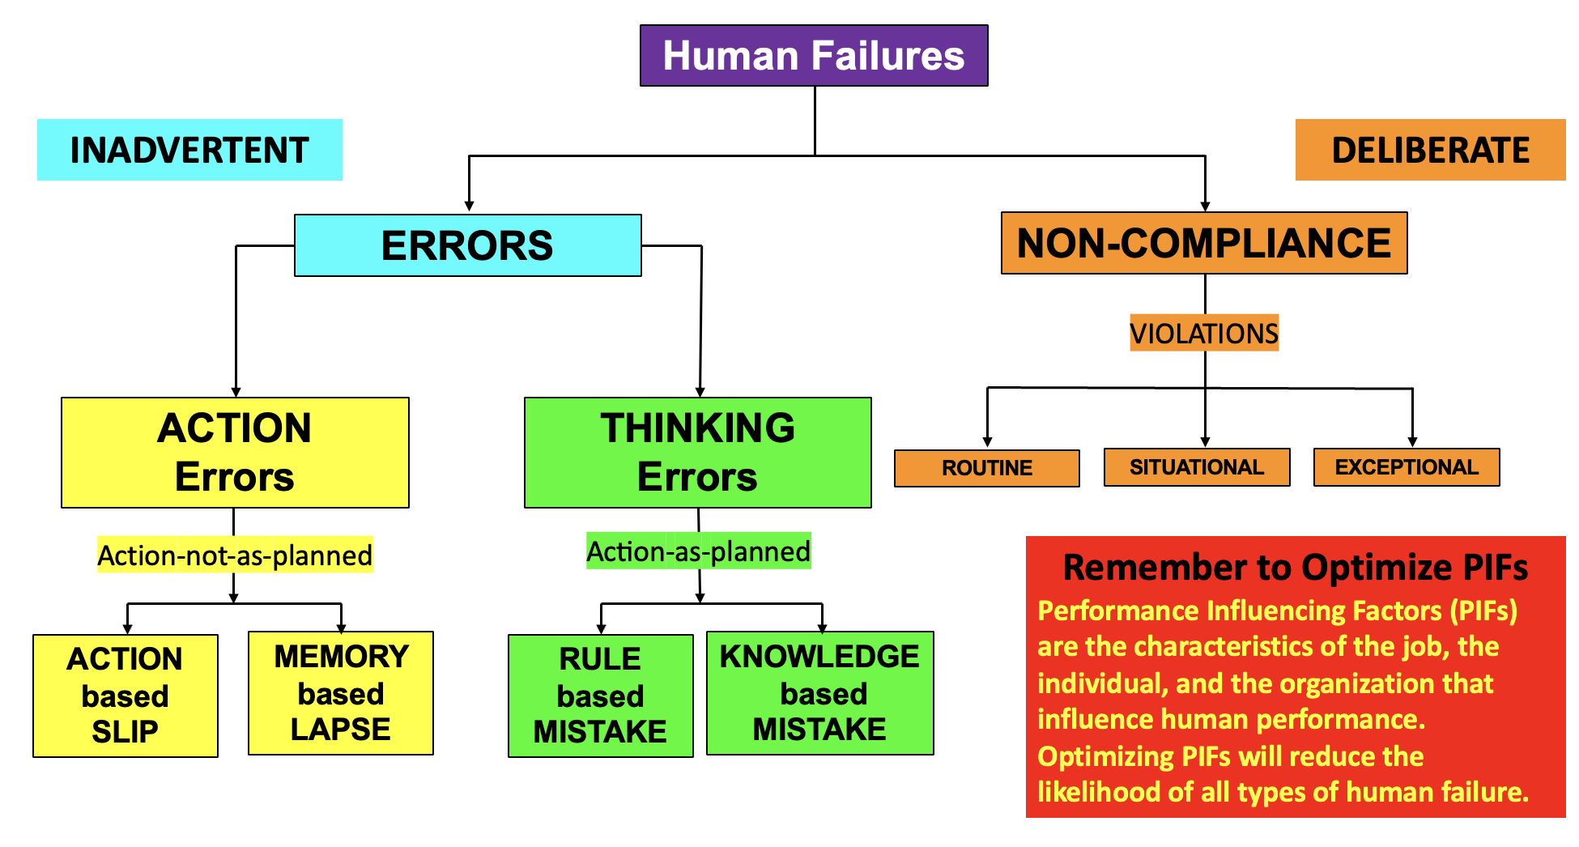
Just Culture, Reporting and Learning
Make “Just Culture” Real
  Staff should not be punished for actions that are in keeping with their experience and training
  Instead, they need to understand what happened, support those involved, and improve work systems to reduce the risk of recurrence
  Is “just culture” the way we do things or is it just a policy?
    “Just Culture” is NOT just a policy on the wall; it lives and breathes throughout the organization
  Do we talk about Just Culture?

Slide 34
Just Culture, Reporting and Learning
Unacceptable Behavior
  If a colleague regularly took unacceptable risks, what would happen?
    Risky behavior can be challenging to define, but unacceptable behavior must be understood and dealt with
  Who draws the line, and how should the organization deal with different types of unacceptable behavior?

Slide 35
Just Culture, Reporting and Learning
Focus on the Issue
  When a safety issue is raised, do we focus on the message or messenger?
    Sometimes, we pay more attention to the person who raises a safety issue than the issue itself
    Our perception of the “whistleblower,” “troublemaker,” or simply responsible individual can affect our response
  How can we ensure that we focus on the message rather than the messenger?

Slide 36
Just Culture, Reporting and Learning
To Err is Human
  How would a front-line worker who was involved in a genuine “error” incident be treated?
    “Human error” is just a by-product of normal variability in performance
    This is accepted and managed in a healthy and mature Culture of Safety
  How can leaders better support people when errors become part of prosecution?

Slide 37
Just Culture, Reporting and Learning
Avoid the Blame Game
  When people report safety-related occurrences, are they blamed or treated in a just and fair manner?
    How people are treated when they report safety-related occurrences, including “errors, mistakes, and violations,” is a test for the “Just Culture” of the organization
  How can we encourage a “Just Culture” within the organization and the team?

Slide 38
Just Culture, Reporting and Learning
Reporting for Safety
  Does reporting incidents and hazards improve safety?
    Incident and Hazard reporting ultimately aims to reduce reoccurrence, improving safety
  How can we make sure reports make a visible difference and motivate people to report?
HUGE Opportunity to BUILD TRUST & CREDIBILITY

Slide 39
Just Culture, Reporting and Learning
How to Report
  Does our workforce know how to report situations that may compromise safety or their own well-being?
    Knowing how to report occurrences should be simple
  How can reporting be simple and easy enough for everyone to understand and do?

Slide 40
Just Culture, Reporting and Learning
Feedback Loop
  Do people get timely feedback on the safety issues they raise?
    Timely feedback to people who raise safety issues is CRITICAL
    It keeps them informed and helps maintain their MOTIVATION to continue to raise safety issues
  What kind of feedback best suits the needs of those who raise safety issues, and when should this be given?
A FORMAL and MEASURABLE “Feedback-Loop” plays a CRITICAL ROLE in maintaining “safety morale”

Slide 41
Just Culture, Reporting and Learning
Investigate to Improve
  How well do we investigate safety occurrences?
    A good investigation should describe and explain the occurrence and the factors that contributed to it and present workable recommendations to reduce the chance that it will happen again
  What are the positives and negatives about how we investigate, and how could it be improved?

Slide 42
Just Culture, Reporting and Learning
Talk it Over
  How do we talk about incidents?
    With open and fair discussion, LESSONS can be learned quickly after occurrences
  How can we create the right environment for these discussions so that we can learn from the experience?

Slide 43
1. Leadership and Management Commitment
2. Resourcing
3. Just Culture, Reporting and Learning
4. Risk Awareness and Management
5. Teamwork
6. Communication
7. Responsibility
8. Involvement

Slide 44
Risk Awareness and Management
Safe Procedures
  Do workers have the need to deviate from procedures?
    When we often have the need to deviate from procedures, it can be a sign that things are “drifting into danger”
  How do we make sure the task(s) remains safe?

Slide 45
Risk Awareness and Management
Know our Risks
  Do we know the top five (5) risks that are relevant to our facility?
    We need to be aware of the top risks that may be relevant to our work so that we can prioritize and manage them.
  Does Senior Leadership know the top five risky facilities and the risks that drive the risks at these facilities?
The Serious Injury & Fatality (SIF) Approach

Slide 46
Risk Awareness and Management
Balancing Safety
  How do you balance safety against other requirements of your job?
    Safety MUST become a VALUE in high-risk workplaces, and this will be reflected in decisions by frontline supervisors, support staff, management, and other specialist and technical staff
    But safety is NOT the only requirement!
  How can we get the balance right?

Slide 47
Risk Awareness and Management
Taking Risks
  Do we sometimes have to take risks that make us feel uncomfortable about safety?
    It is hard to assess the level of risk involved in our own activities
    But if we have to take risks that make us feel uncomfortable, it is time to stop and think
  How do we respond to risky activities?

Slide 48
Risk Awareness and Management
Maintaining Safety
  Do frontline staff understand how equipment or procedural failures affect risks?
    These risks need to be identified, assessed, and controlled via training, procedures, teamwork, and communication
  What do we have in place that ensures risks are appropriately managed?

Slide 49
Risk Awareness and Management
Managing Risk of Changes?
  How do we manage the risks of changes to the organization, systems, and procedures?
    Many types of changes can present new risks, or changing existing risks may take us by surprise
  How can we best assess and manage the risk from the different types of changes?

Slide 50
Risk Awareness and Management
Blind Spots
  Are we aware of latent organizational failures that are not being addressed appropriately?
    Sometimes problems seem so long-standing or difficult to resolve that they are ignored and become a “blind spot”
  How can we help to make sure that latent organizational failures are resolved rather than ignored?
Safety Blind Spots are situations where a worker is unsafe because of a lack of insight.
Sometimes workers—or even employers—don’t even know they have a blind spot, or worse they are aware of the blind spot, but they don’t think it will lead to a dangerous situation.

Slide 51
Risk Awareness and Management
Under Pressure?
  Do workers feel pressure to keep operating despite recognized and unacceptable risks?
    We all want to do the best job we can, but sometimes we can experience pressure to take or accept risks that make us feel uncomfortable
  How do we respond when the pressure is on?

Slide 52
1. Leadership and Management Commitment
2. Resourcing
3. Just Culture, Reporting and Learning
4. Risk Awareness and Management
5. Teamwork
6. Communication
7. Responsibility
8. Involvement

Slide 53
TEAMwork
Us, or Us and Them?
  How well does our team work with other teams?
    Sometimes, working relationships can threaten safety
  How does the safety team interact with other teams?

Slide 54
TEAMwork
Working Together
  How well does our team work together?
    Teamwork will affect everything we do, including safety.
  What are we doing well, and what could we improve?

Slide 55
TEAMwork
Consult
  How does frontline management consult with relevant others to maintain equipment and procedures so that safety is not negatively impacted?
    Knowing about the status of equipment and procedures is CRITICAL.

Slide 56
TEAMwork
Talking about Systems
  How does frontline management provide information about system problems to more senior colleagues (and vice versa) to keep systems working properly?
  Is everyone getting the information they need?

Slide 57
TEAMwork
Challenge Risk
  What happens in our workplace if we see risky or unsafe behavior?
    Unsafe behavior needs to be challenged, regardless of whose behavior it is
  How would we intervene if we were uncomfortable with a colleague’s behavior, and how can we discuss what is acceptable and what is not?

Slide 58
TEAMwork
Confidence in Colleagues
  Do we have confidence in the people that we interact with?
    CONFIDENCE and TRUST in colleagues is an essential part of teamwork
    Sometimes, we might feel that we are losing (or have lost) confidence in a colleague
  If this happened, how would we handle it?

Slide 59
TEAMwork
Handling Negativity
  How do we handle people who have a negative attitude to safety?
    Occasionally, there are people whose safety attitude is so negative that colleagues do not want to work with them
  What is the most productive way for us to improve the situation?

Slide 60
1. Leadership and Management Commitment
2. Resourcing
3. Just Culture, Reporting and Learning
4. Risk Awareness and Management
5. Teamwork
6. Communication
7. Responsibility
8. Involvement

Slide 61
Communication
Share
  How well do we, our team, and our organization share safety-related information?
    Open sharing of safety information is vital to highlight risks and good practices so that others can learn and act
  What can we do to open the lines of communication?

Slide 62
Communication
Get the Picture
  Do we have a picture of the current safety performance?
    Without a clear picture of safety performance, we can’t manage safety or risks properly
  How would we like this information to be made available and understandable?

Slide 63
Communication
Stay in-communication
  Are we aware of the safety-related change in our setting that may be relevant to our work?
    Our workplace changes constantly, and there can be implications for safety if we are not up-to-date
  How should safety-related changes be communicated?

Slide 64
Communication
Going up? Going down?
  How well do management and staff communicate about safety matters?
    Two-way communication between management and staff is essential to ensure EVERYONE is aware of changes, problems, and solutions
  How would we like vertical communication about safety to be?

Slide 65
Communication
Look Outside
  How well does our team communicate with other relevant organizations?
    A Culture of Safety needs OPEN and EFFECTIVE communication with EXTERNAL STAKEHOLDERS (e.g., neither Corporate Safety nor OSHA are the devil)
  How can we improve our communication?

Slide 66
1. Leadership and Management Commitment
2. Resourcing
3. Just Culture, Reporting and Learning
4. Risk Awareness and Management
5. Teamwork
6. Communication
7. Responsibility
8. Involvement

Slide 67
Responsibility
Know your Relevance
  How is our work relevant to safety in our setting?
    Directly or indirectly, we are all supporting safety, whether we realize it or not
    Recognizing our contribution to safety helps us to focus on the things that matter
  How could we better understand our roles?

Slide 68
Responsibility
Take Responsibility
  Whose is responsible for safety?
    If people feel that safety is their responsibility, even if any possible safety consequences seem distant, then they are more likely to consider safety in their decisions and performance generally
  How can we ensure that everybody knows they are responsible for safety?

Slide 69
Responsibility
Colleague Commitment
  How committed to safety are your colleagues?
    The commitment to safety among direct colleagues can have a powerful effect on our attitudes
    A safety-conscious individual can lose this focus if colleagues don’t take safety seriously
  How can we maintain the commitment to safety?

Slide 70
Responsibility
The Whole Picture
  Do others understand how your job contributes to safety?
  Do you understand how others contribute?
    While we might understand how we contribute to safety, it is harder to understand others’ contributions, especially further away from the “sharp end” of safety, such as Human Resources, Finance, Research & Development, etc.
  How can we improve our understanding of our contributions to safety?

Slide 71
Responsibility
Speak Up
  Would we speak up to your manager if we had safety concerns?
    Authority should NEVER PREVENT people from speaking up when they notice something is wrong
  How can we ensure that we feel safe to speak up when we need to?

Slide 72
1. Leadership and Management Commitment
2. Resourcing
3. Just Culture, Reporting and Learning
4. Risk Awareness and Management
5. Teamwork
6. Communication
7. Responsibility
8. Involvement

Slide 73
Involvement
We Make a Difference
  How is our team influencing safety in our setting?
    It can be difficult for some staff to consider how their individual job can influence safety
    But it is more apparent when we think of our whole team
  How can our team better understand this impact?

Slide 74
Involvement
Contribute to Change and Improvement
  Are we sufficiently involved in system changes?
    System changes need to be made with the end user in mind
  How can we ensure that input from all impacted groups helps steer changes in the right direction?

Slide 75
Involvement
Assessing Everyday Risk
  What is our role in safety assessments?
    Safety Assessments need the correct input from the right people
  How can we ensure that we participate effectively in safety assessments?

Slide 76
Involvement
Our Procedures
  What is the role of frontline staff in changes to procedures?
    Procedures, like systems, need to be designed for the intended users and with their expertise
  How can we ensure the right level of input from the right people to ensure the procedures are correct?

