Slide 1
Labeling Workplace Containers
1910.1200(f)(1) Shipped Containers
versus
1910.1200(f)(6) Workplace Containers

Slide 2
Shipped Containers Labeling
1910.1200(f)(1) Labels on SHIPPED containers
The chemical manufacturer, importer, or distributor shall ensure that each container of hazardous chemicals leaving the workplace is labeled, tagged or marked…
Where the chemical manufacturer, importer, or distributor is required to label, tag or mark the following shall be provided:
  1910.1200(f)(1)(i) Product identifier;
  1910.1200(f)(1)(ii) Signal word;
  1910.1200(f)(1)(iii) Hazard statement(s);
  1910.1200(f)(1)(iv) Pictogram(s);
  1910.1200(f)(1)(v) Precautionary statement(s);
  1910.1200(f)(1)(vi)Name, U.S. address, and U.S. telephone number of the chemical manufacturer, importer, or other responsible party.

Slide 3
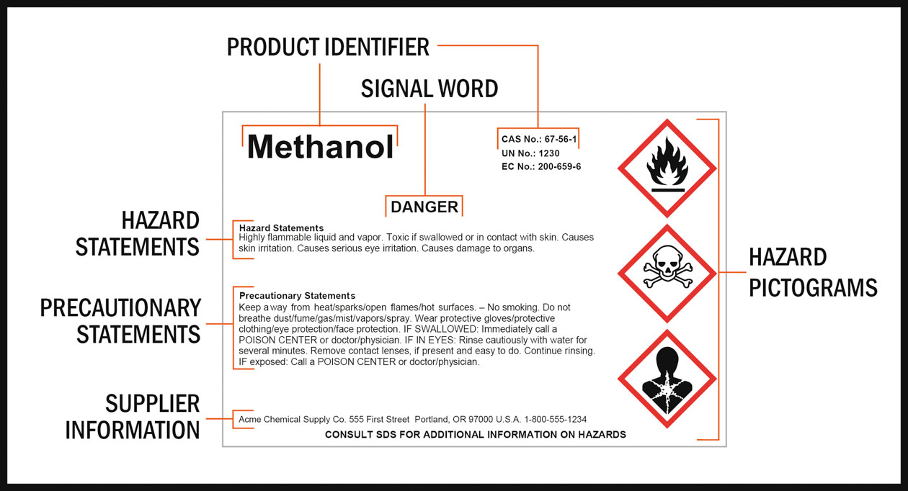
Shipped Containers Labeling

Slide 4
Workplace Labeling
1910.1200(f)(6) WORKPLACE labeling
Except as provided in paragraphs (f)(7) and (f)(8) of this section, the employer shall ensure that each container of hazardous chemicals in the workplace is labeled, tagged or marked with either:
1910.1200(f)(6)(i) The information specified under paragraphs (f)(1)(i) through (v) of this section for labels on shipped containers;
OR
1910.1200(f)(6)(ii) Product identifier and words, pictures, symbols, or combination thereof, which provide at least general information regarding the hazards of the chemicals, and which, in conjunction with the other information immediately available to employees under the hazard communication program, will provide employees with the specific information regarding the physical and health hazards of the hazardous chemical.

Slide 5
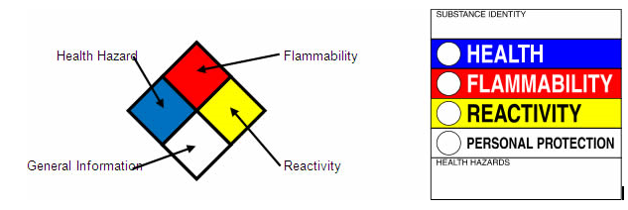
Workplace Labeling
Hazardous Materials Identification System (HMIS)
NFPA 704 Diamond
Chemical Name
These traditional labeling schemes work, but they MUST also include the Chemical Name, so workers are able to look up the SDS for said chemical.

Slide 6
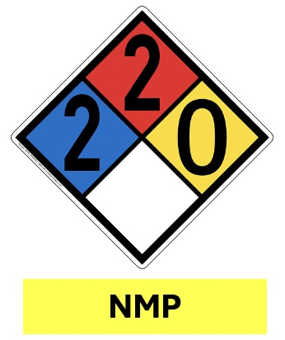
Workplace Labeling
A real-life example for N-Methyl-2-pyrrolidone (NMP). Using the NFPA 704 Diamond and the Chemical Name meets .1200(f)(6)
Product identifier and words, pictures, symbols, or combination thereof, which provide at least general information regarding the hazards of the chemicals, and which, in conjunction with the other information immediately available to employees under the hazard communication program, will provide employees with the specific information regarding the physical and health hazards of the hazardous chemical.
The yellow NMP label is NOT required to be the color yellow; I just match my chemical name labels with the color coding on Pipe Labels per ASME A13.1

Slide 7
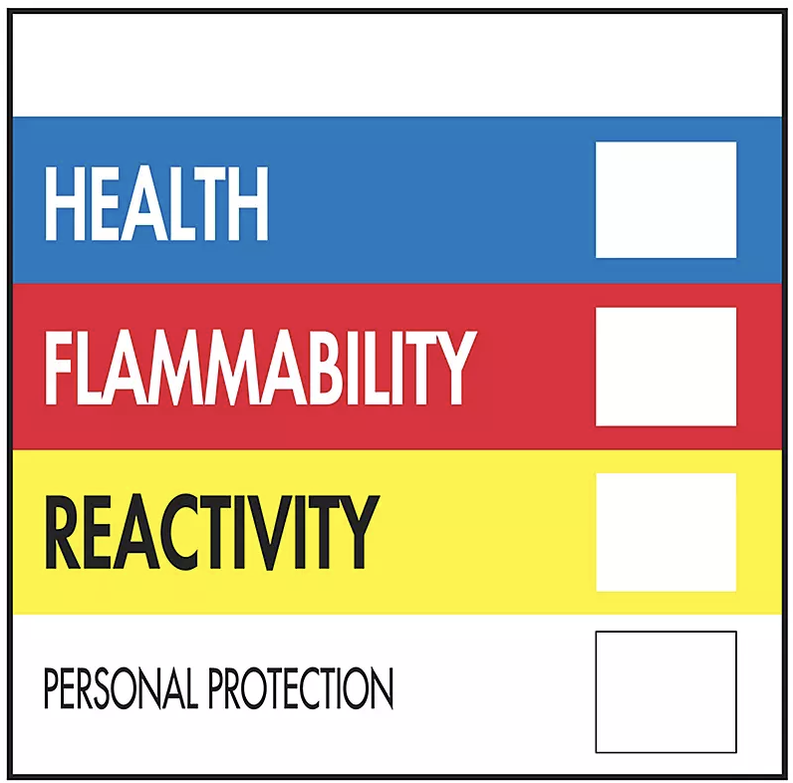
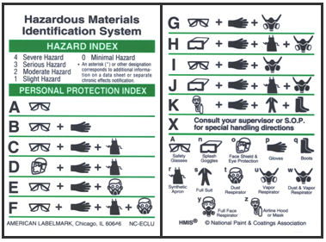
Workplace Labeling
A real-life example for N-Methyl-2-pyrrolidone (NMP). Using the Hazardous Materials Identification System (HMIS) and the Chemical Name meets .1200(f)(6)
Product identifier and words, pictures, symbols, or combination thereof, which provide at least general information regarding the hazards of the chemicals, and which, in conjunction with the other information immediately available to employees under the hazard communication program, will provide employees with the specific information regarding the physical and health hazards of the hazardous chemical.
N-Methyl-2-pyrrolidone (NMP)
2
2
0
D

Slide 8
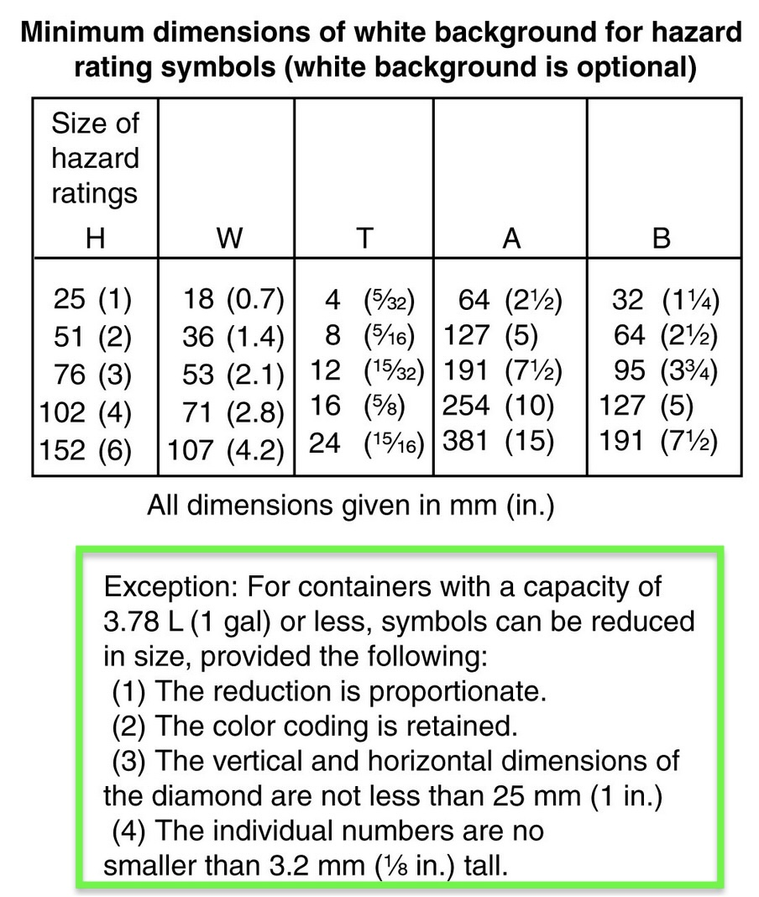
Does NFPA prohibit the use of 704 on secondary containers?
ABSOLUTELY NOT!
In fact, it provides specific guidance on how to use the Diamond on small containers.

Slide 9
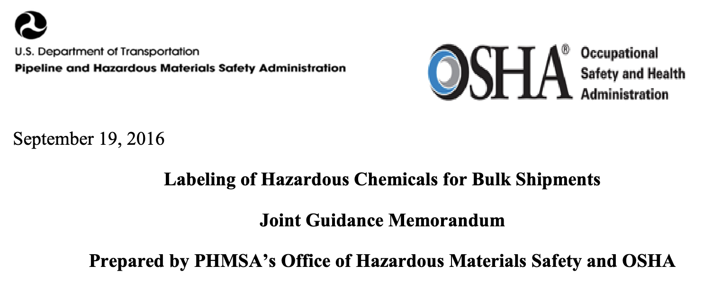
Why are BULK containers leaving the workplace NOT labeled with Pictograms, Signal Words, etc.
Source: https://www.osha.gov/sites/default/files/joint_phmsa_memo_09192016.pdf

Slide 10
Why are BULK containers leaving the workplace NOT labeled with Pictograms, Signal Words, etc.
DOT HMR Labeling Requirements
DOT’s HMR requires labeling to be displayed or provided with a shipment during transportation in commerce.
The HMR provides a comprehensive labeling system to communicate to personnel involved in the transportation of hazardous materials, including emergency responders and the general public, the potential dangers of handling packages containing hazardous materials or a sudden uncontrolled release of hazardous materials during transportation.
During transportation, DOT’s HMR governs hazard communication labeling requirements. OSHA’s HCS 2012 labeling is NOT required on shipping containers in transport, even when DOT’s HMR does not require labeling in transportation.

Slide 11
Why are BULK containers leaving the workplace NOT labeled with Pictograms, Signal Words, etc.
OSHA HCS 2012 Labeling Requirements for Bulk Shipments in DOT Containers (e.g., tanker trucks & rail cars)
OSHA’s HCS 2012 requires labeling of hazardous chemicals in the workplace, BOTH before and after transportation in commerce.
OSHA requires labeling on the immediate container of hazardous chemicals. Regarding bulk shipments of hazardous chemicals, the HCS 2012 requires either labeling the immediate container with hazard information OR transmitting the required label with shipping papers, bills of lading, OR by other technological or electronic means so that it is immediately available to workers in printed form on the receiving end of a shipment.

