Slide 1
Acceptable Isolation
Double Block and Bleed on both sides of Opening/Break
Area of OPENING/BREAK
100’s of feet may be between isolation valves
LOCKED CLOSED
LOCKED OPEN

Slide 2
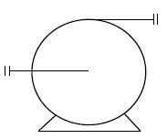
PREPARING Piping - EVACUATING HAZMATS
Storage Tank
#5
#6
#6
#2
#1
100’s of feet may be between isolation valves containing HAZMAT liquid/gas
#4
#3
Let’s look at removing a pump from the process:
We have a liquid HAZMAT with a HIGH expansion ratio and is an Extremely Hazardous Substance that we must EVACUATE and then ISOLATE the pump from the process. We will be using a Double Block and Bleed Positive Isolation.
Use the process flows to empty the piping of as much LIQUID HAZMAT as possible. This means that we will CLOSE Valve #1 first and allow the pump to run for some time to pull as much liquid out of the feed piping as possible. DO NOT cavitate the pump!
STOP the pump and CLOSE Valve #2. There should be minimal liquid HAZMAT between CLOSED Valves 1 &2, but there will be HAZMAT GAS/Vapors.
APPLY lockout devices and locks to Valves 1 &2 in their CLOSED position.
With the bleed valve #5 CLOSED and LOCKED OUT, follow the Safe Work/Opening Permit requirements and remove the cap/plug/gauge on the end of the vent. STAY OUT OF LINE OF FIRE!

Slide 3
CLOSED
PREPARING Piping - EVACUATING HAZMATS
OPEN
#5
#6
#6
#2
#1
100’s of feet may be between isolation valves containing HAZMAT liquid/gas
#4
#3
Use the process flows to empty the piping of as much liquid HAZMAT ss possible. This means that we will CLOSE Valve #1 first and allow the pump to run for some time to pull as much liquid out of the feed piping as possible. DO NOT cavitate the pump!
CLOSE Valve #2 and STOP the pump. There should be minimal liquid HAZMAT between CLOSED Valves 1 & 2, but there will be a lot of HAZMAT GAS/VAPOR that poses extreme risks to the workers who will be removing the pump
APPLY lockout devices and locks to Valves 1 & 2 in their CLOSED position
With the bleed valve #5 CLOSED and LOCKED OUT, follow the Safe Work/Opening Permit requirements and remove the cap/plug/gauge on the end of the pipe. STAY OUT OF LINE OF FIRE!

Slide 4
CLOSED
PREPARING Piping - EVACUATING HAZMATS
OPEN
#5
#6
#6
#2
#1
100’s of feet may be between isolation valves containing HAZMAT liquid/gas
#4
#3
Attach your Dead-Man Valve Piping assembly to the THREADED PIPE CONNECTION. ENSURE that you have used a PROPER thread-sealant and torque on this connection! NOTE: some will include a check-valve in this pipe assemby
Attach an APPROVED NH3 transfer hose to the Dead-Man Piping and Valve assembly.
Based on the estimate of NH3 gas between valves #1 & #2, ensure that you have at least 1-gallon of solution (usually water) for every 1-pound of gas/vapor. This could be a 5-gallon bucket, a 55-gallon drum, or maybe even a 330-gallon tote
SLOWLY crack OPEN Bleed Valve #5 with the Dead-Man Valve CLOSED and check for leaks in the check valve assembly connection. No leaks, continue to OPEN Bleed Valve #5 to the 50% OPEN position
SLOWLY OPEN the Dead-Man Valve and vent GAS/VAPOR ONLY to the scrubber/container. DO NOT FULLY OPEN the Dead-Man Valve until we are confident, we are dealing with 100% GAS/Vapor

Slide 5
CRITICAL POINTS to observe
Scrubbing media container MUST be capable of handling a Liquid Event and ALL of the HAZMAT
Scrubbing container MUST be CLOSED TOP container – bleed hose fits through the smallest bung possible
BOTH bungs MUST be open to allow for breathing
End of the transfer hose may need to be WEIGHTED DOWN to ensure it remains in the BOTTOM of the water container
  Some have chosen to install a check-valve on the Deadman valve assembly to prevent water from being sucked into the process
During transfer to the scrubbing media – KEEP ALL PERSONNEL AWAY from the container, except to check for bubbles (indication that the gas transfer is complete).
  When checking on bubbles be donned in PPE that protects against SPLASH and INHALATION hazards
Deadman Valve MUST NEVER be misused/bypassed/manipulated to remain open
Deadman Valve MUST be installed at the point-source and not the scrubbing container
Scrubbing container should be far enough away as to protect the worker holding OPEN the Deadman valve should something happen, he/she would have ample time to escape
Some may choose to sample the drum head space with a HAZMAT detector or the scrubbing media with a pH device
PREPARING Piping - EVACUATING HAZMATS
#5
#2
#1

Slide 6
CLOSED
PREPARING Piping - EVACUATING HAZMATS
OPEN
#5
#6
#2
#1
100’s of feet may be between isolation valves containing HAZMAT liquid/gas
#4
#3
Once we have completed our EVACUATION of the HAZMAT gas/vapor between Valves #1 and #2, we can CLOSE VALVE #5, remove the Deadman valve assembly and hose
SLOWLY OPEN Valve #5 to the 50% position and DOUBLE CHECK we are GAS/VAPOR FREE. If all goes well, OPEN Valve #5 100% and LOCK IT (or if allowed – TAG IT) in the OPEN position for our BLEED
  NOTE: Some facilities have chosen to connect a hose to the vent to ensure any venting is carried away from workers in the working area
We now have achieved a DB&B isolation with VERIFICATION of a ZES within the Double Block on that side of the pump
We would do the same procedure on the other side of the break/opening, realizing that the amount of NH3 gas will be considerably more based on the distance between the two (2) isolation valves.

Slide 7
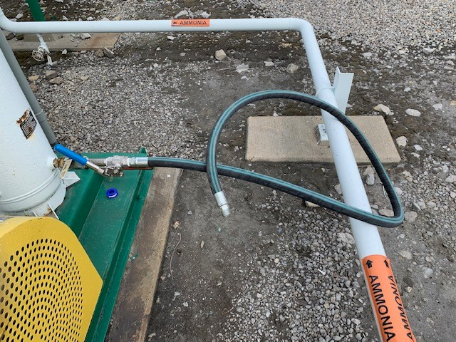
PREPARING Piping - EVACUATING HAZMATS
Ammonia Rated Hose assembly with Check-valve

Slide 8
Unacceptable Isolation
Double Block and Bleed on both sides of Opening/Break; however, there is a ¼” NAOH line tying into the DB&B which NULLIFIES our positive means of isolation
NOT ALLOWED – this nullifies our DB&B isolation
¼” Caustic Line
Even if this valve is LOCKED CLOSED, we no longer have a DB&B
Area of OPENING/BREAK
100’s of feet may be between isolation valves
NOTE: If the NAOH line can be isolated using BB&B, then this isolation would be acceptable!
LOCKED CLOSED
LOCKED OPEN

